Slide 1
Supplemental Fig. S6
Fig. 1 – 3: Repetitions of all experiments in triplicates. In particular, the faint CT band is confirmed beyond doubt.

Slide 2
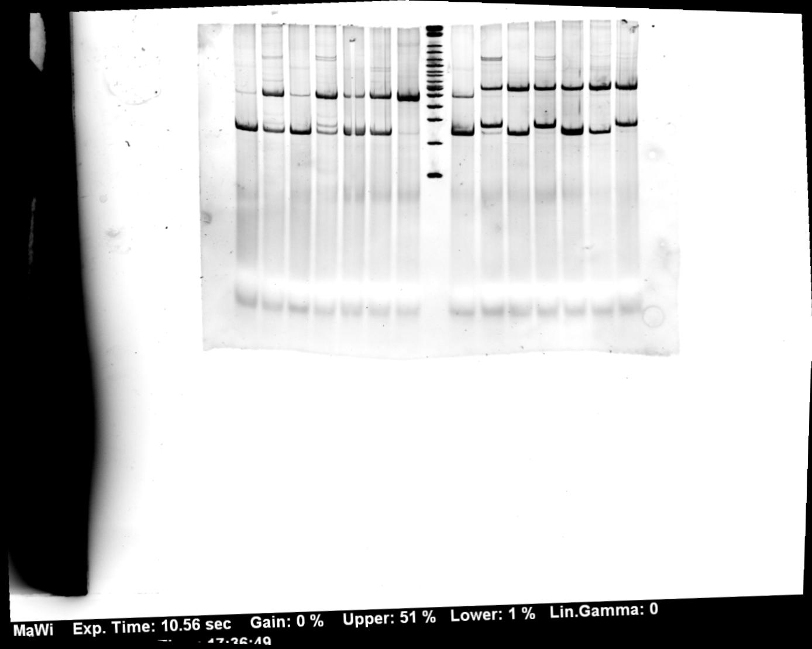
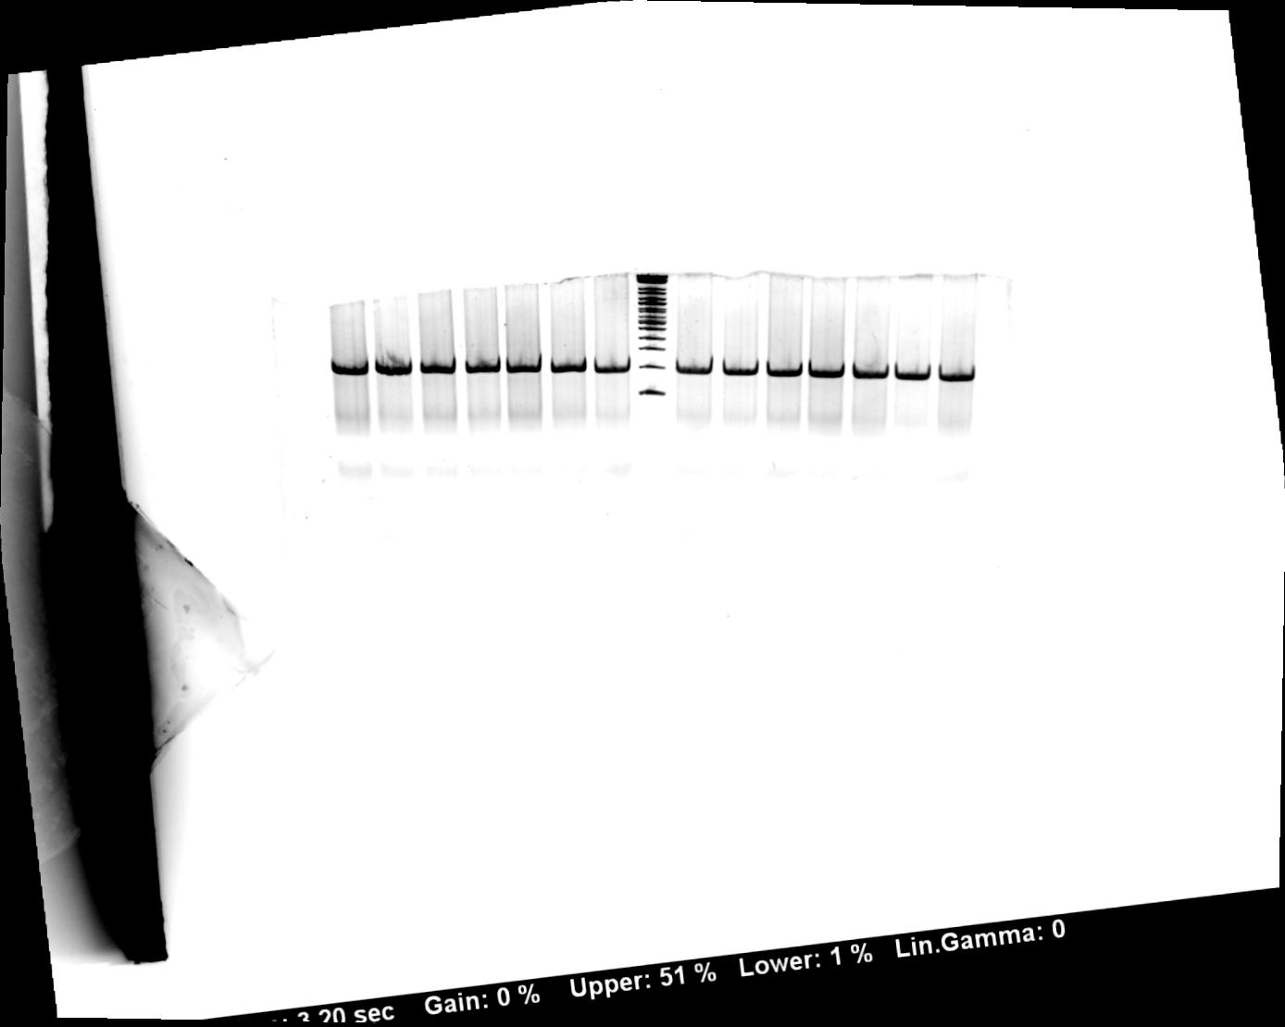
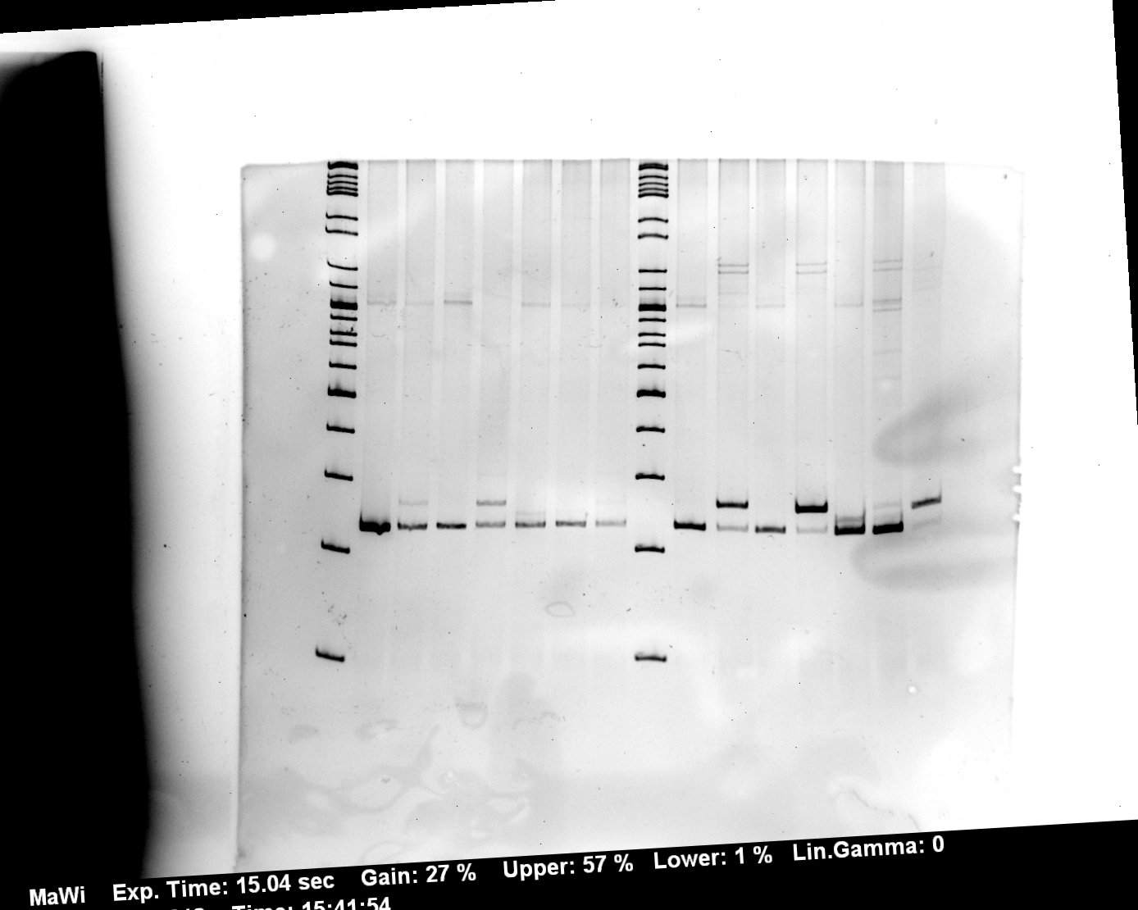
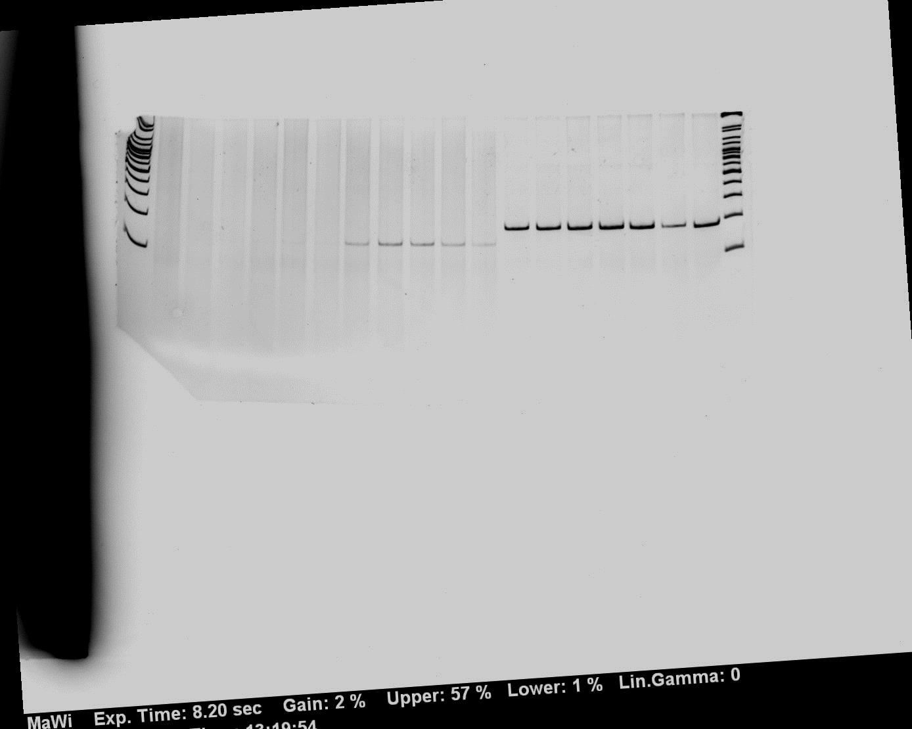
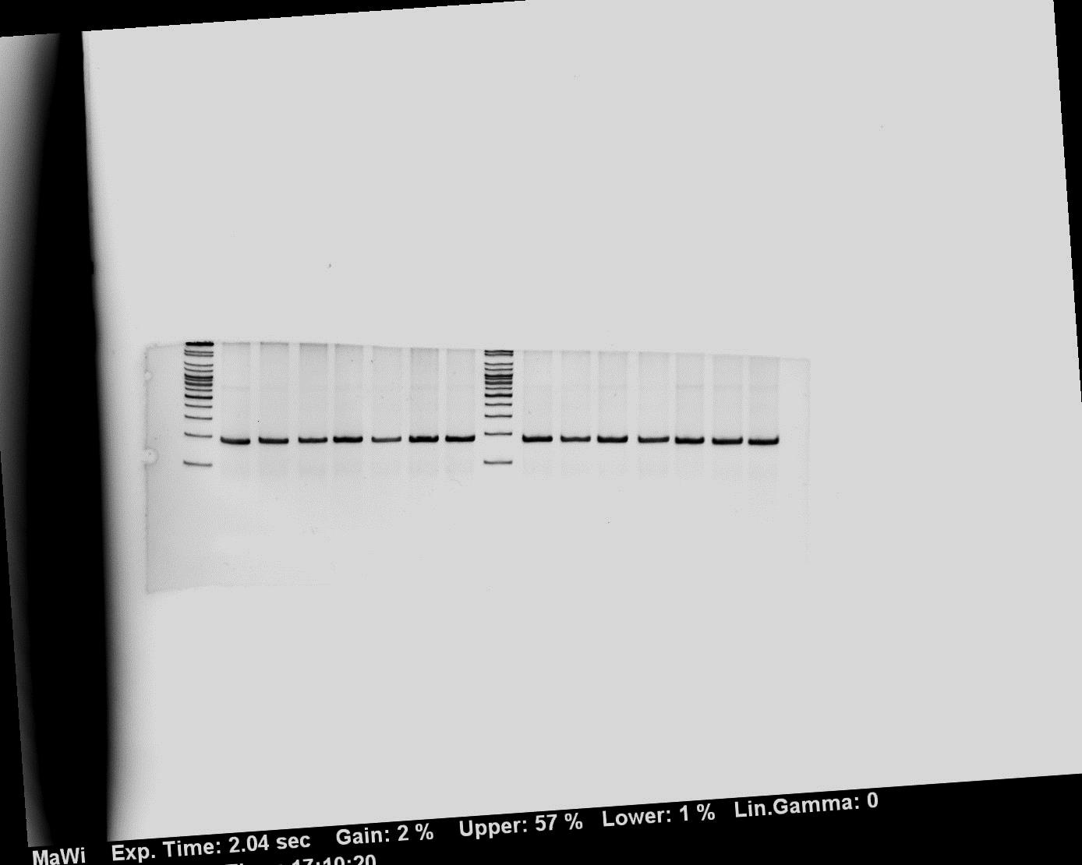
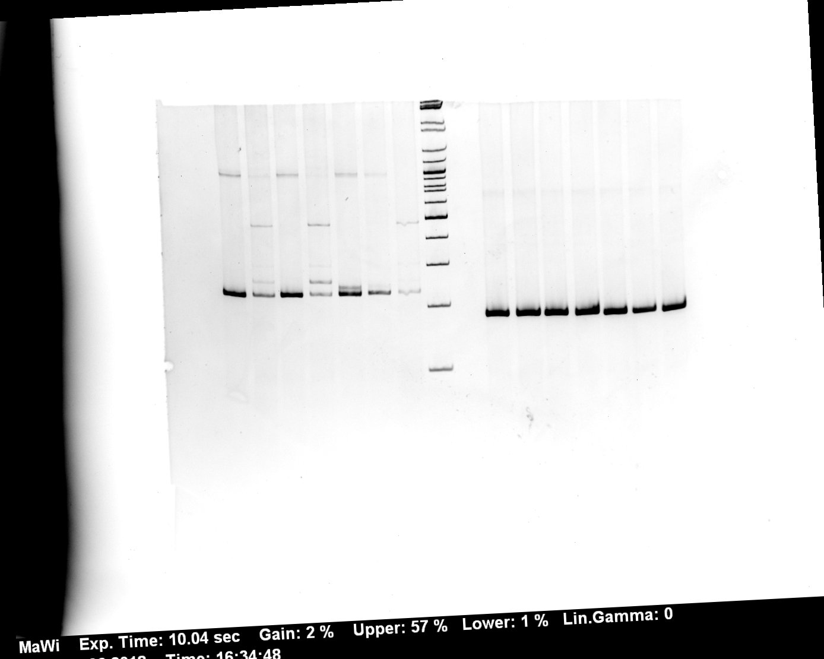
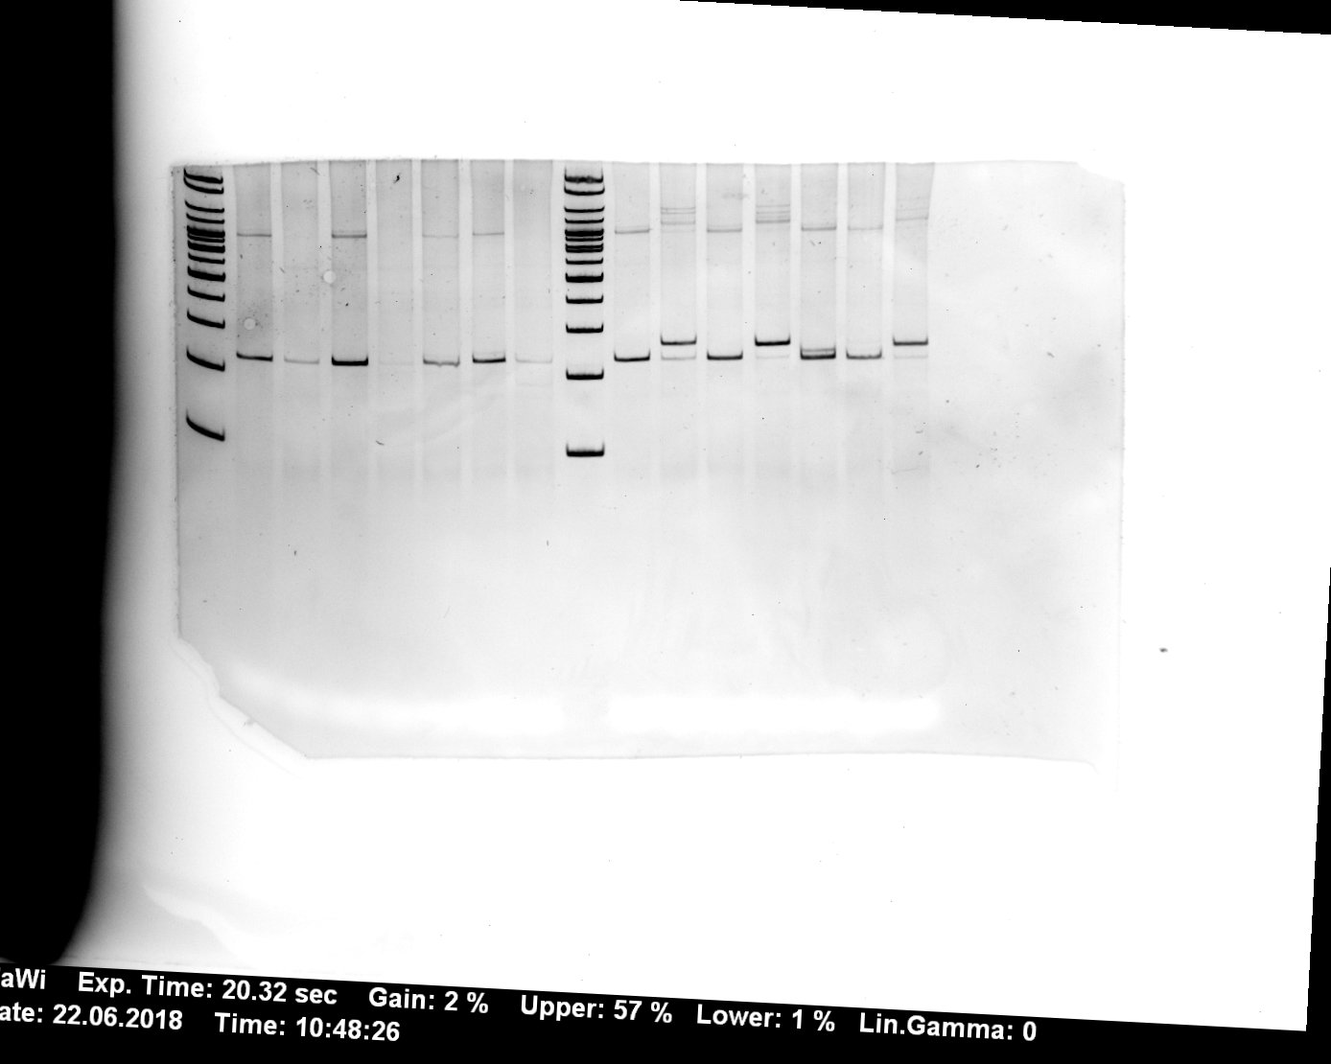
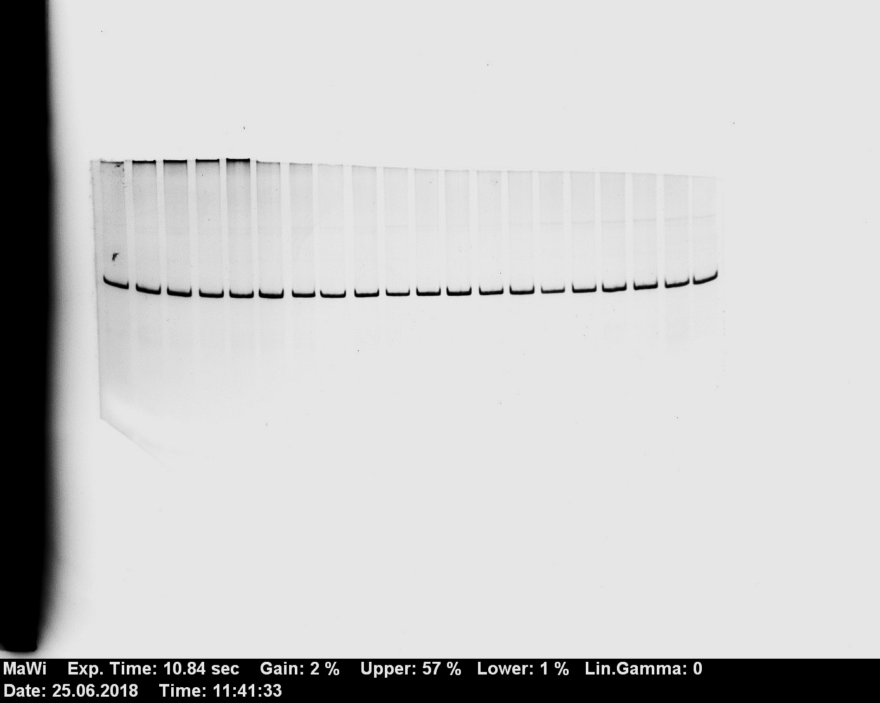
Figure 1
wo TIA1
with TIA1
GT
GA
GC
GG
TT
AT
CT
M
GT
GA
GC
GG
TT
AT
CT
10.4
#1
test
GH1
1
2
3
4
5
6
7
8
9
10
11
12
13
14
wo TIA1
with TIA1
GT
GA
GC
GG
TT
AT
CT
GT
GA
GC
GG
TT
AT
CT
10.4
#2
test
GH1
1
2
3
4
5
6
7
8
9
10
11
12
13
14
wo TIA1
with TIA1
GT
GA
GC
GG
TT
AT
CT
GT
GA
GC
GG
TT
AT
CT
#3
10.4
test
GH1
1
2
3
4
5
6
7
8
9
10
11
12
13
14

Slide 3
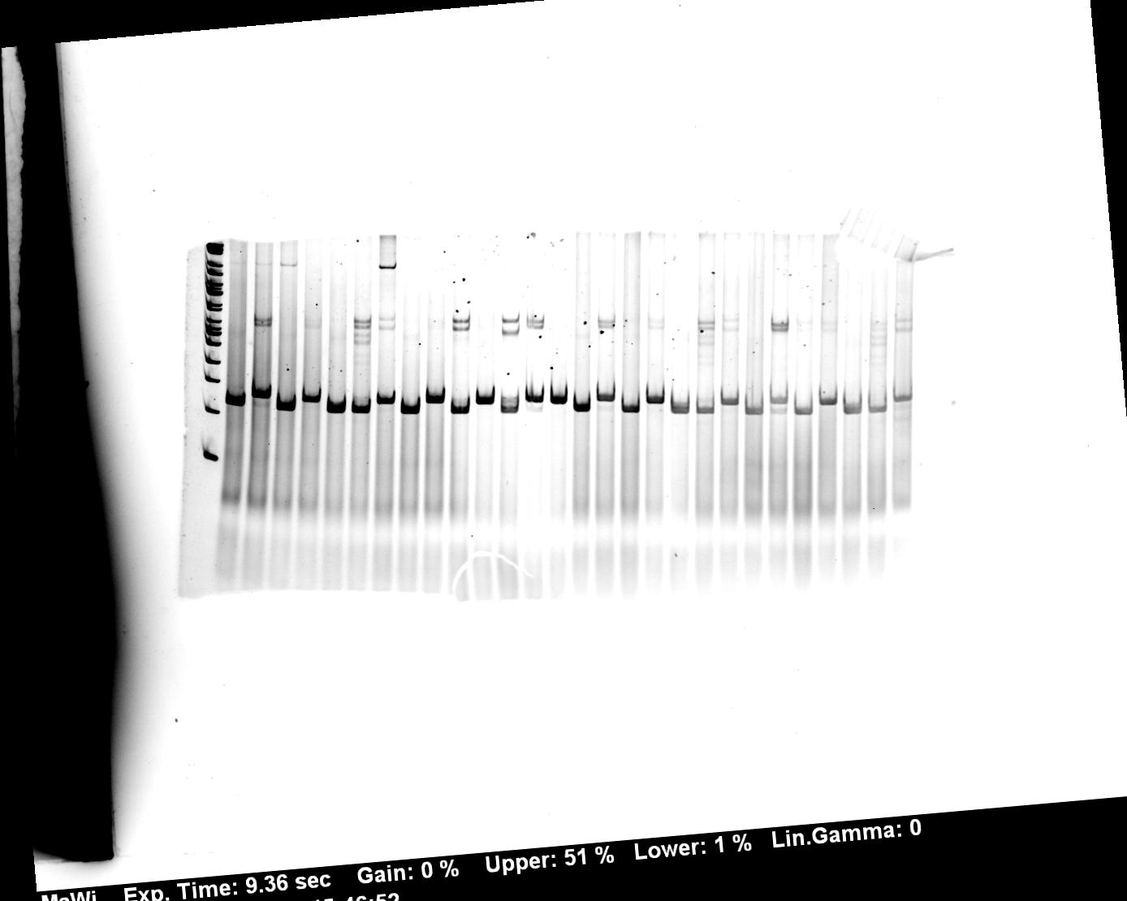
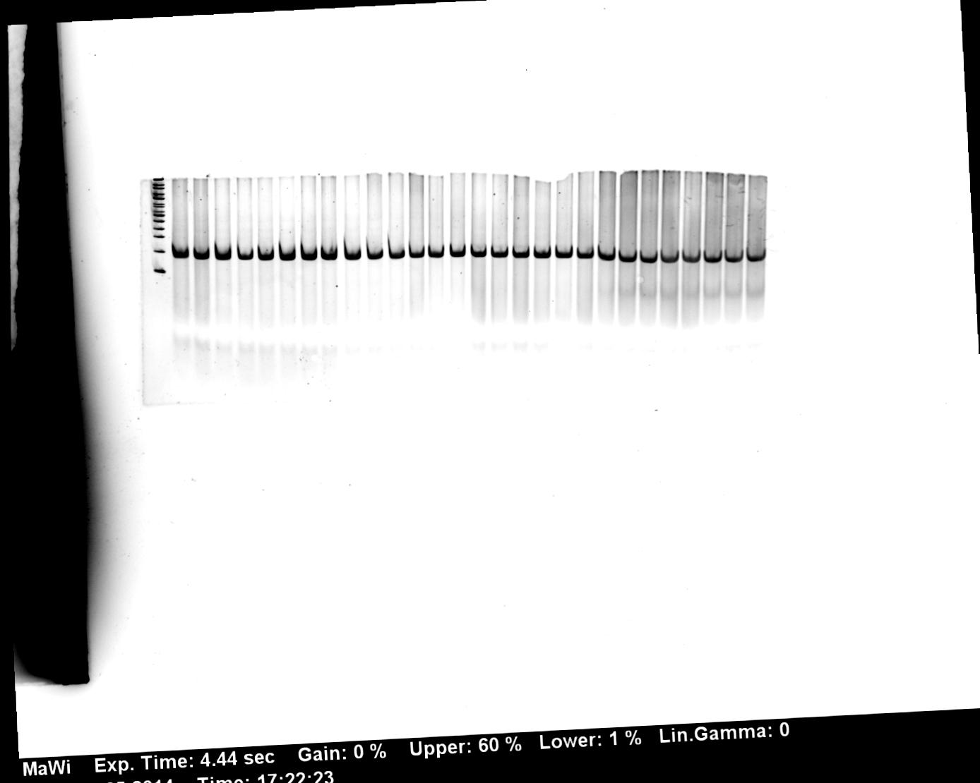
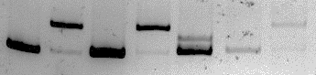
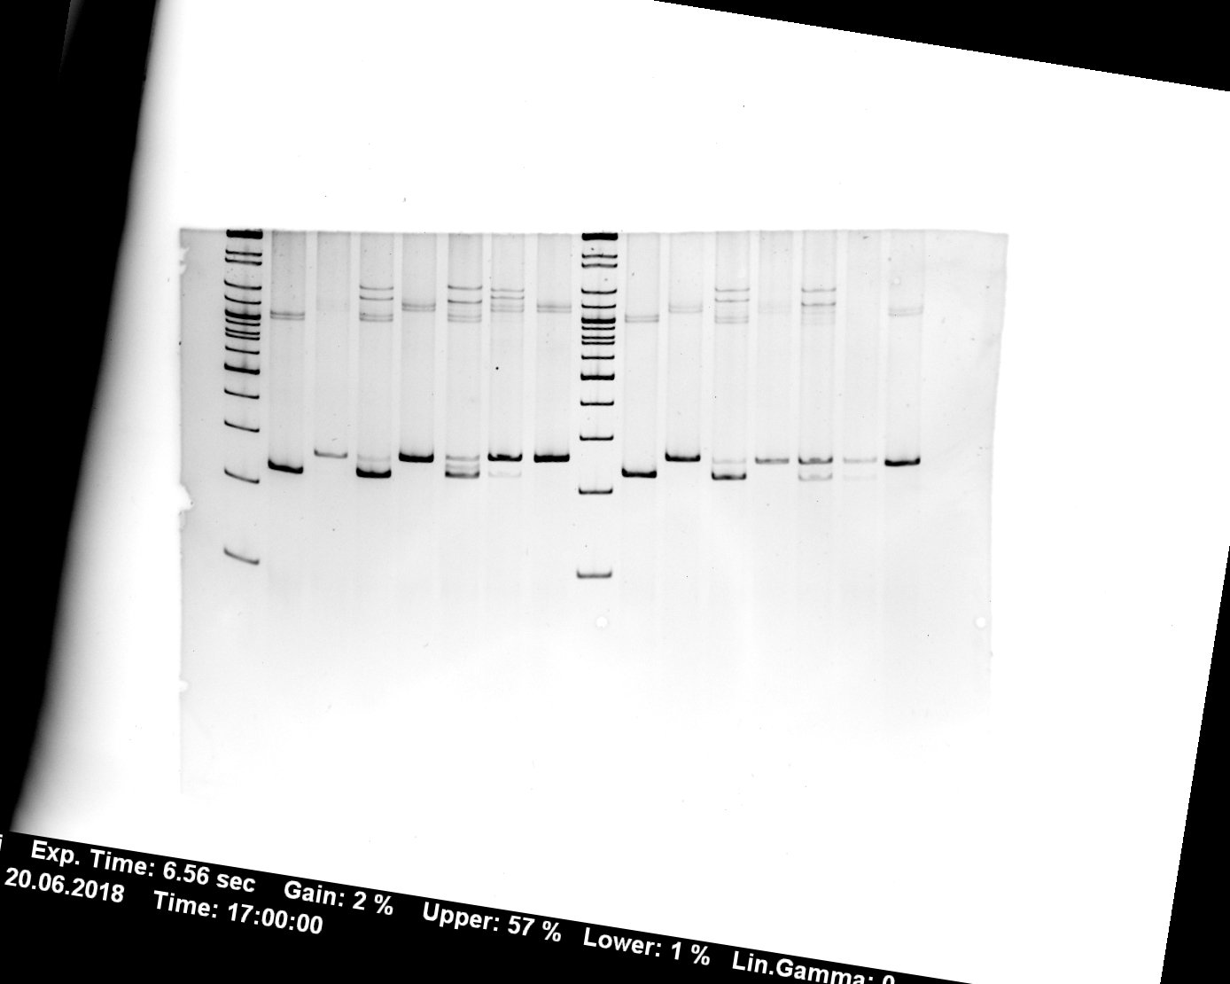
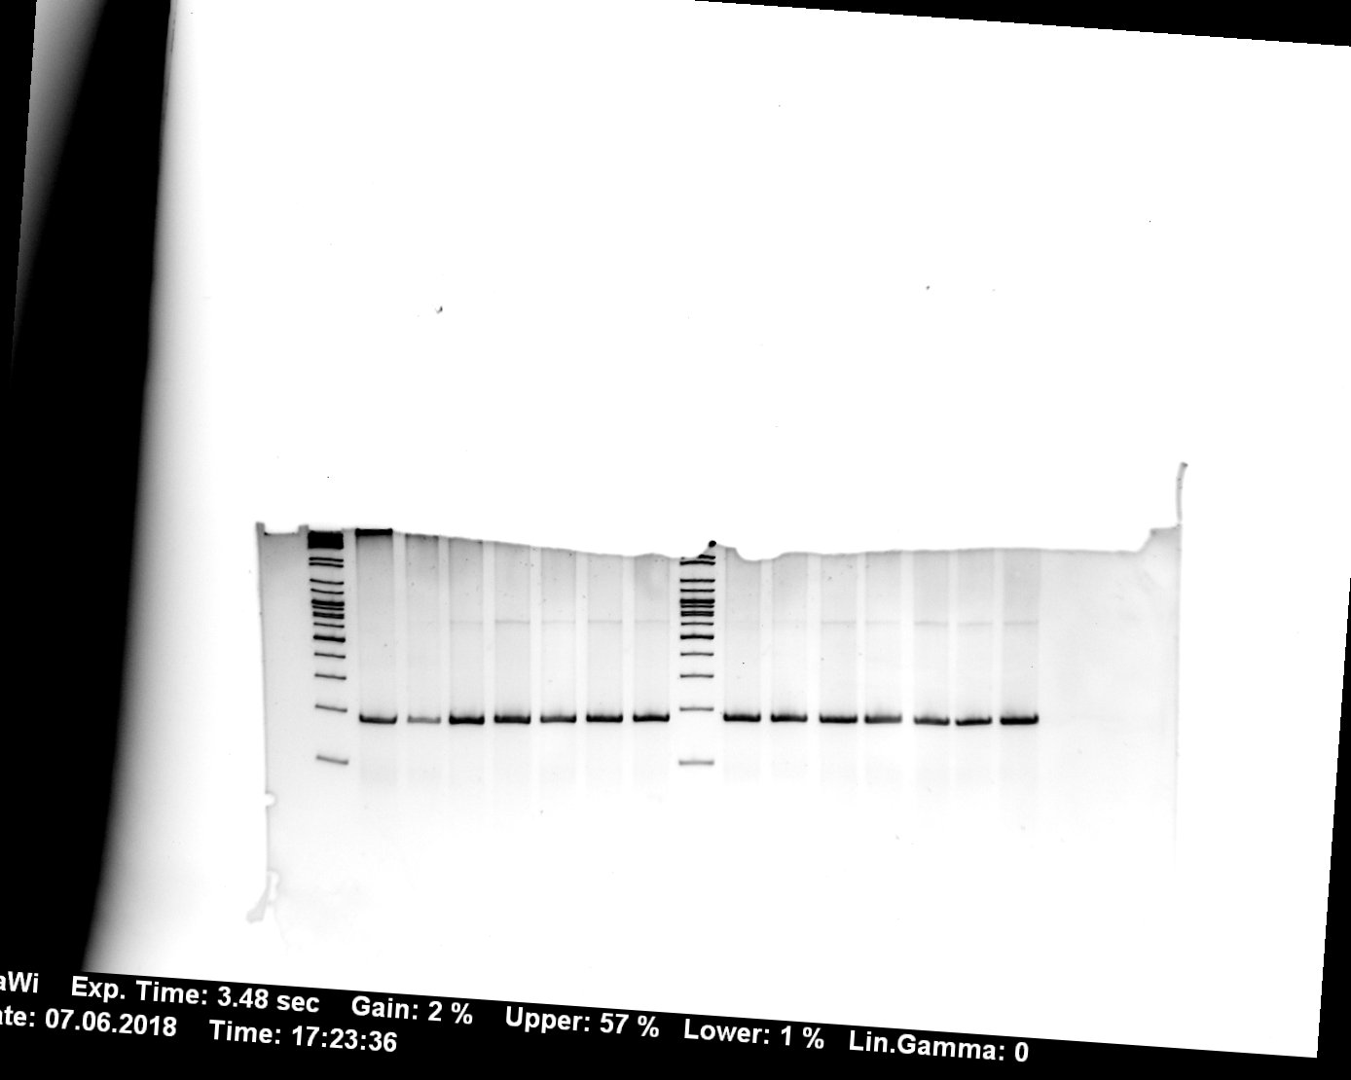
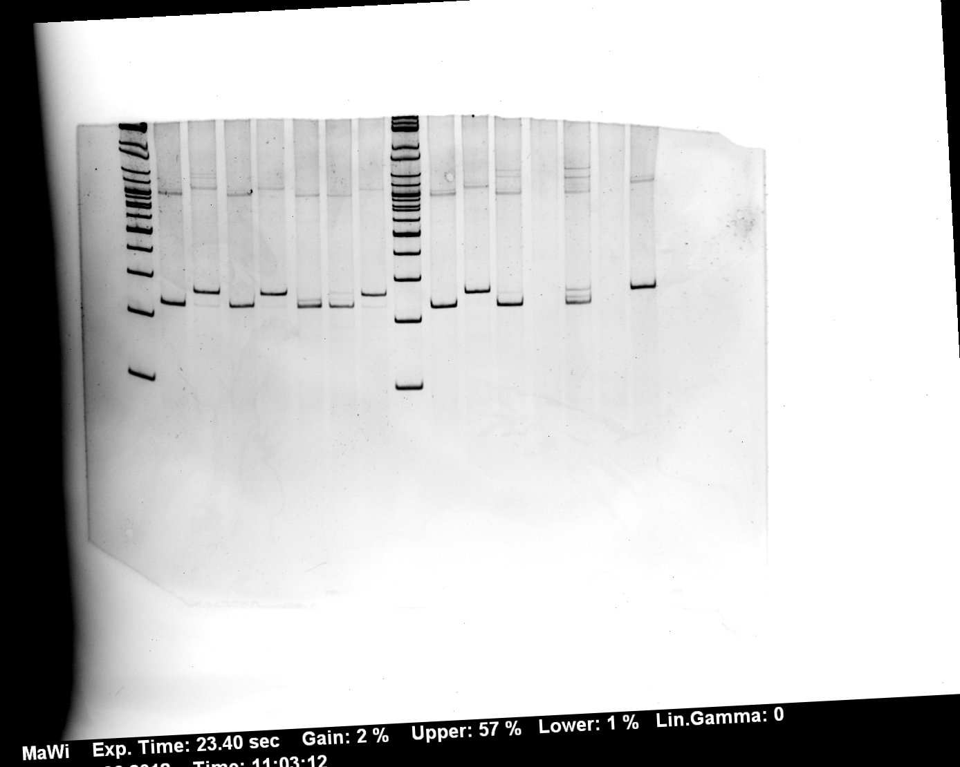
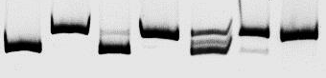
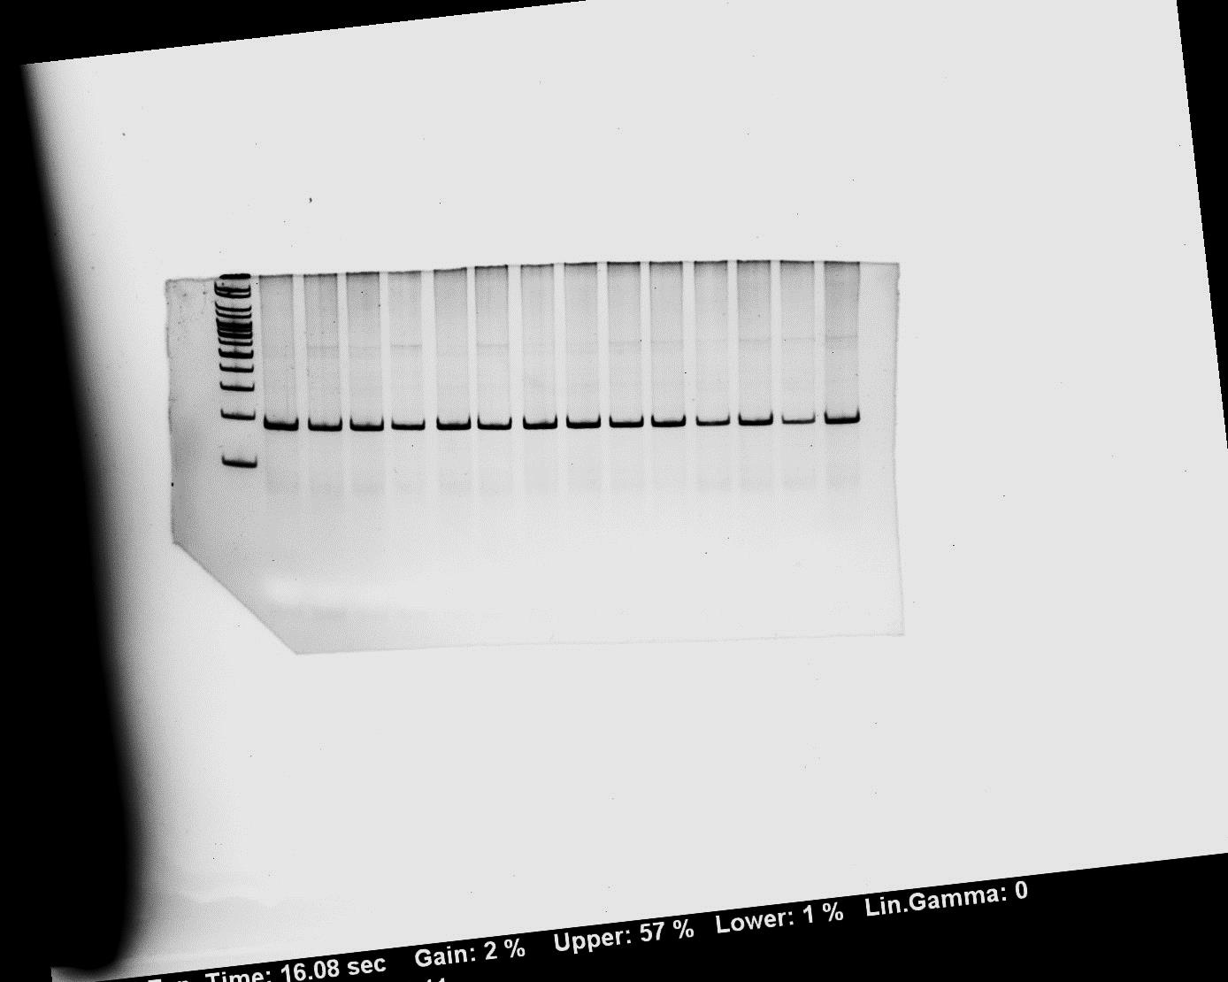
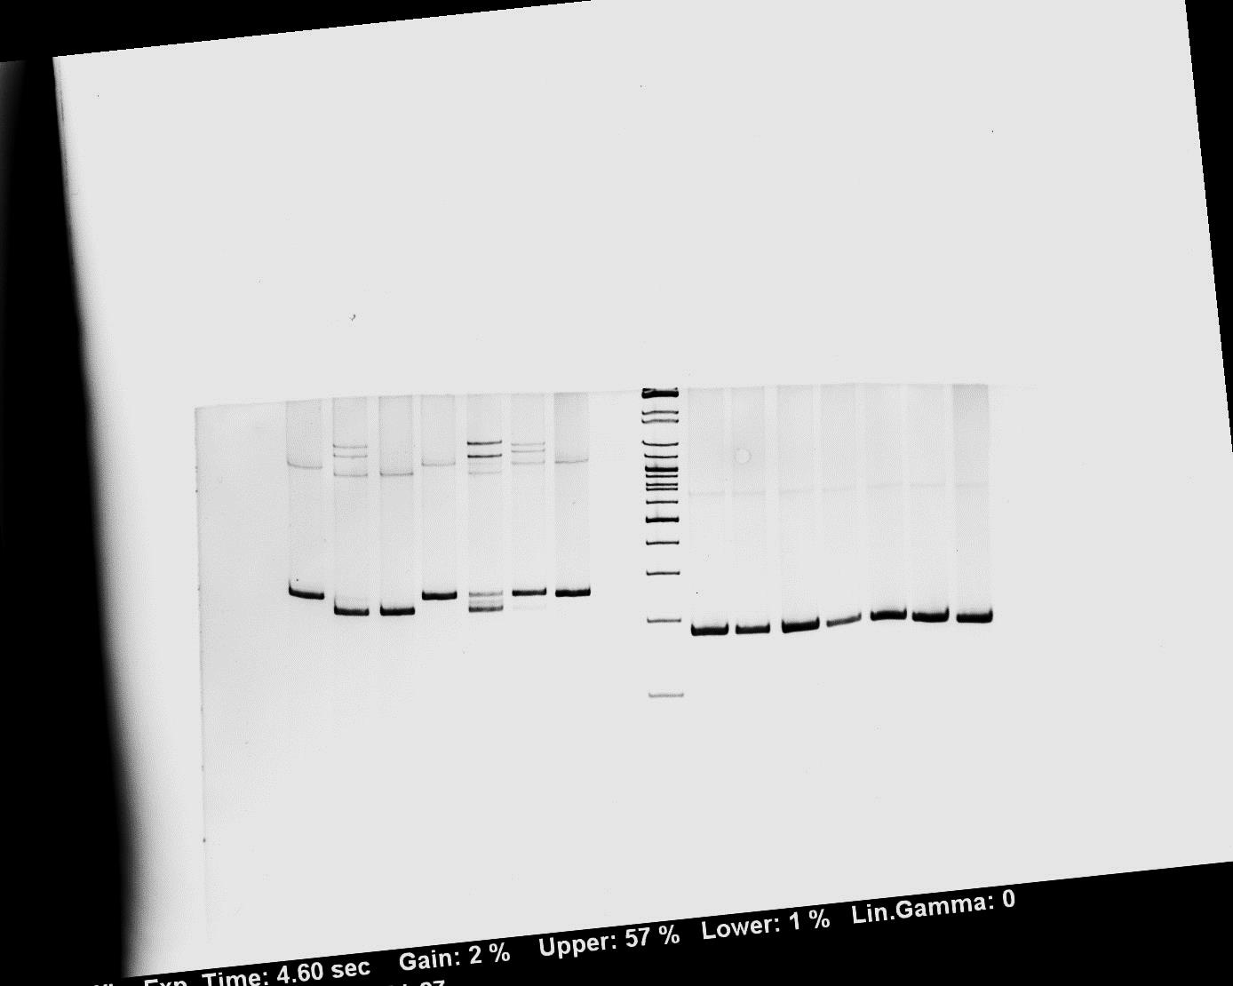
Figure 1
wo TIA1
with TIA1
GT
GA
GC
GG
TT
AT
CT
GT
GA
GC
GG
TT
AT
CT
12.2
#1
test
GH1
1
2
3
4
5
6
7
8
9
10
11
12
13
14
wo TIA1
with TIA1
GT
GA
GC
GG
TT
AT
CT
GT
GA
GC
GG
TT
AT
CT
#2
12.2
test
GH1
1
2
3
4
5
6
7
8
9
10
11
12
13
14
wo TIA1
with TIA1
GT
GA
GC
GG
TT
AT
CT
GT
GA
GC
GG
TT
AT
CT
#3
12.2
test
GH1
1
2
3
4
5
6
7
8
9
10
11
12
13
14

Slide 4
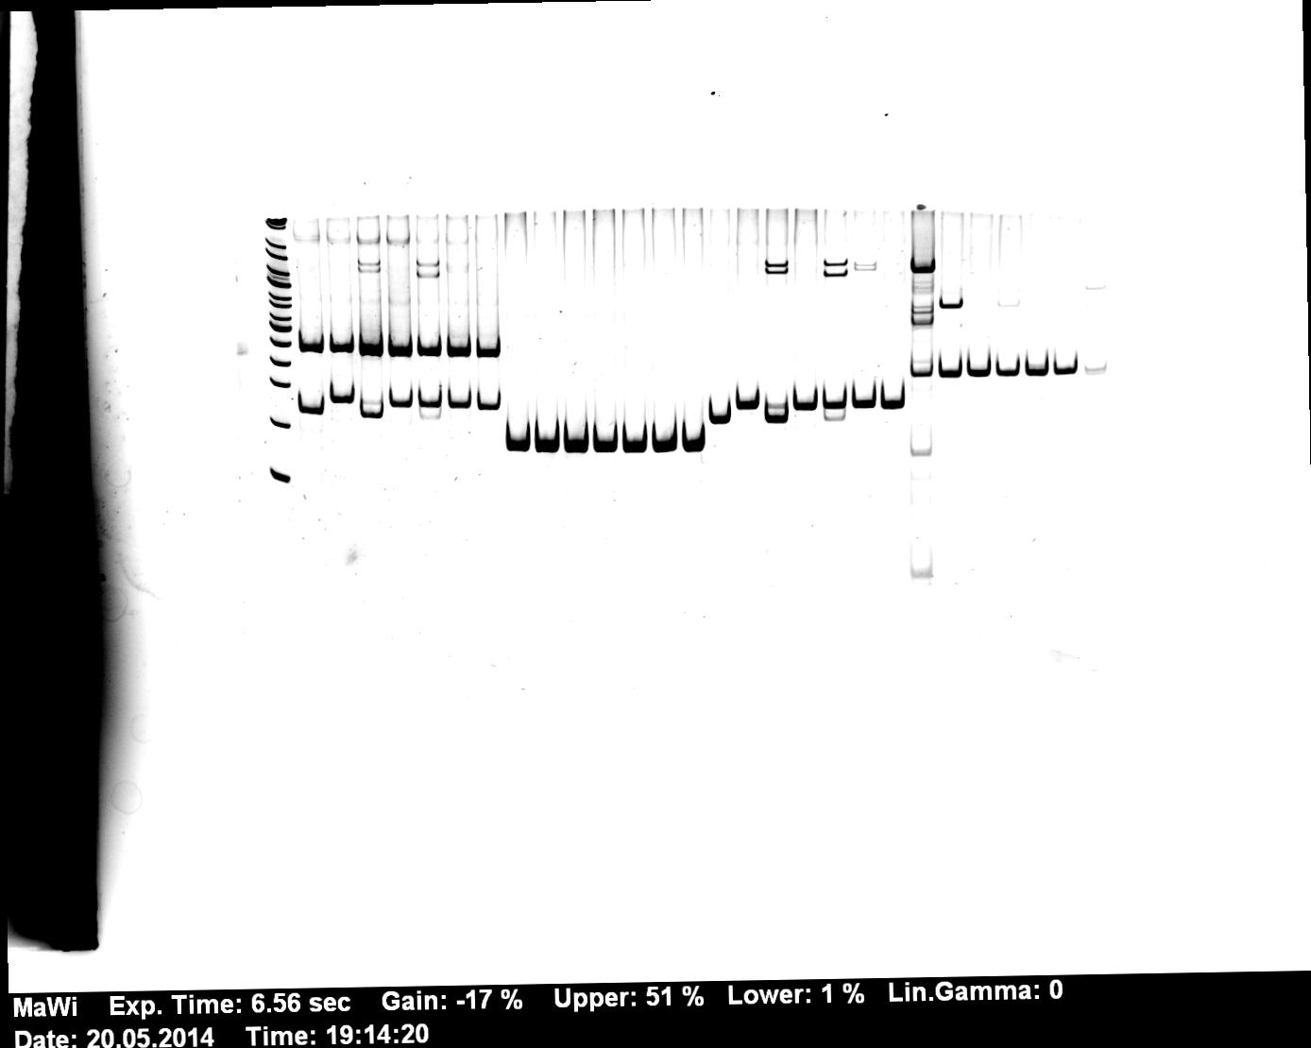
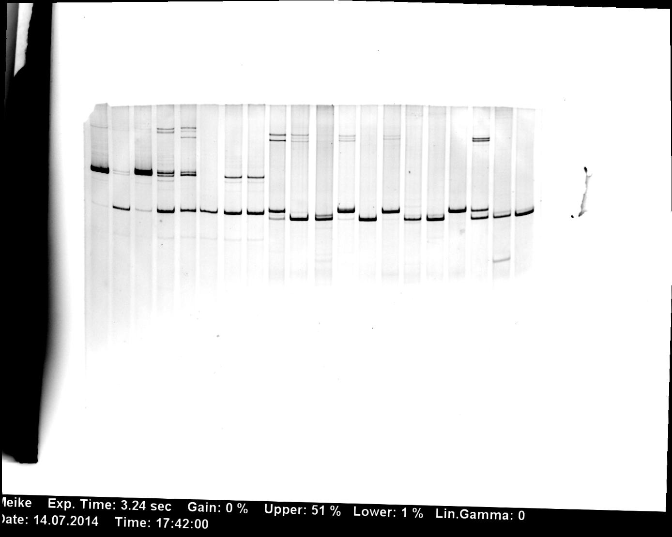

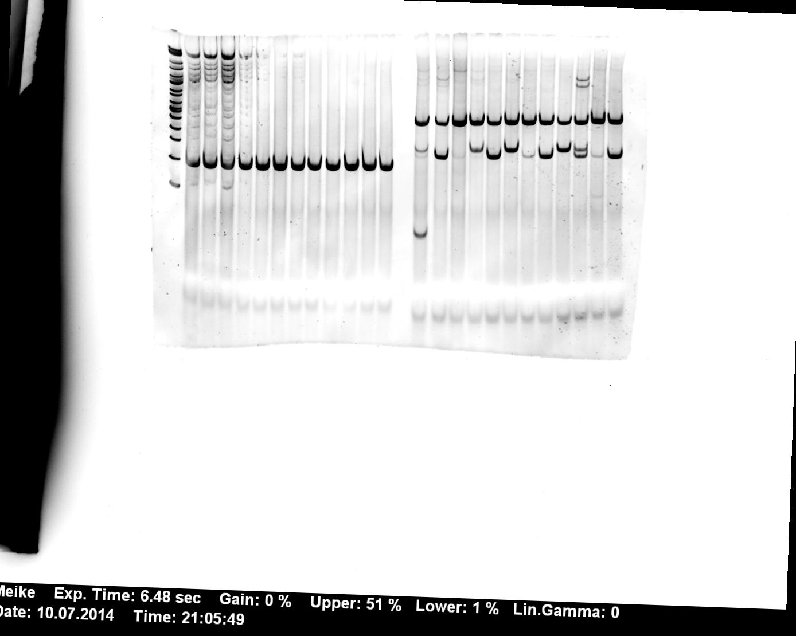
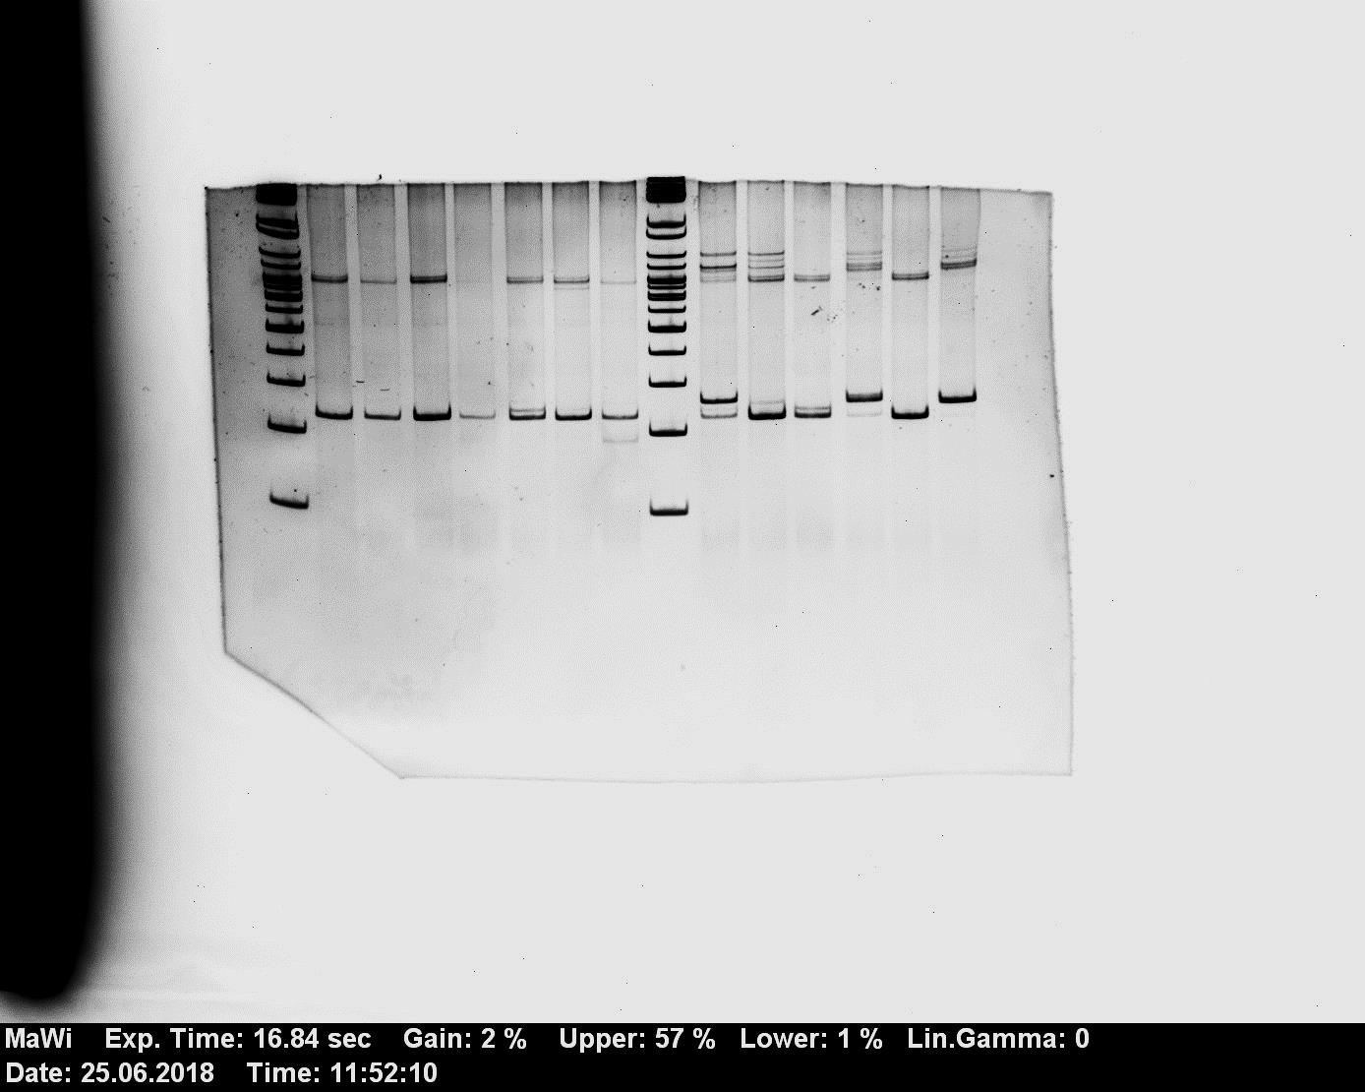
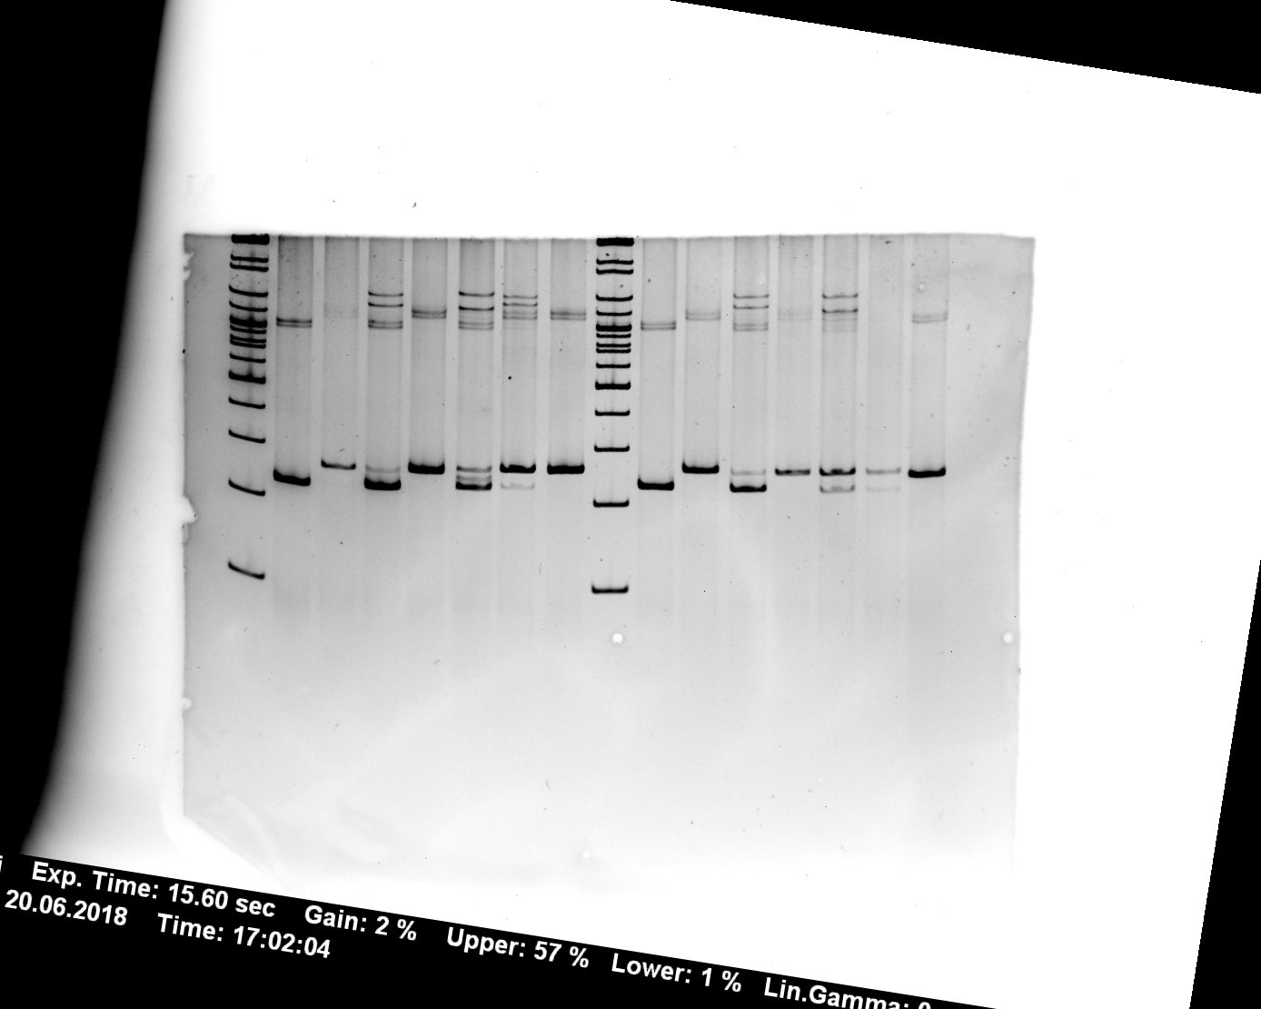
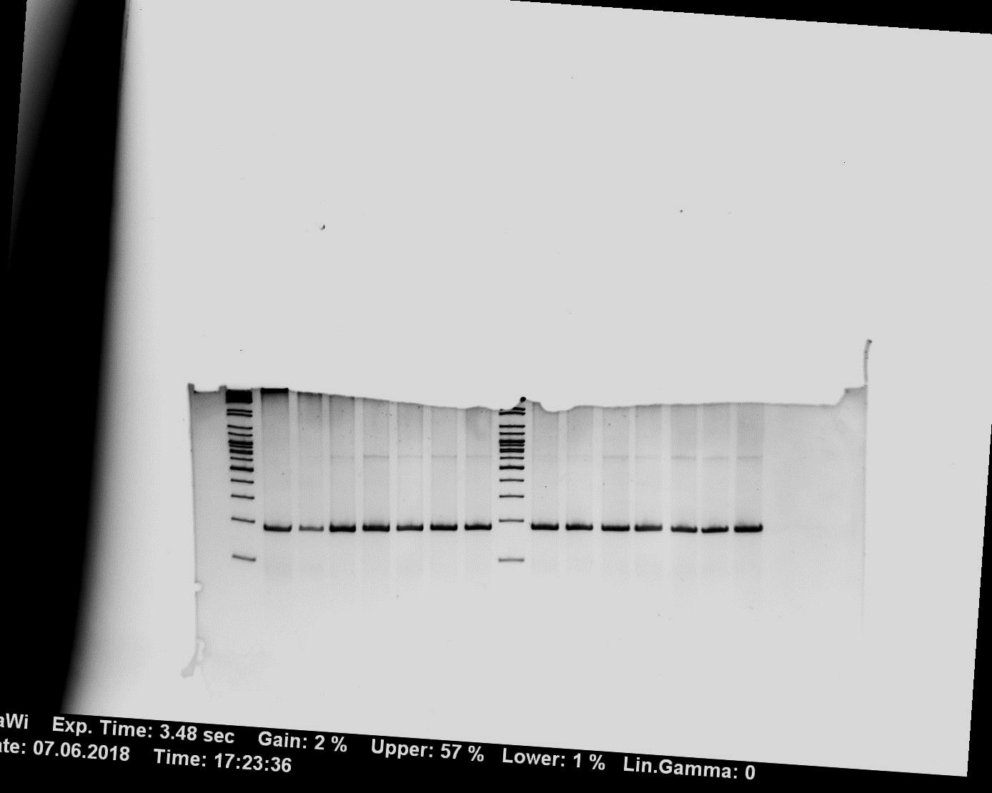
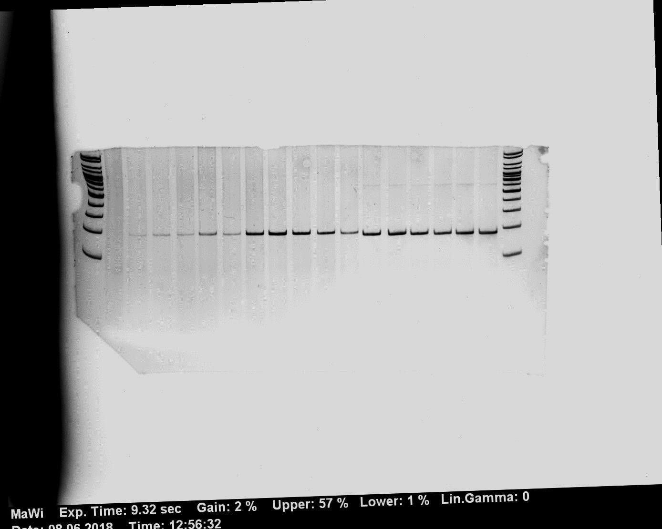
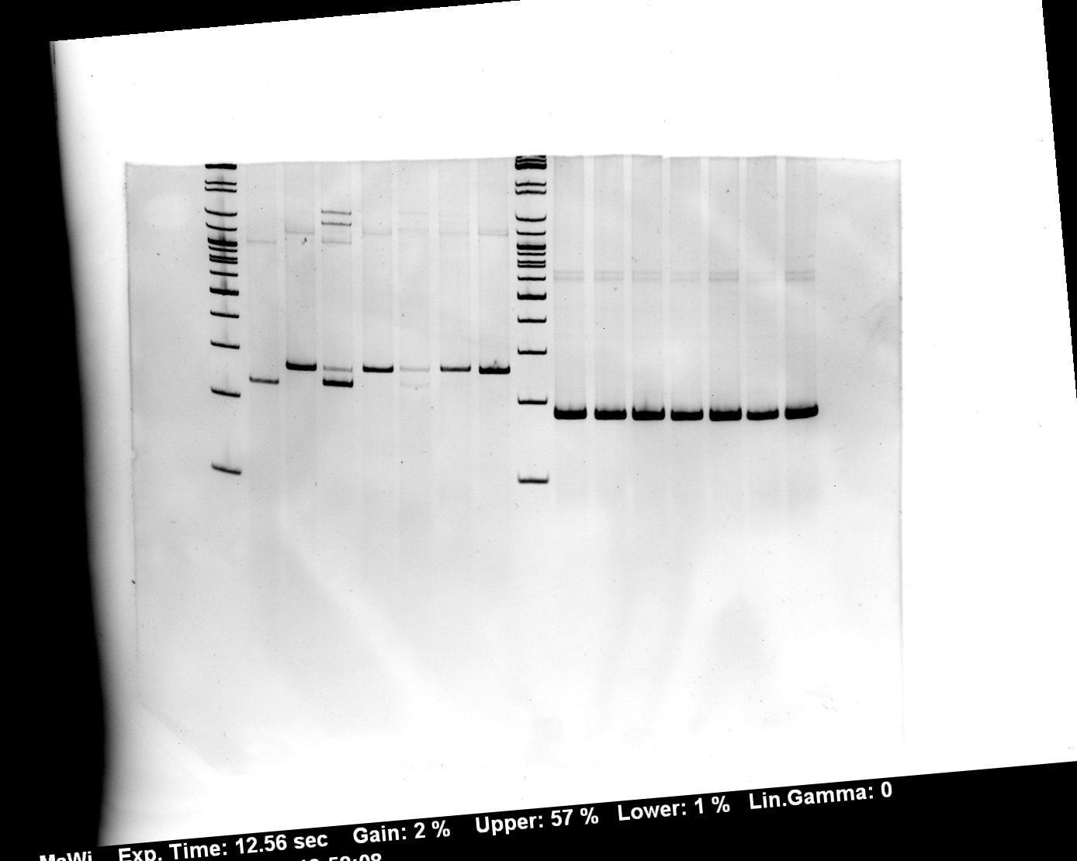
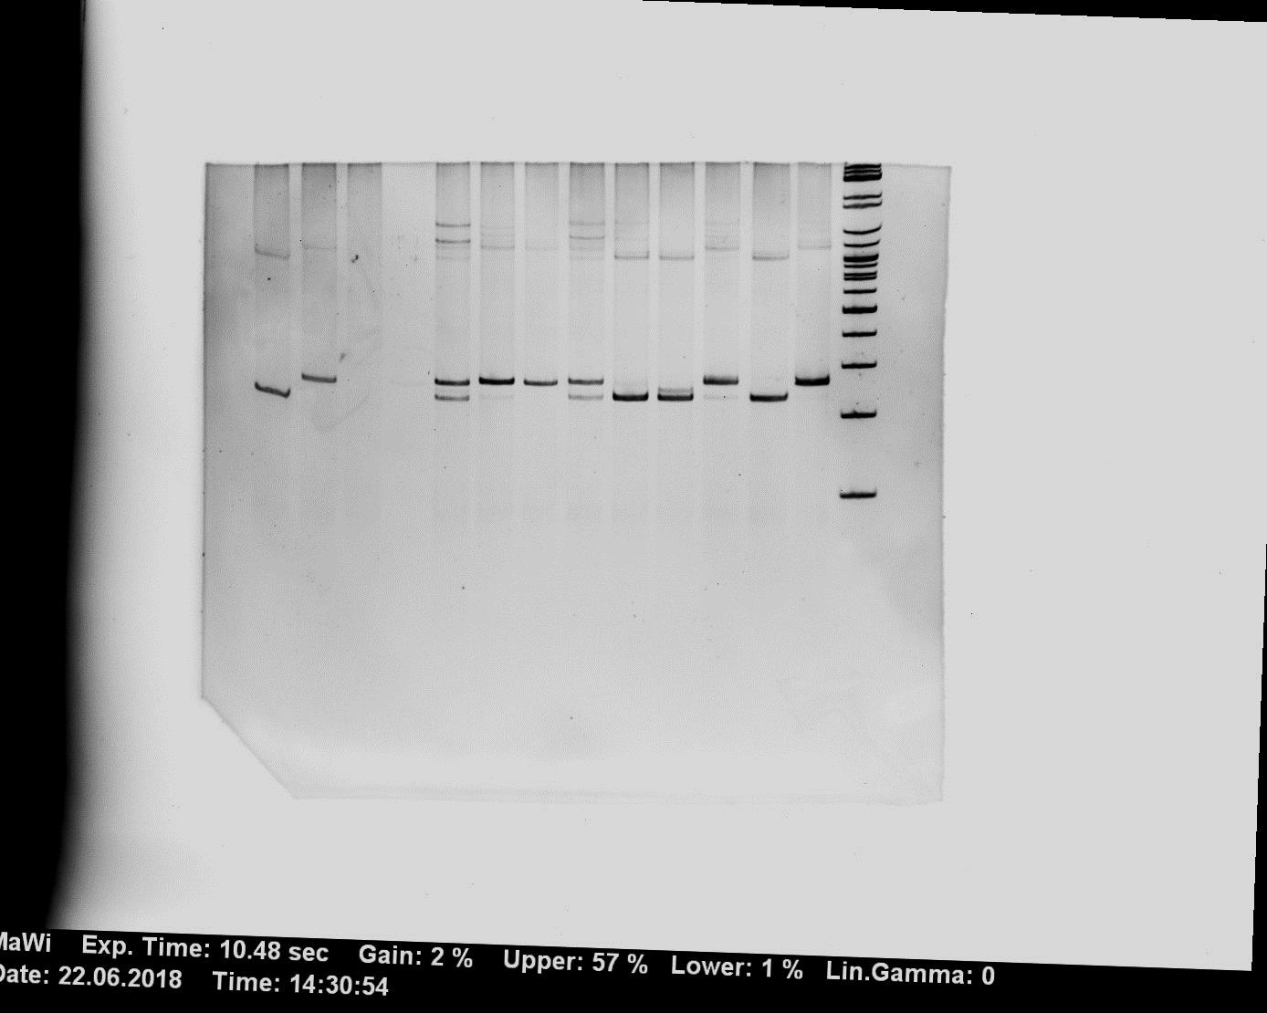
Figure 1
TT vs. GC
AT vs. GC
GC vs. TT
GC vs. AT
AT vs. TT
wo TIA1
TT vs. AT
GT
GA
GC
GG
TT
AT
CT
15.2
d
#1
test
#1
u
GH1
GH1
1
2
3
4
5
6
7
1
2
3
4
5
6
TT vs. GC
AT vs. GC
GC vs. TT
GC vs. AT
AT vs. TT
wo TIA1
TT vs. AT
GT
GA
GC
GG
TT
AT
CT
d
15.2
#2
u
#2
test
GH1
GH1
1
2
3
4
5
6
7
1
2
3
4
5
6
wo TIA1
TT vs. GC
AT vs. GC
GC vs. TT
GC vs. AT
AT vs. TT
TT vs. AT
GT
GA
GC
GG
TT
AT
CT
d
#3
15.2
u
test
#3
GH1
GH1
1
2
3
4
5
6
7
1
2
3
4
5
6

Slide 5
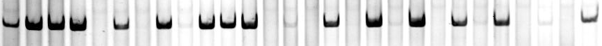
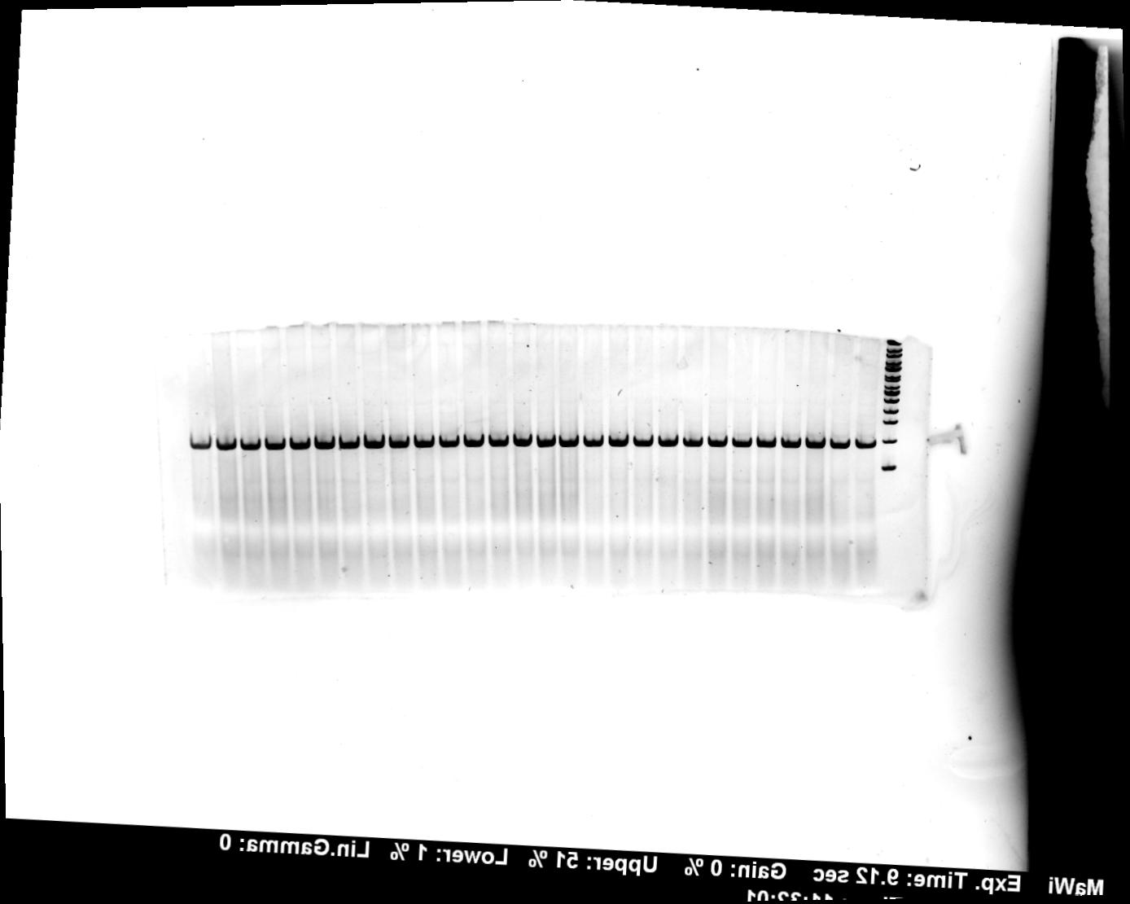
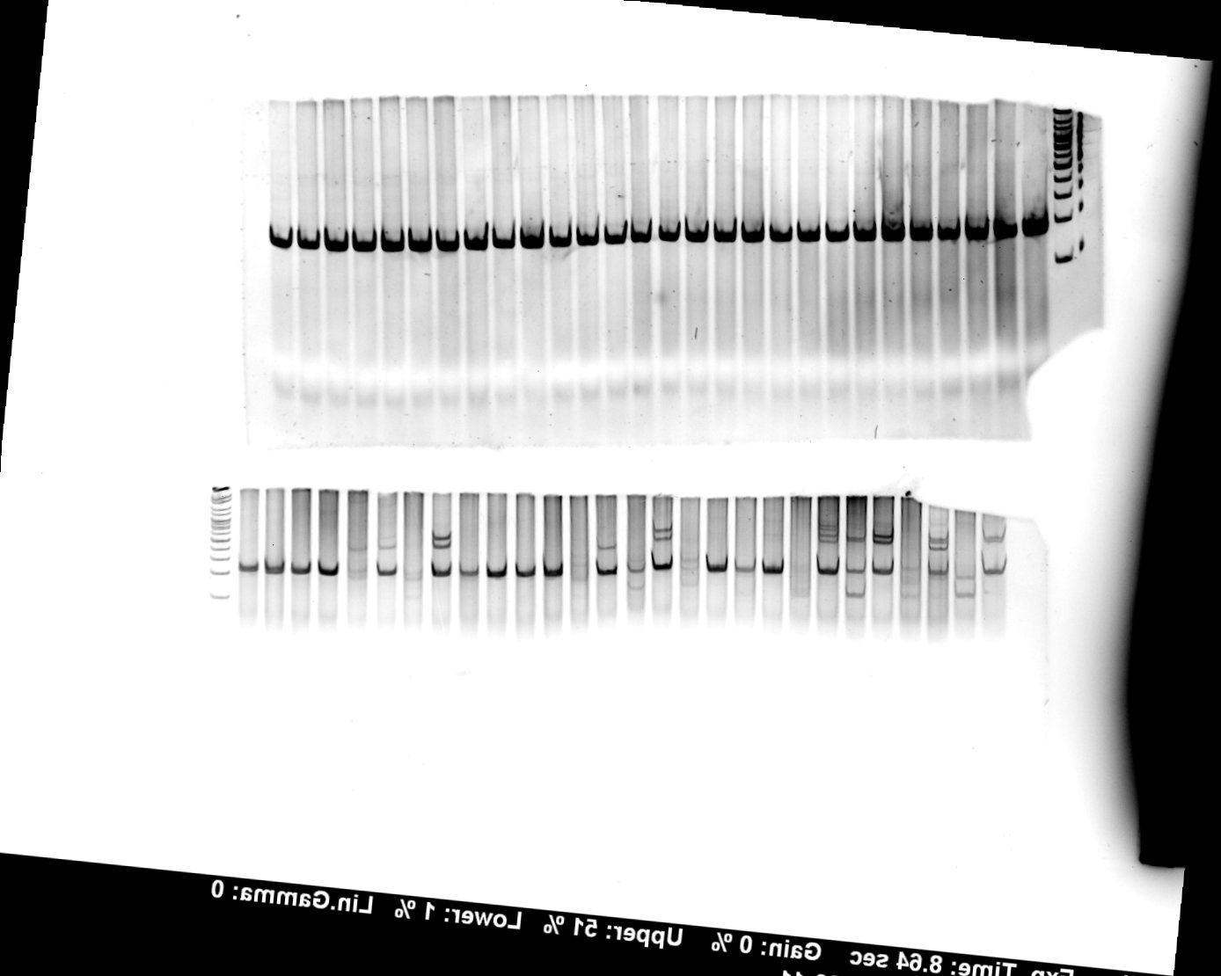
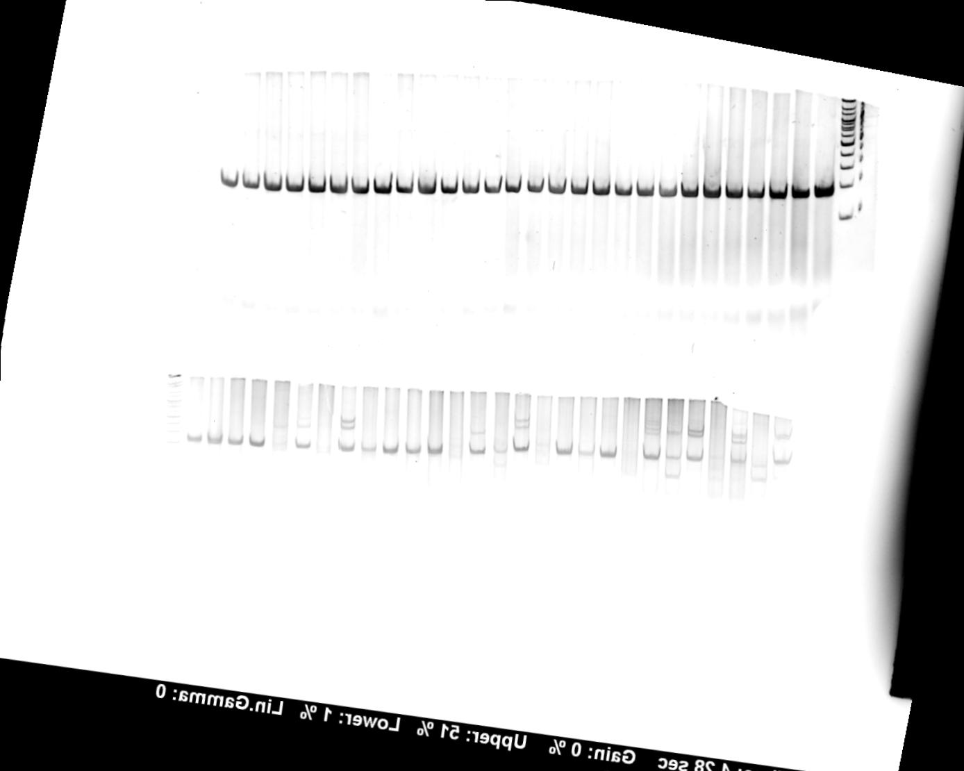
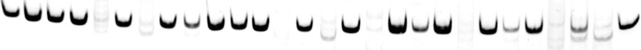
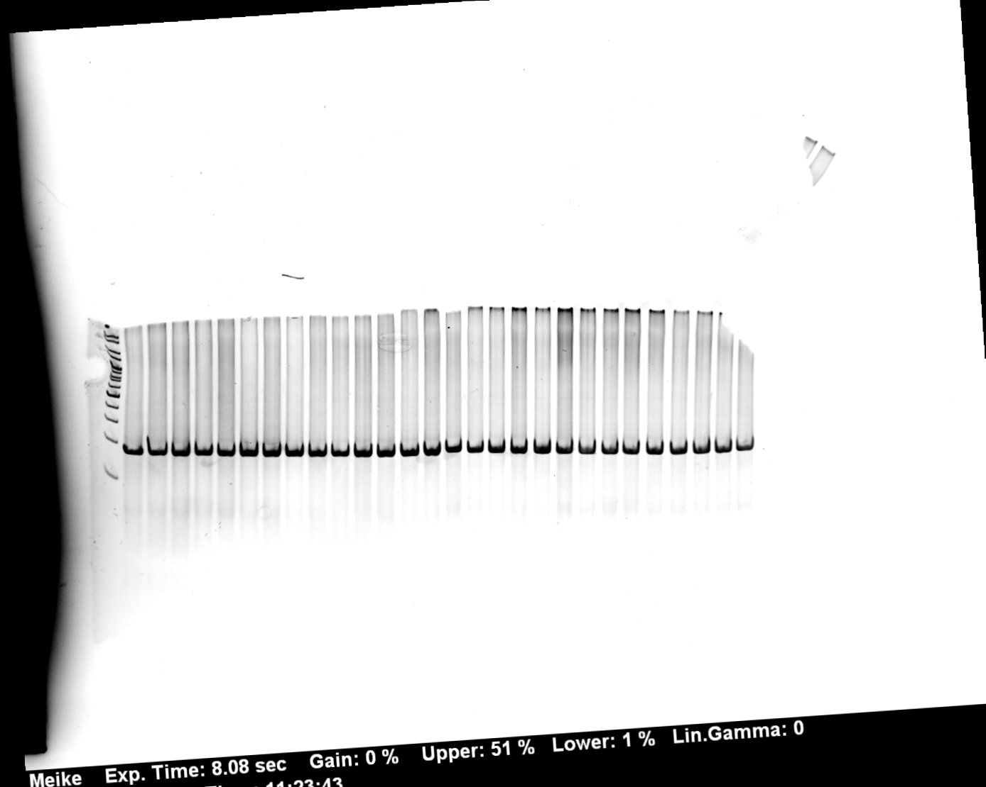
Figure 2
GT
GA
GC
GG
TT
AT
CT
#1
n
S
T
S/T
n
S
T
S/T
n
S
T
S/T
n
S
T
S/T
n
S
T
S/T
n
S
T
S/T
n
S
T
S/T
S
+1
+1
+1
+1
-
+1
-
+1/+5
+1
+1
+1
+1
-
+1
-
+1/+5
-
-1/+1
-1/+1
-1/+1
-
+1
+1/+5
+1/+5
-
+5
-
+1/+5
R
GH1
#2
S
GH1
#3
S
GH1
1
2
3
4
5
6
7
8
9
10
11
12
13
14
15
16
17
18
19
20
21
22
23
24
25
26
27
28

Slide 6
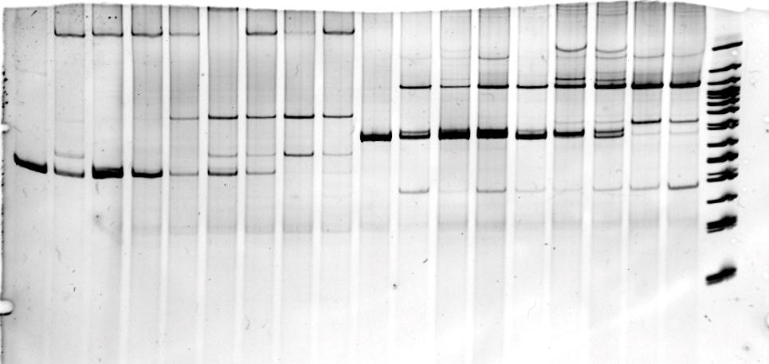
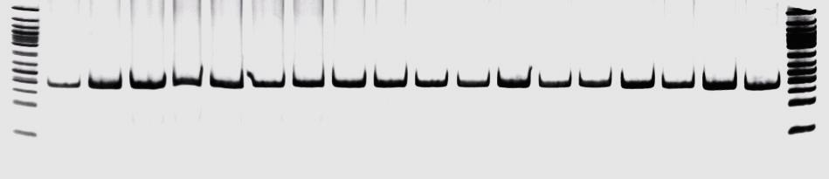
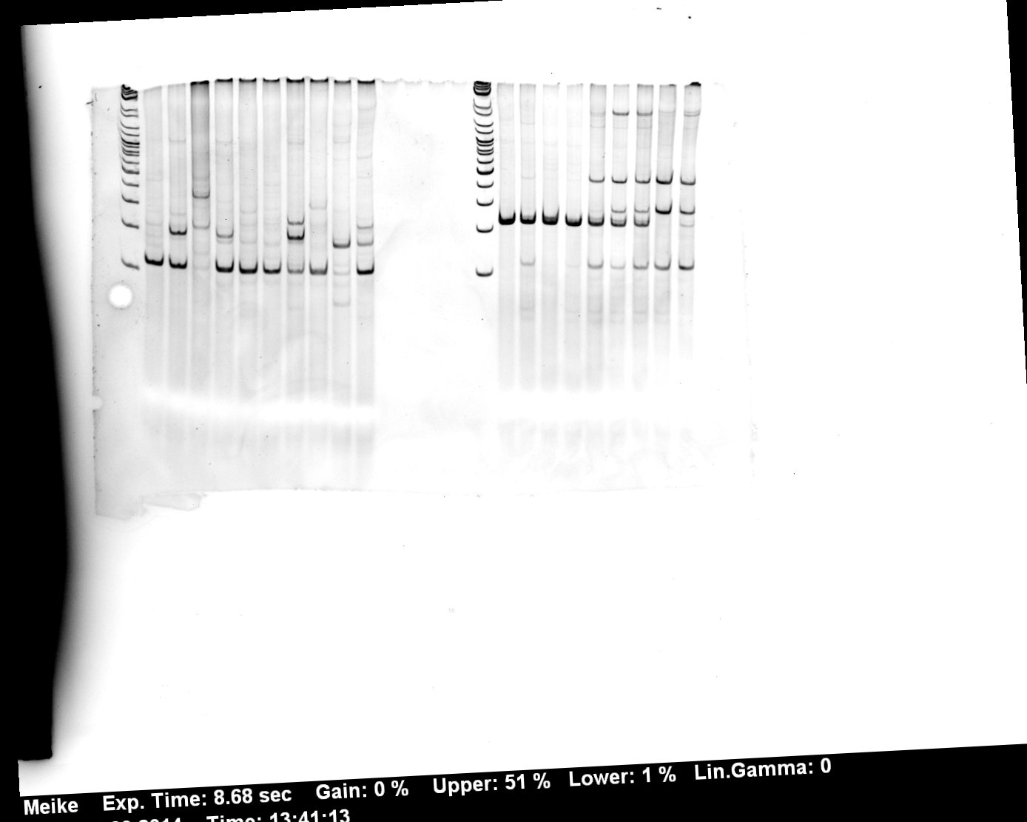
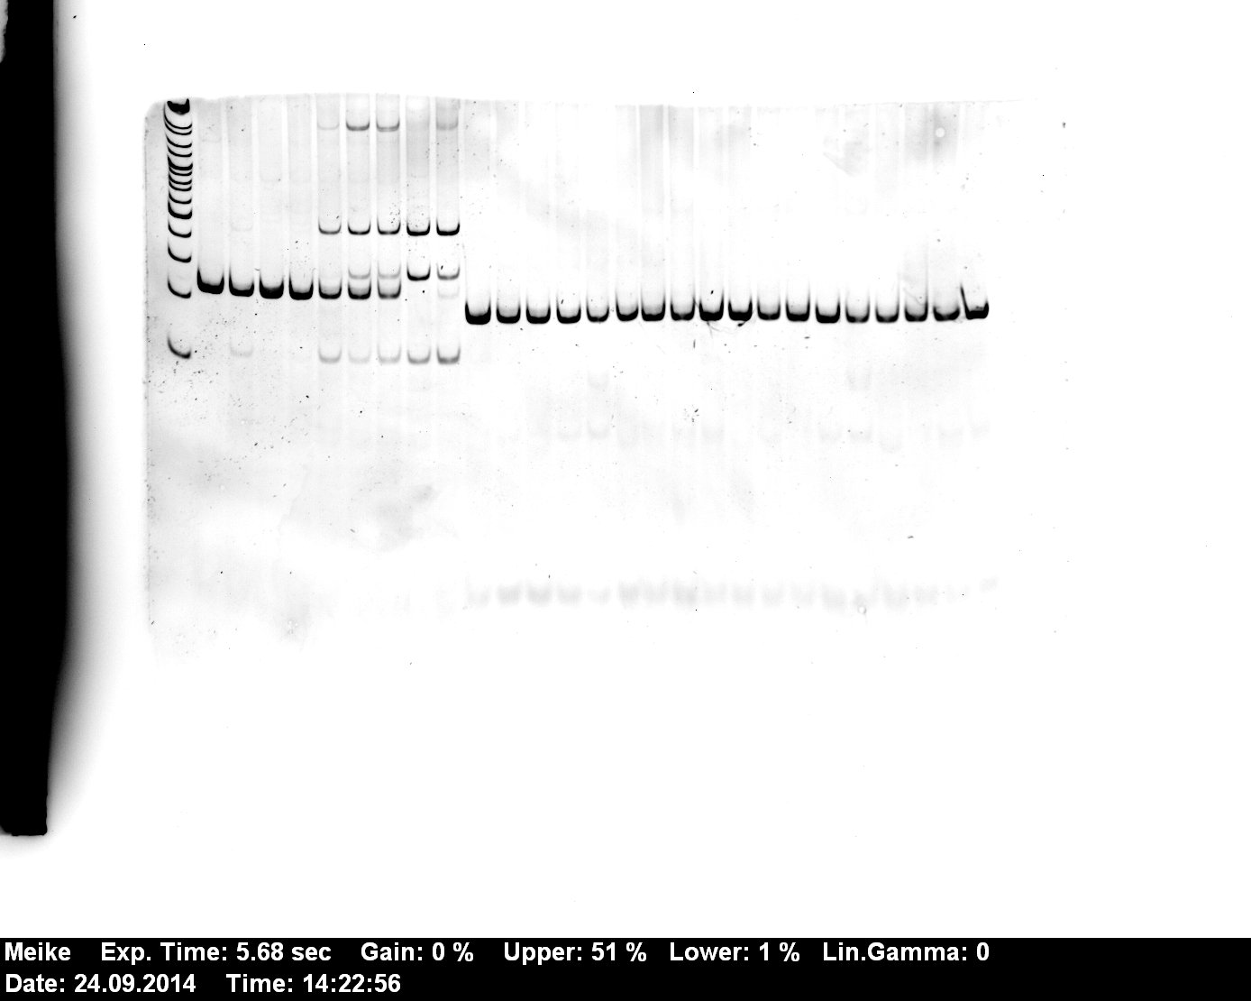
Figure 3
GT
TT
GT
GC
#1
c2
c1
S
+1
+1
±1
+1
+1
±1
±1
-
±1
R
GH1
#2
GT
TT
#3
GT
TT
GT
GC
GT
GC
c2
c2
c1
c1
S
S
+1
+1
±1
+1
+1
±1
±1
-
±1
R
+1
+1
±1
+1
+1
±1
±1
-
±1
R
GH1
GH1

