Slide 1
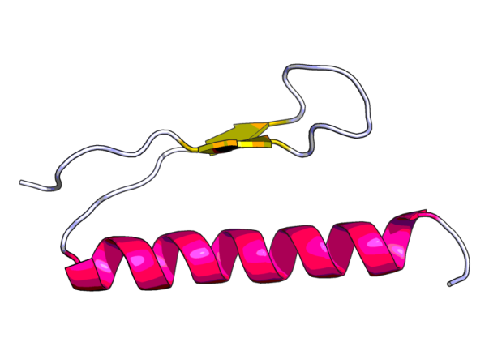
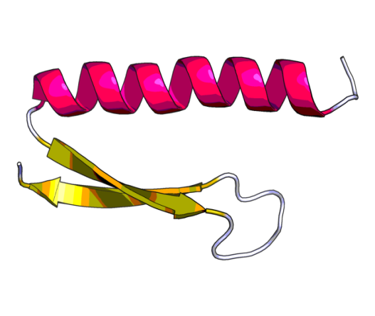
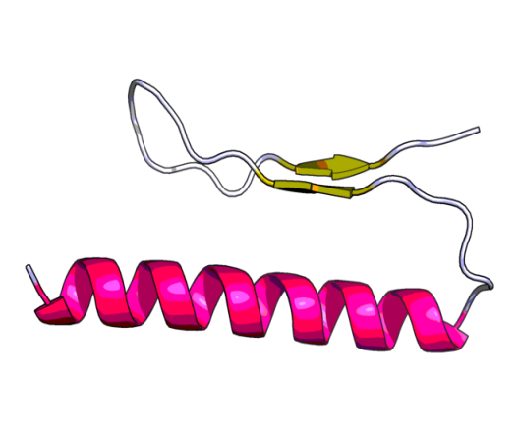
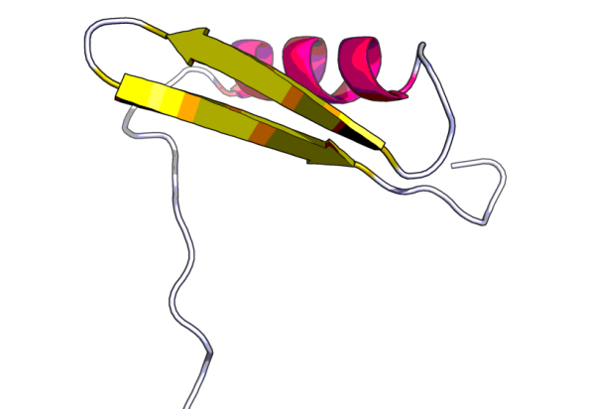
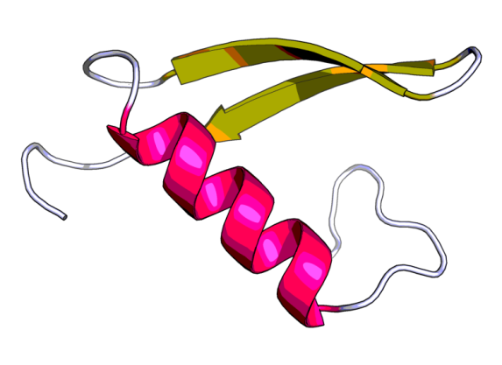
hokA
hokB
hokC
N
N
N
C
C
C
C
hokD
hokE
C
N
N
Notes:
Supplemental Fig S6. Structural prediction of genome encoded hok peptides. The structure of all peptides contain an alpha helix at the N-terminus which is predicted to be anchored to the membrane and two beta strands at the C-terminus that are located at the periplasm (Poulsen et al. 1991).

