Slide 1
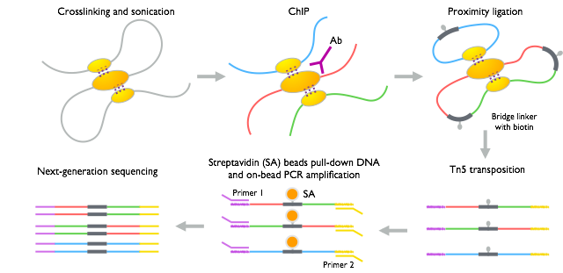
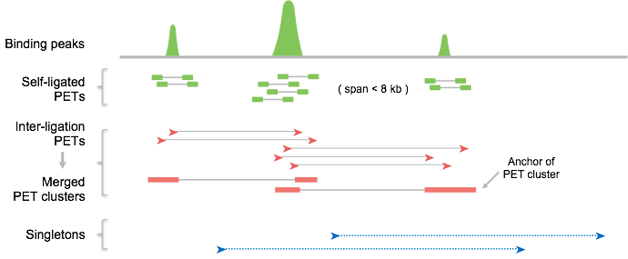
A
B
Figure S1. ChIA-PET protocol and classification of PET sequences.
(A) Schematics show details of ChIA-PET protocol, including ChIP pull-down, proximity ligation, Tn5 transposition involved sequencing library preparation.
(B) Features and categories of ChIA-PET PET sequences. According to the mapping orientations and spans, the PET sequences were classified into self-ligation and inter-ligation PETs. The coverage of self-ligation PETs reflects the binding sites of the protein factor that was immunoprecipitated during the ChIA-PET experiment. Inter-ligation PETs that overlapped at both ends were collapsed together as PET clusters. Each PET cluster has two interaction anchors, which indicate the loci involved in the interaction. Inter-ligation PETs that could not be clustered were regarded as singletons.

Slide 2
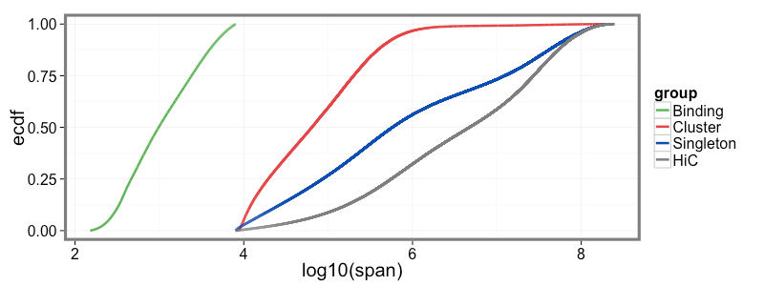
1.00
0.75
0.50
Self-ligation PETs
Cumulative fraction
PET clusters
Singletons
0.25
Hi-C
cutoff site
(8 kb)
0
100 bp
10 kb
65 kb
580 kb
1 Mb
100 Mb
Figure S2. Cumulative density function (CDF) plot of the interaction distances of ChIA-PET and Hi-C data. For ChIA-PET data CDFs were computed individually for self-ligation, PET clusters, and singletons categories. The span of the self-ligation PETs ranged from 150 bp to 8 kb. Interaction distances of the vast majority PET clusters are from 8 kb to 100 Mb. Fully 50% of PET clusters have an interaction distances less than 65 kb. Interaction distances of singletons ranged from 8 kb to 10 Mb, with more than 50% larger than 580 kb. The interaction distance distribution for singletons is similar to that of Hi-C. For the Hi-C data, the interactions with span less than 8 kb did not show in the CDF plot. The vertical gray dashed line indicates the span cutoff for self-ligation and inter-ligation PETs. The vertical dash line with light red color indicates the interaction distance of fifty percent of PET clusters. The vertical dash with light blue color indicates the interaction distance of fifty percent of singletons.

Slide 3
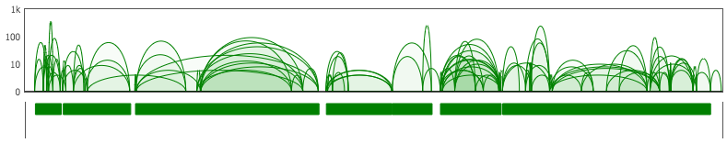
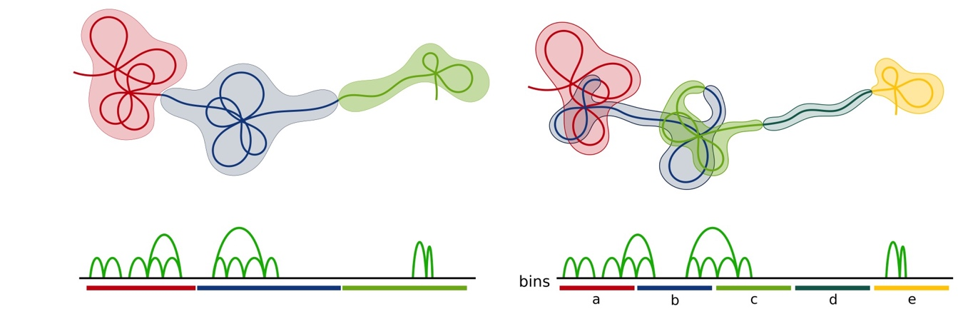
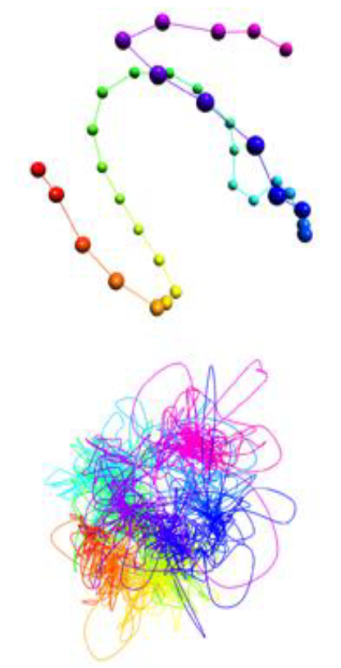
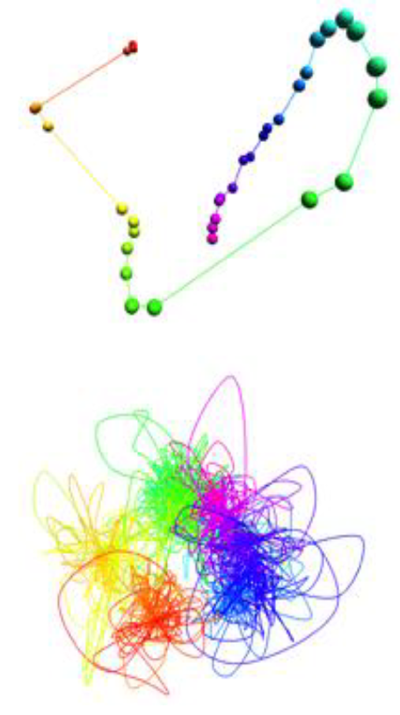
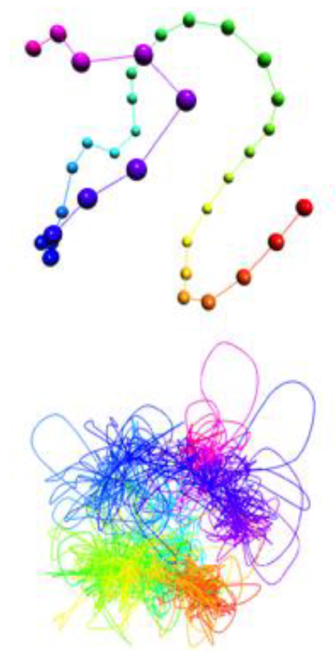
A
chr12:113235367-120651276
CTCF
clusters
CCDs
I
II
III
IV
Segments
B
C
SA
D
GD+SA
E
GD+MDS
Figure S3. Top: illustration of genomic binning procedure. (A) CTCF PET interactions can be partitioned into dense networks, called chromatin contact domains (CCDs), of high frequency interactions connected by weak or no interactions. CCDs are grouped together into segments, which form the fundamental unit of the low resolution models and whose size is determined by the desired resolution. (legend continued on next page)

Slide 4
Figure S3, continued. (B) A schematic to illustrate the biological basis for our binning procedure. The left image shows the bins identified using CCDs, while the right image shows the same region partitioned using a uniform binning scheme. The CCD partitions mirror naturally occurring chromatin clusters, while uniform bins can split domains and lead to bins in loosely structured, weakly interacting regions. Below: structure of Chromosome 13 on segment and sub-anchor levels obtained using different pipelines. (C) Standard simulated annealing pipeline. (D) Simulated annealing pipeline using the graph distance renormalized heatmap. (E) Standard multidimensional scaling pipeline, which uses the graph distance heatmap.

Slide 5
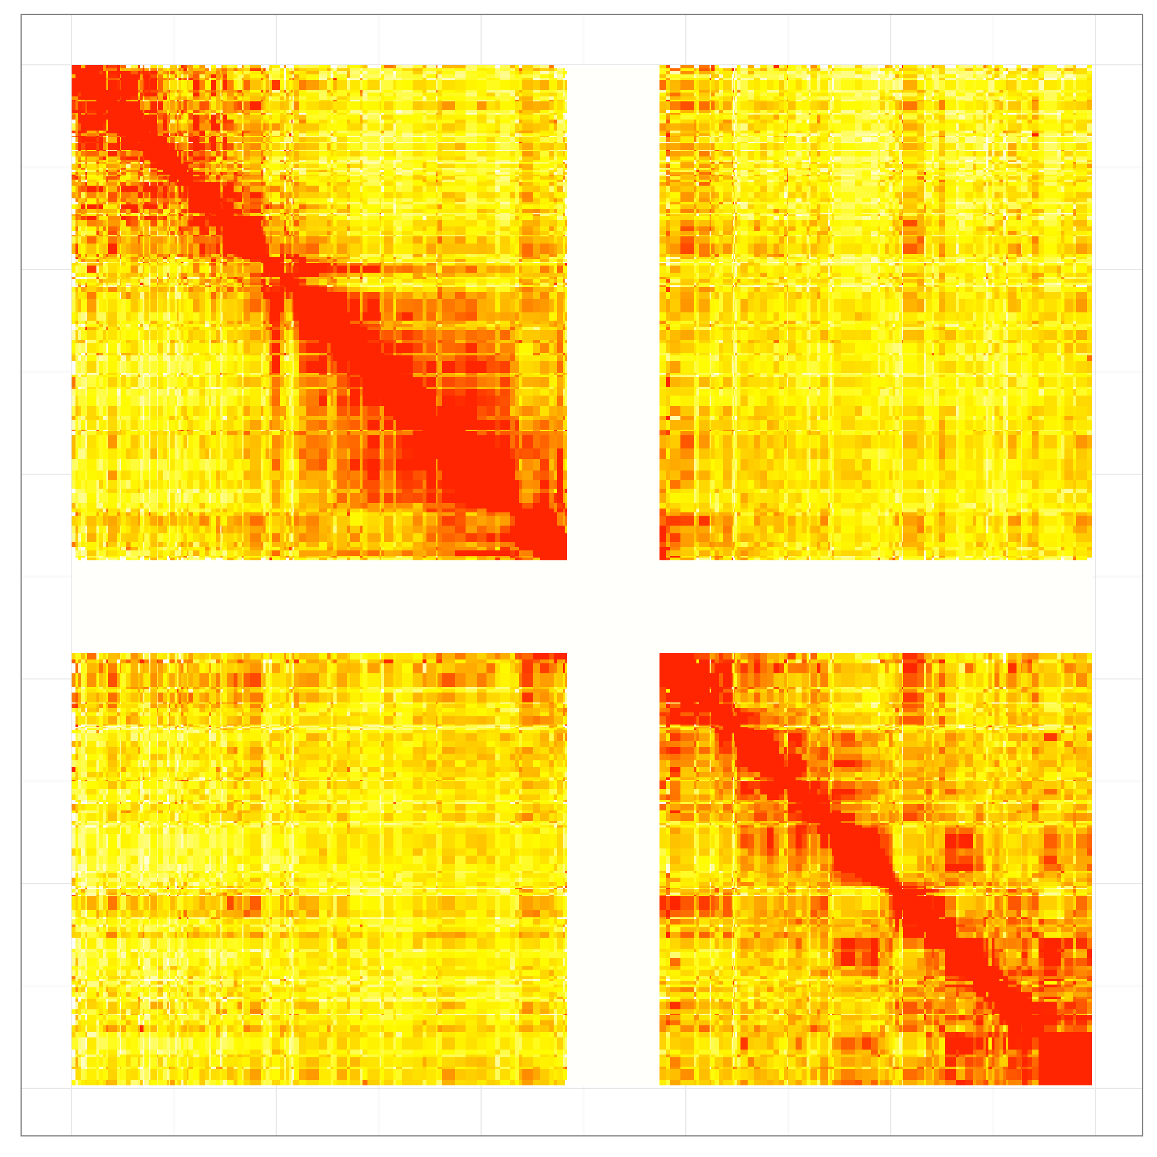
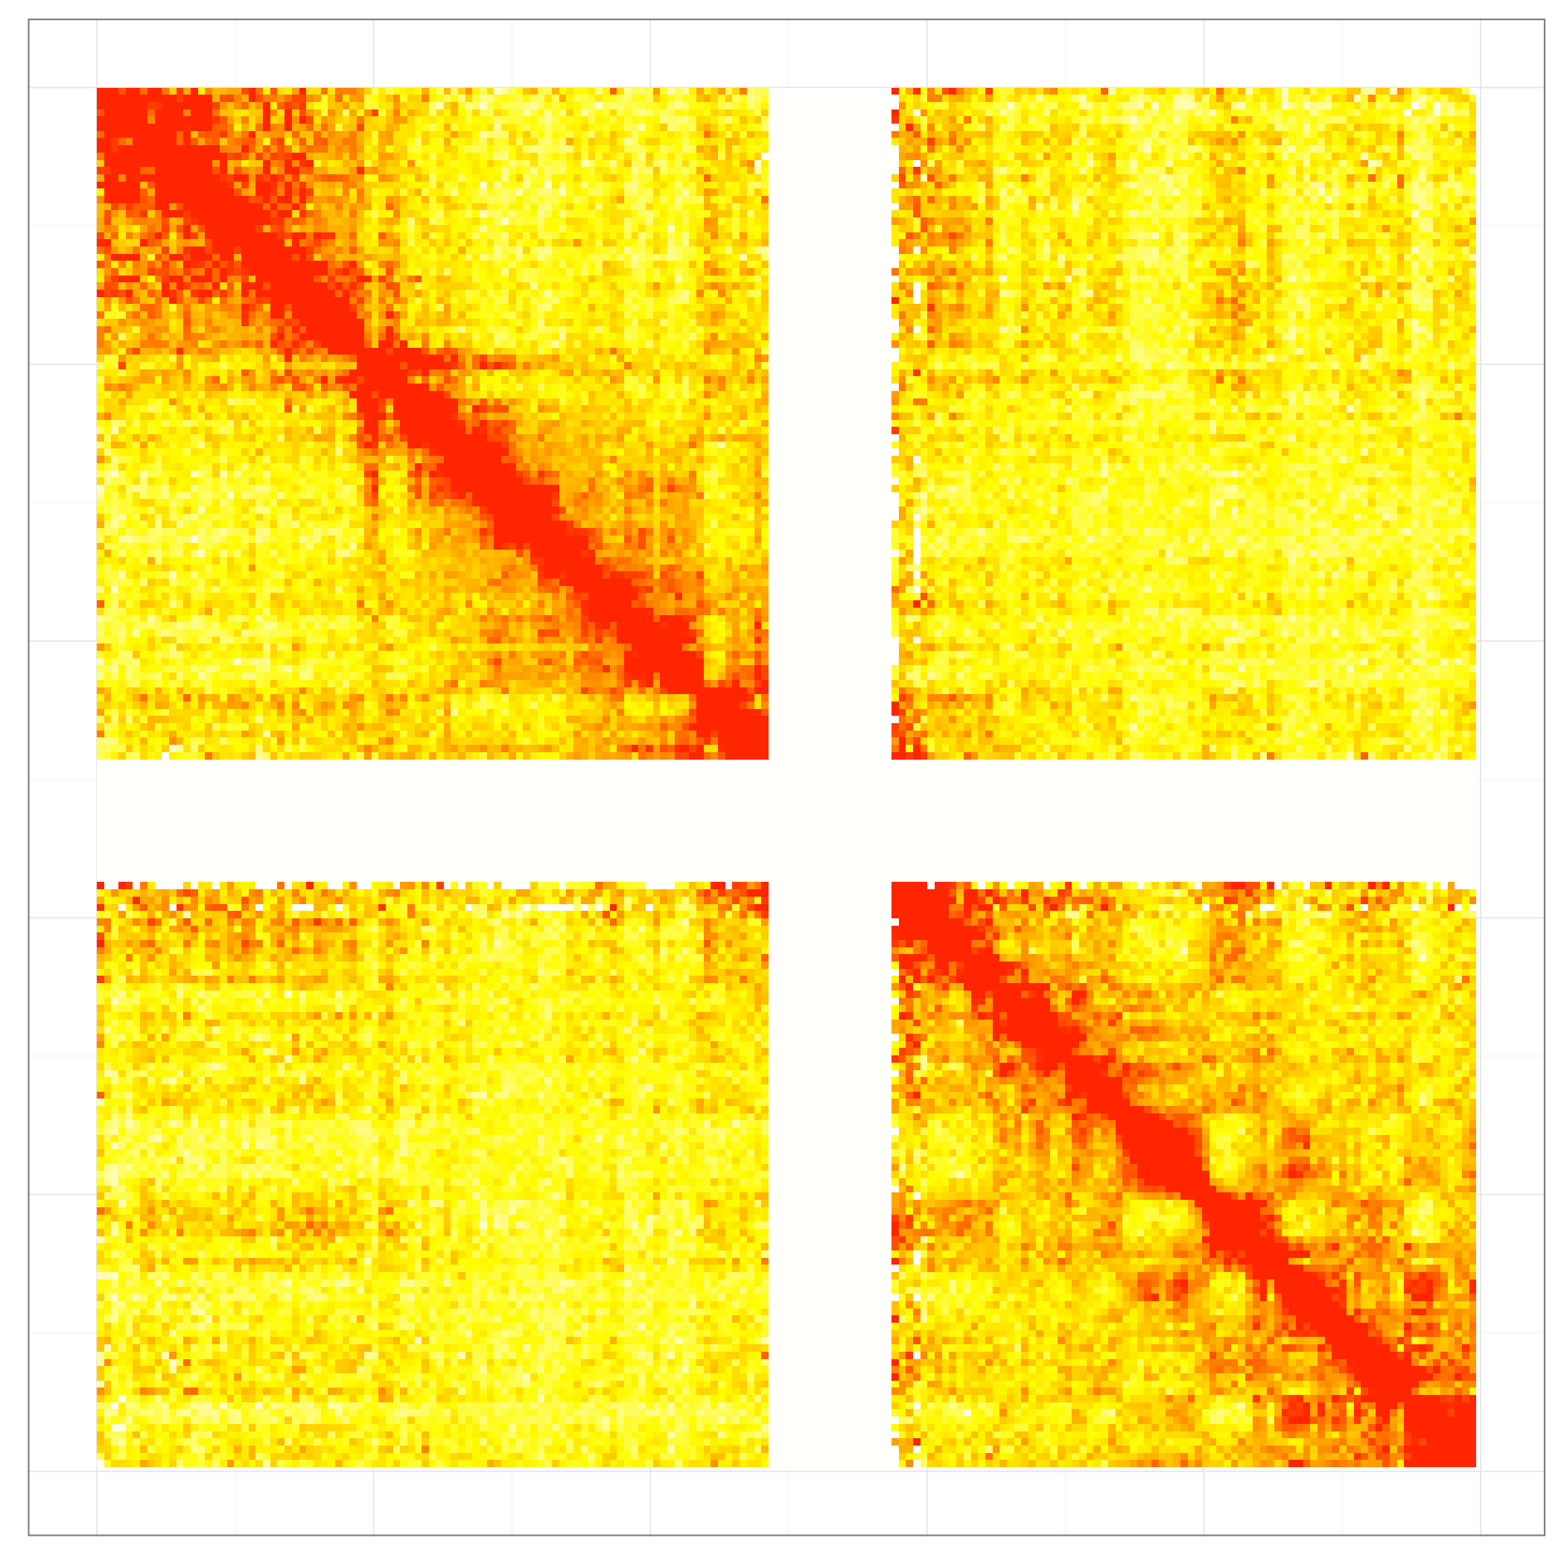
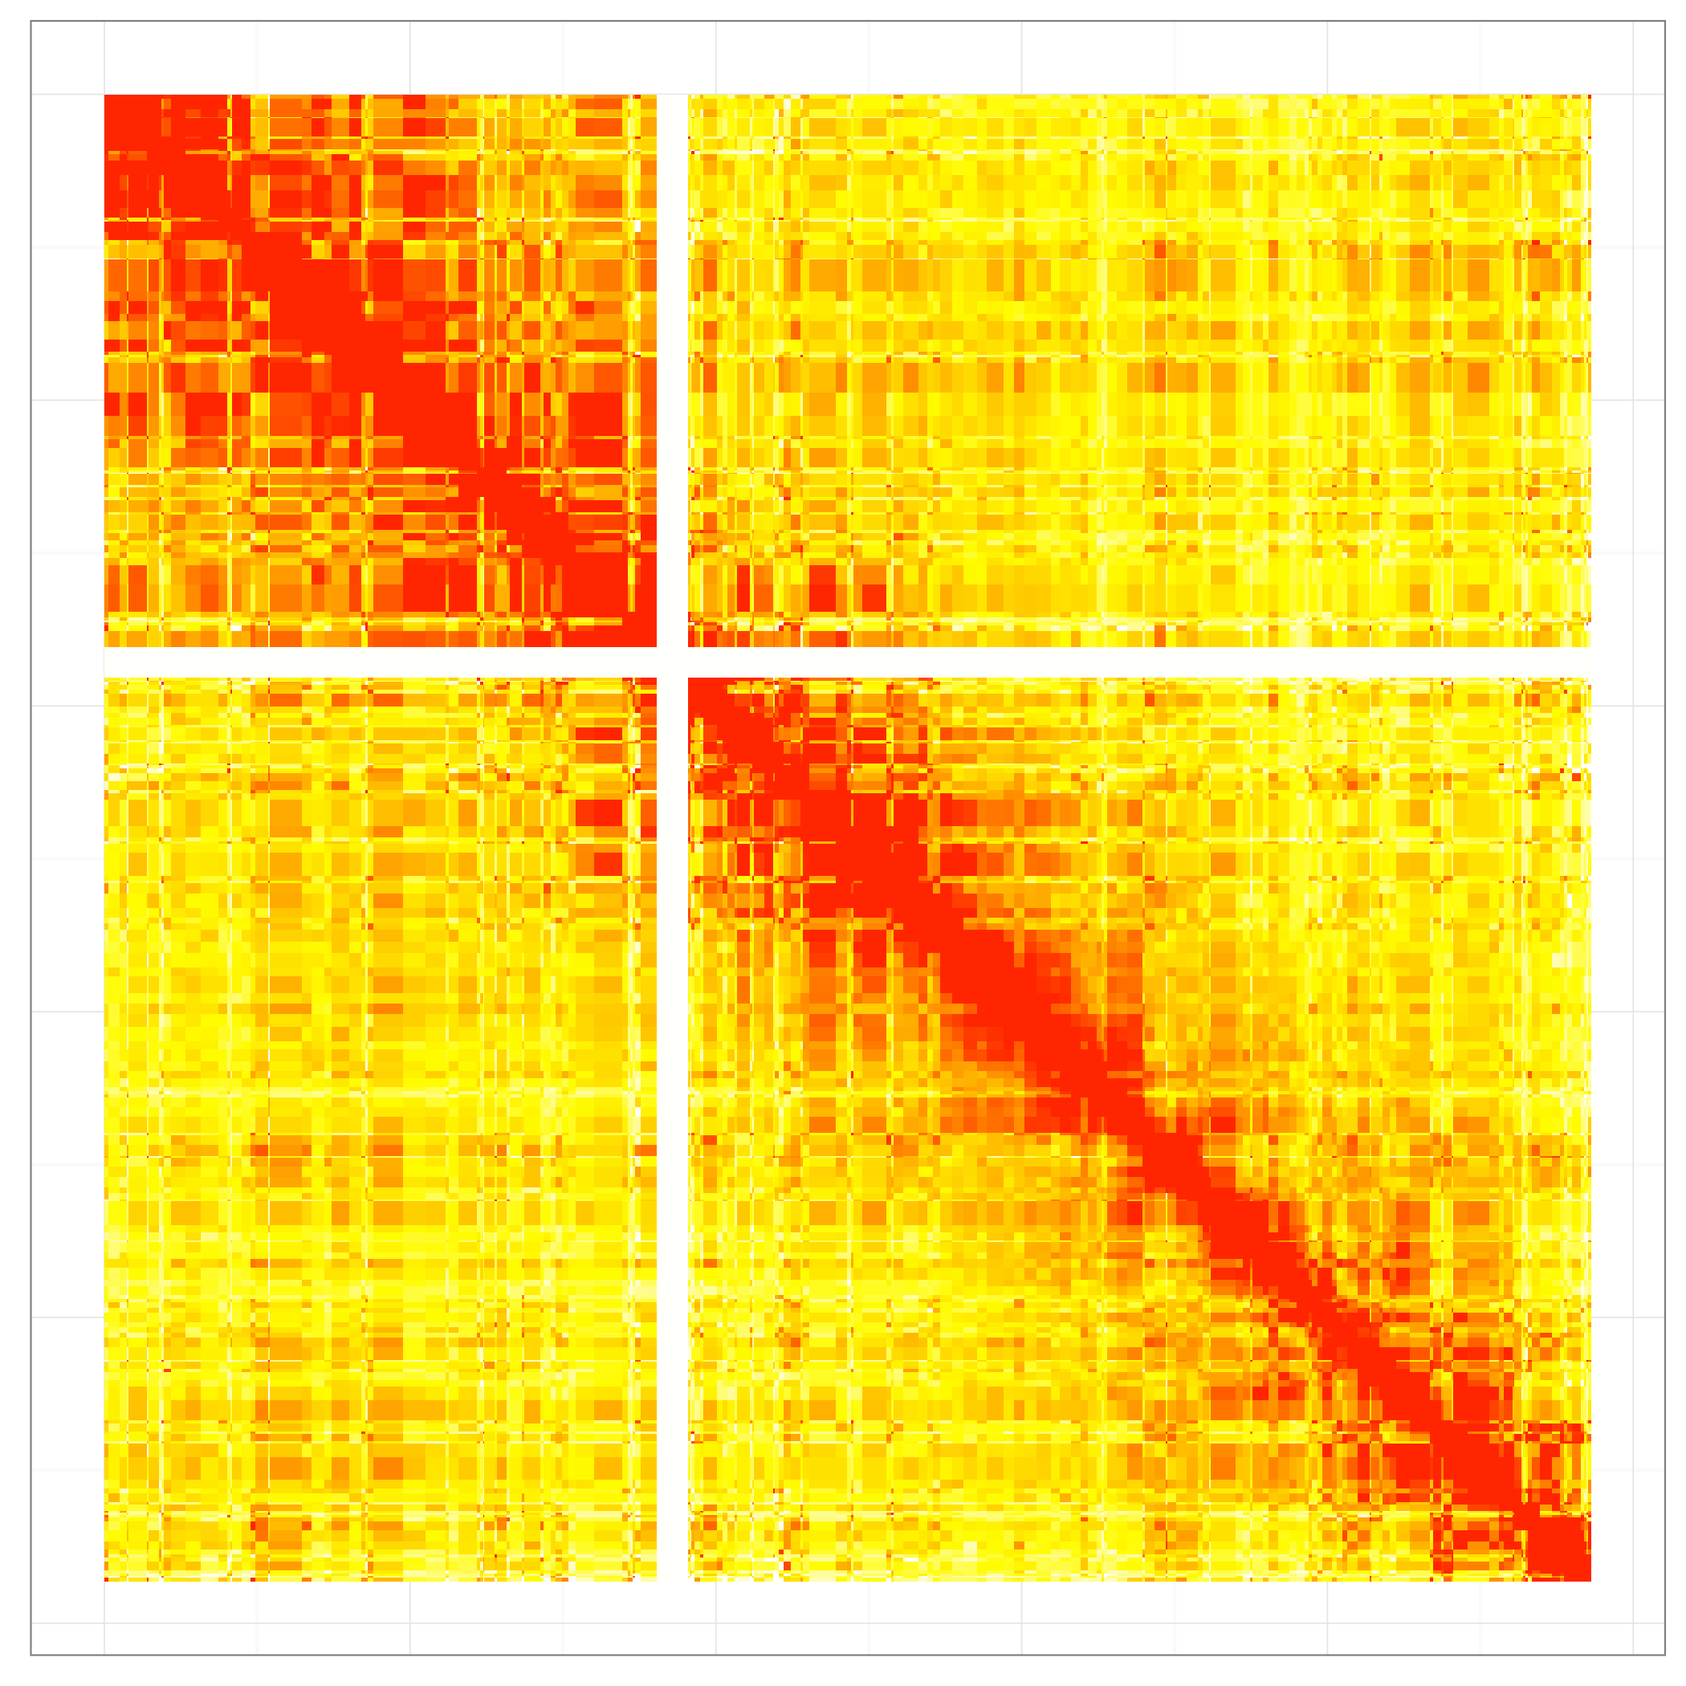
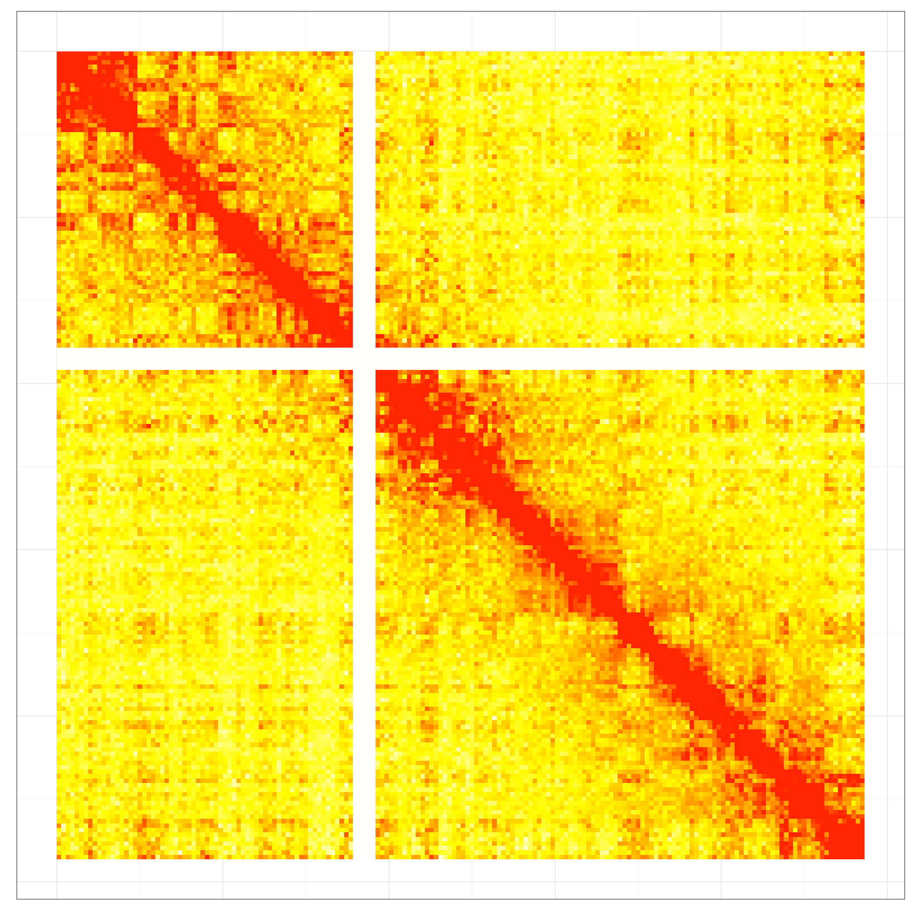
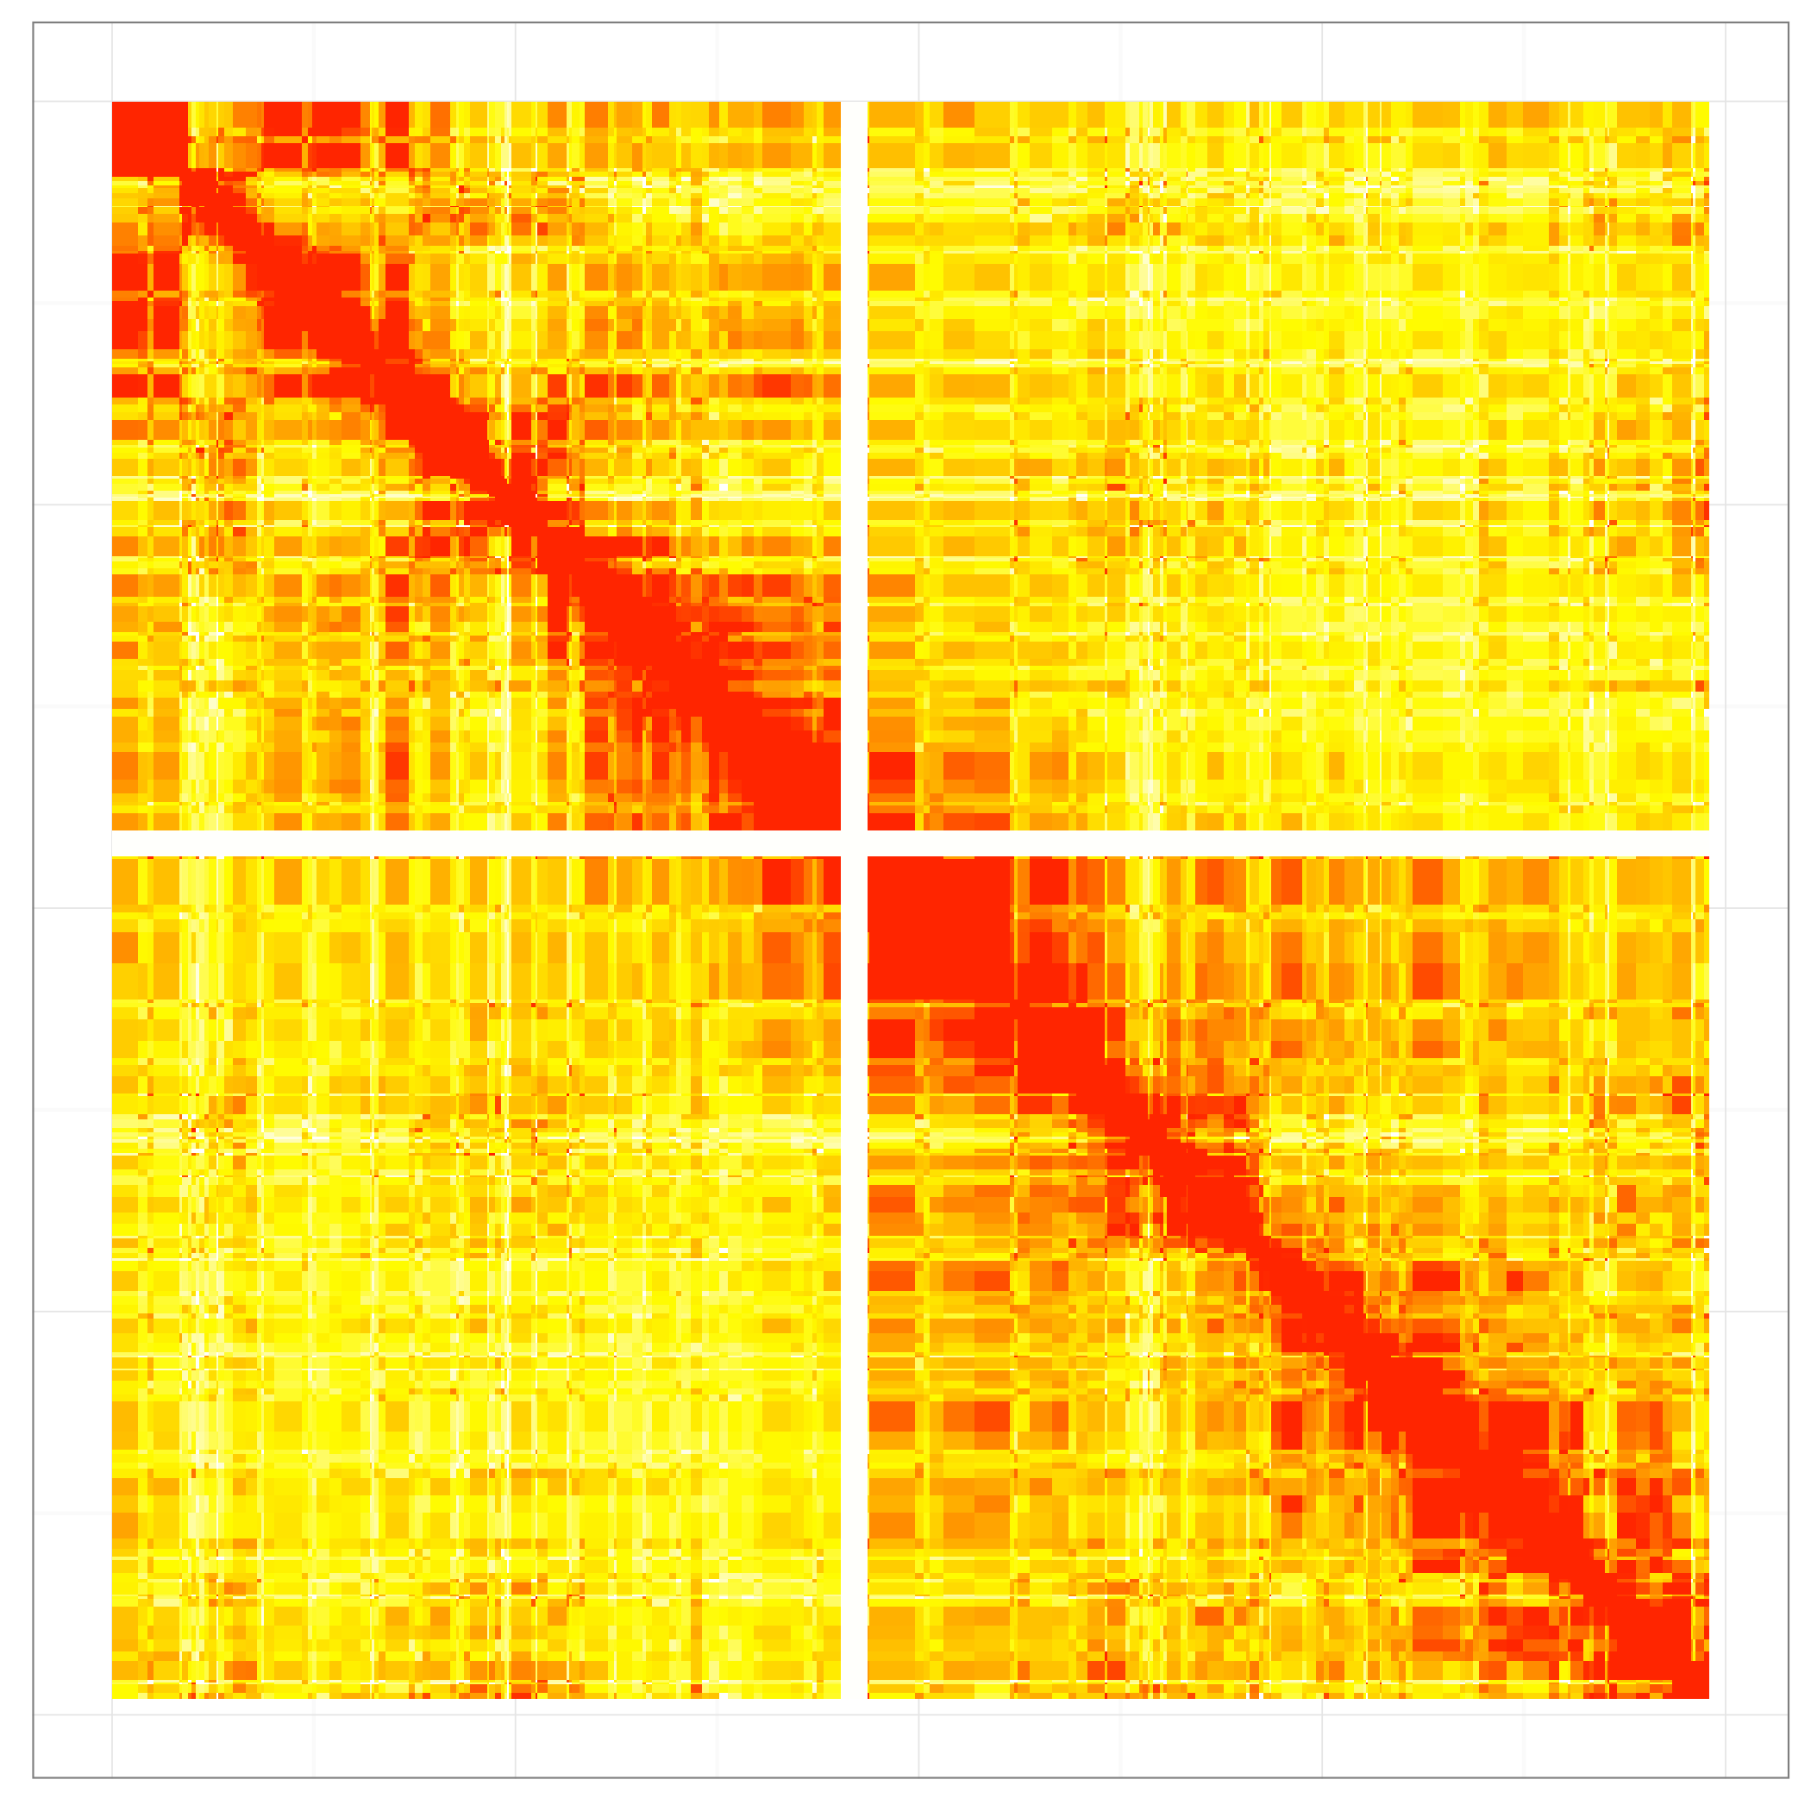
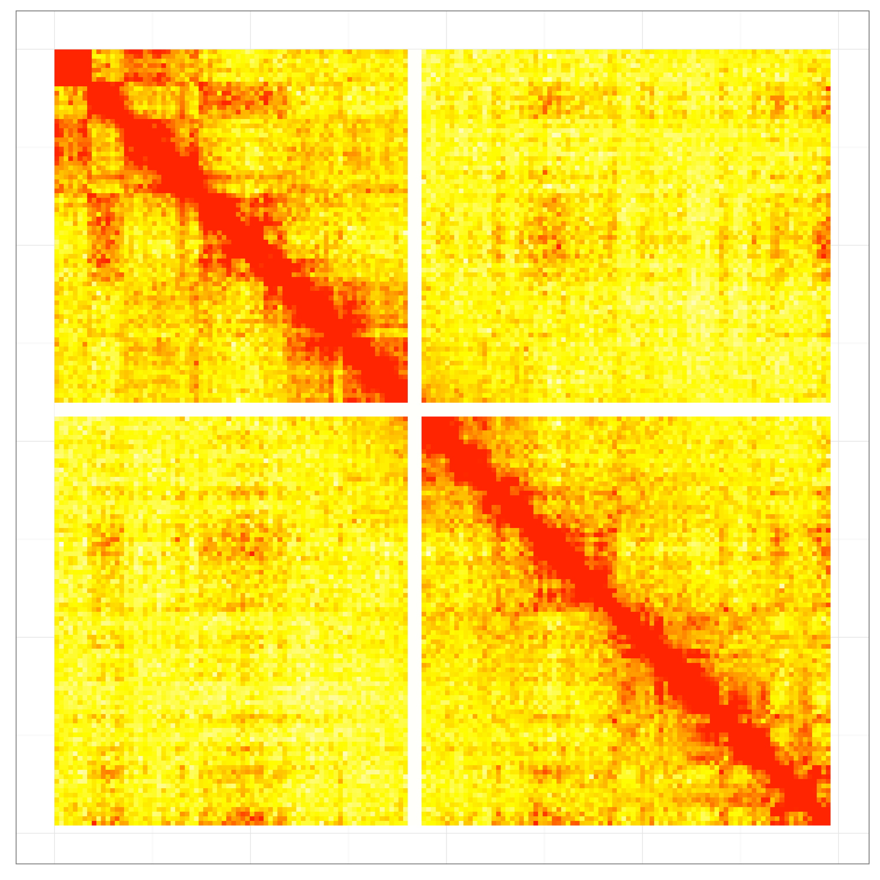
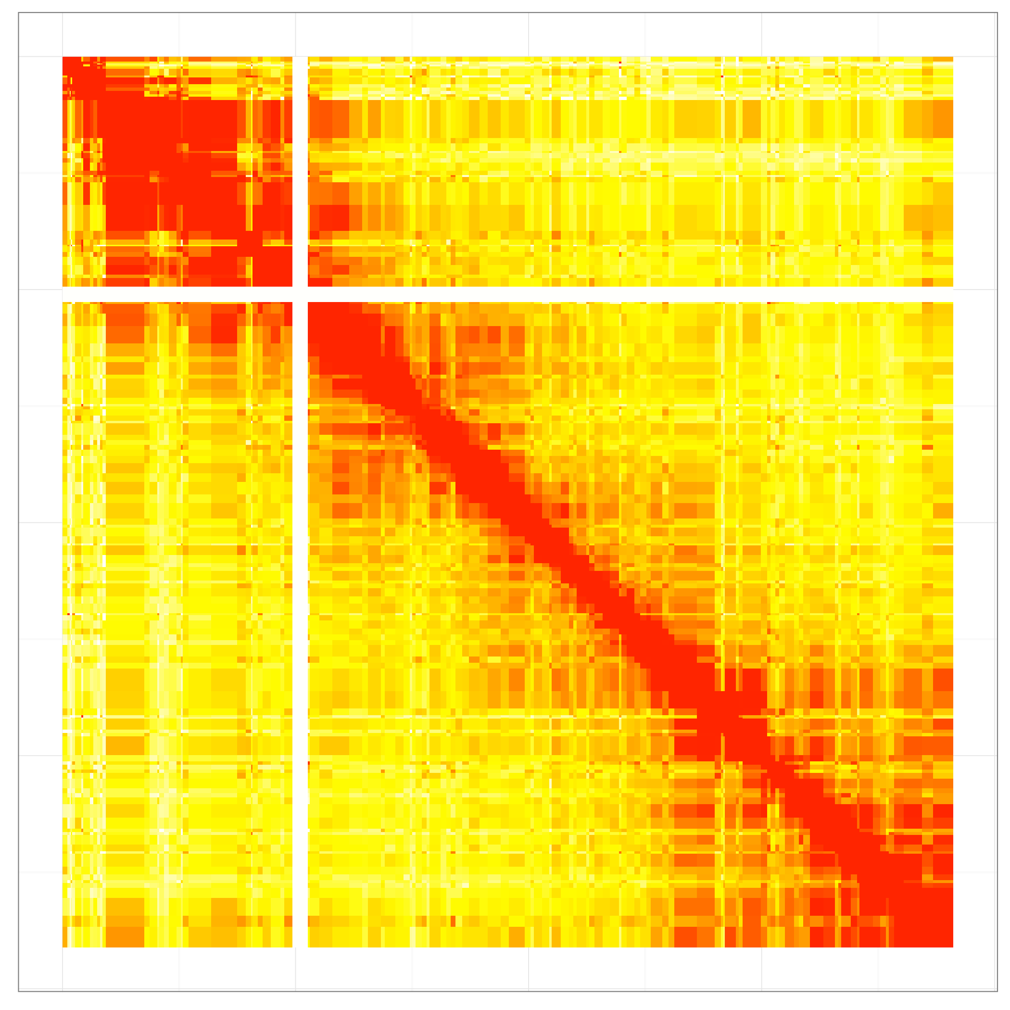
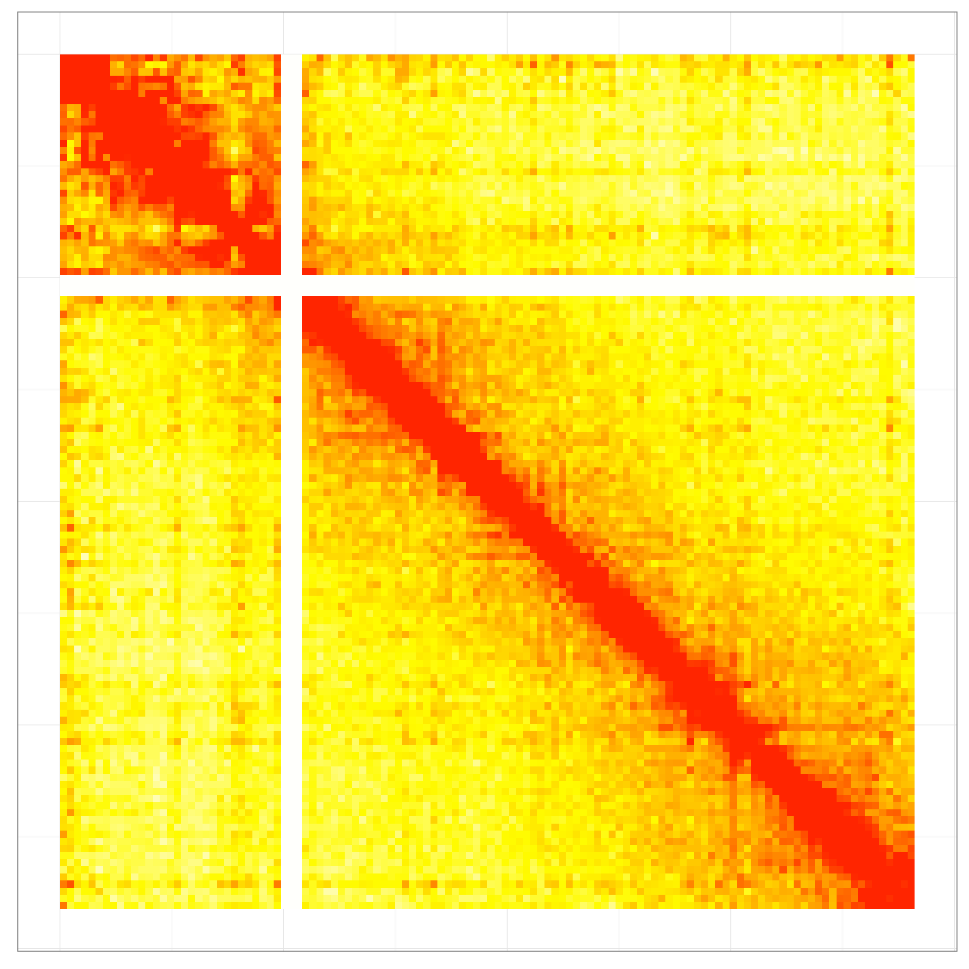
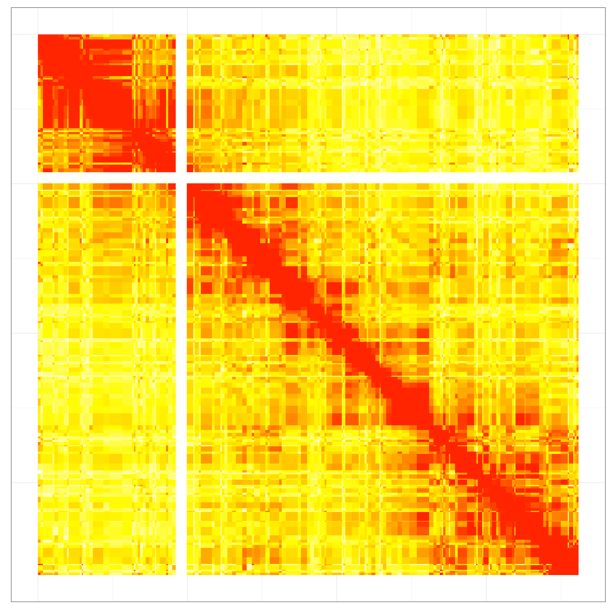
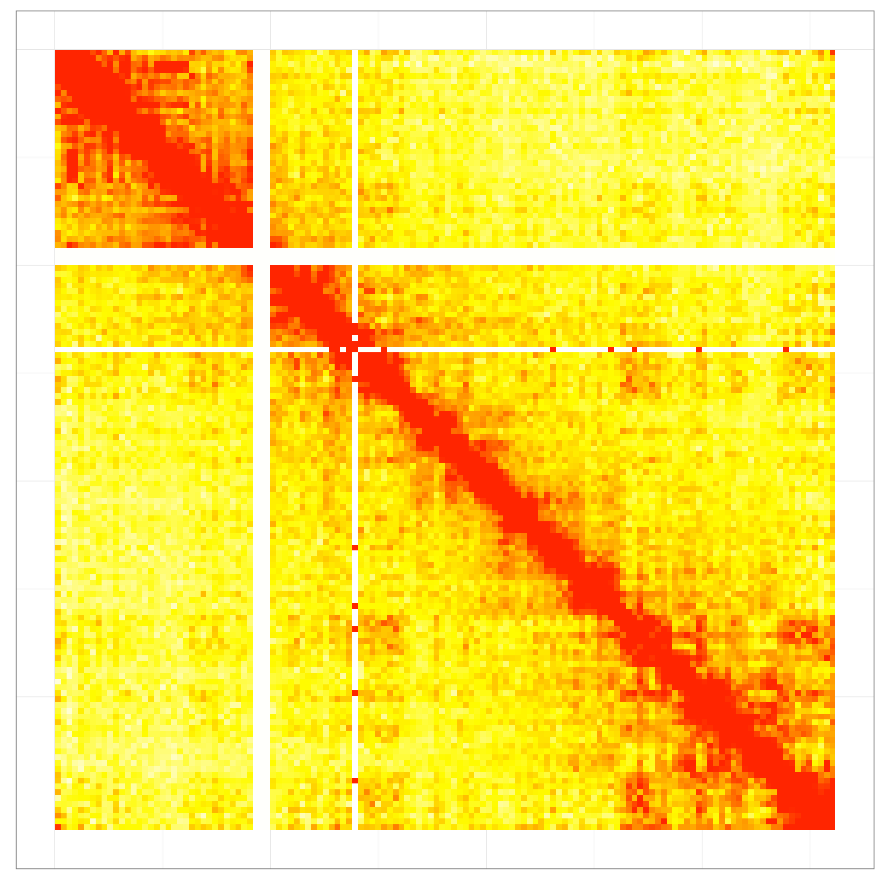
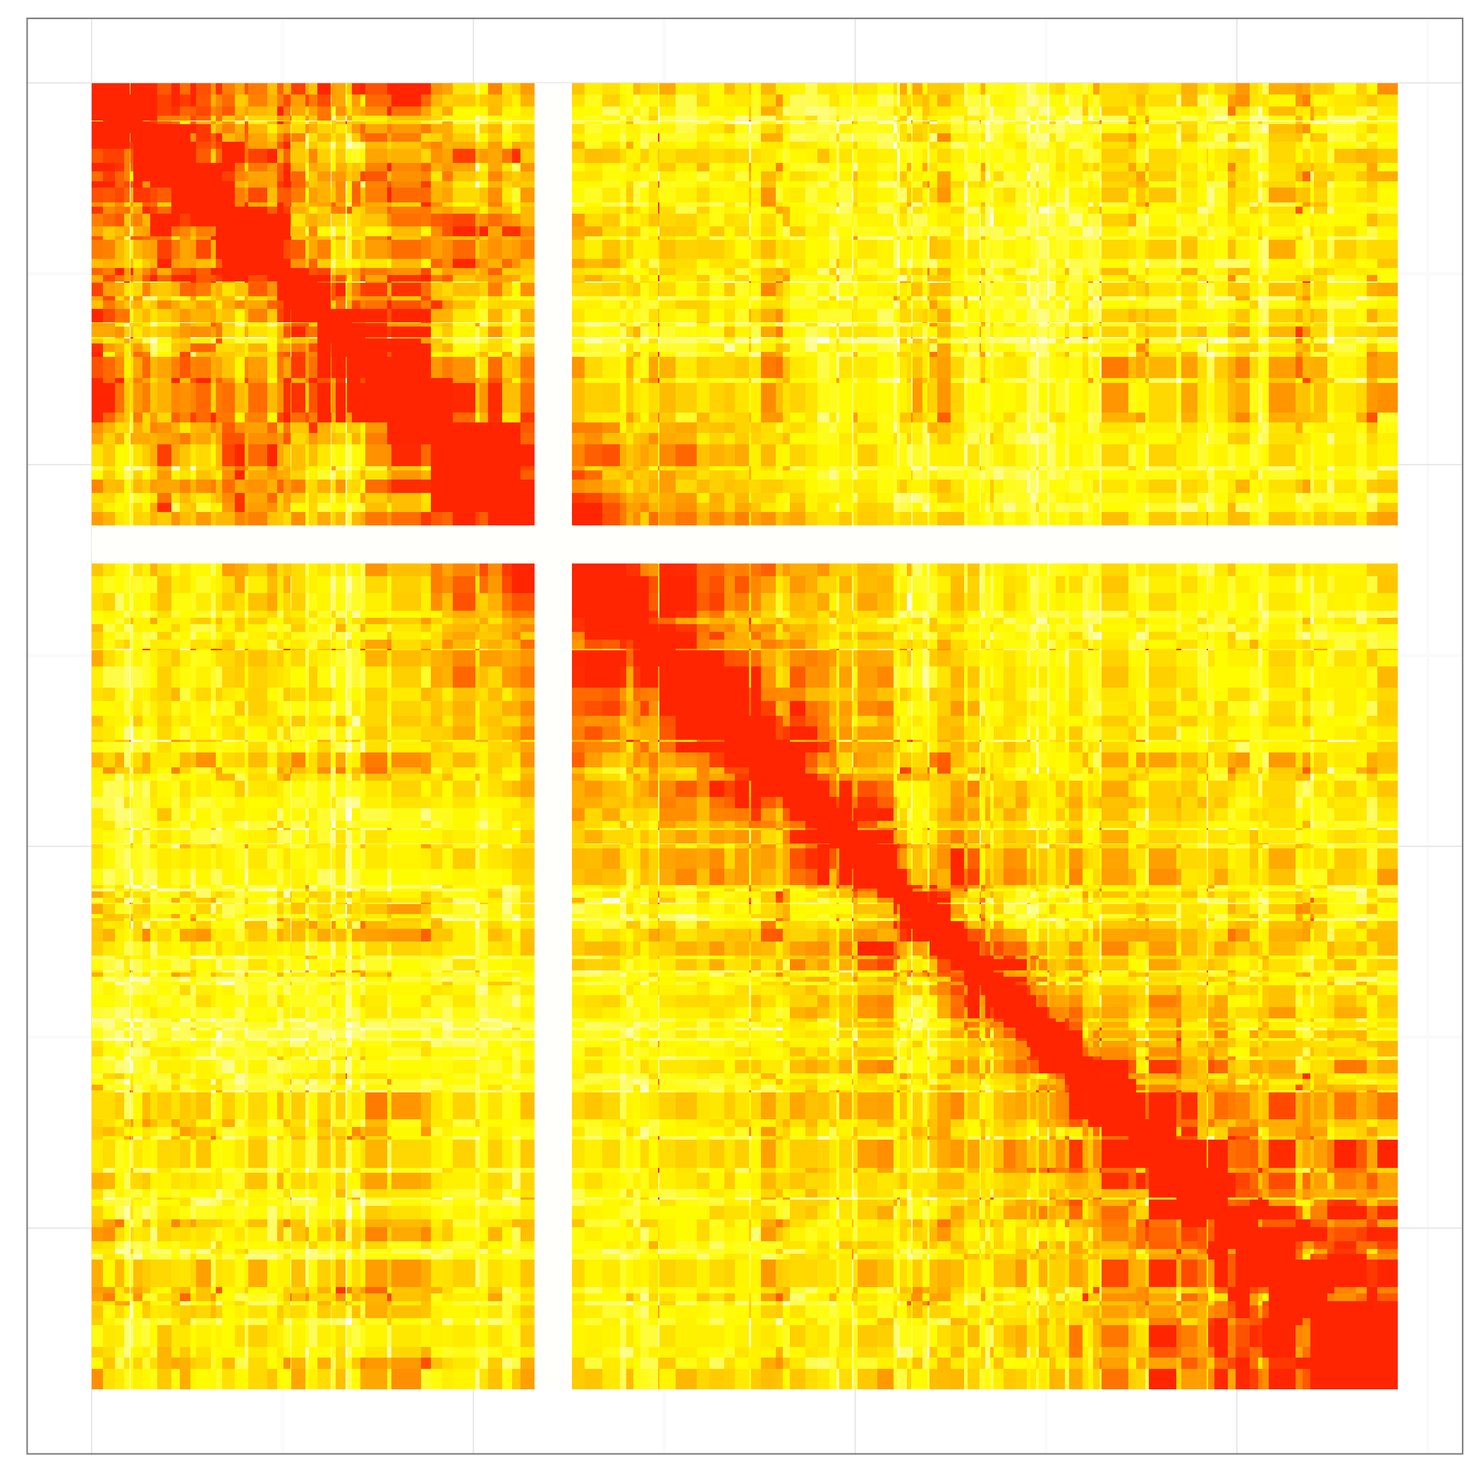
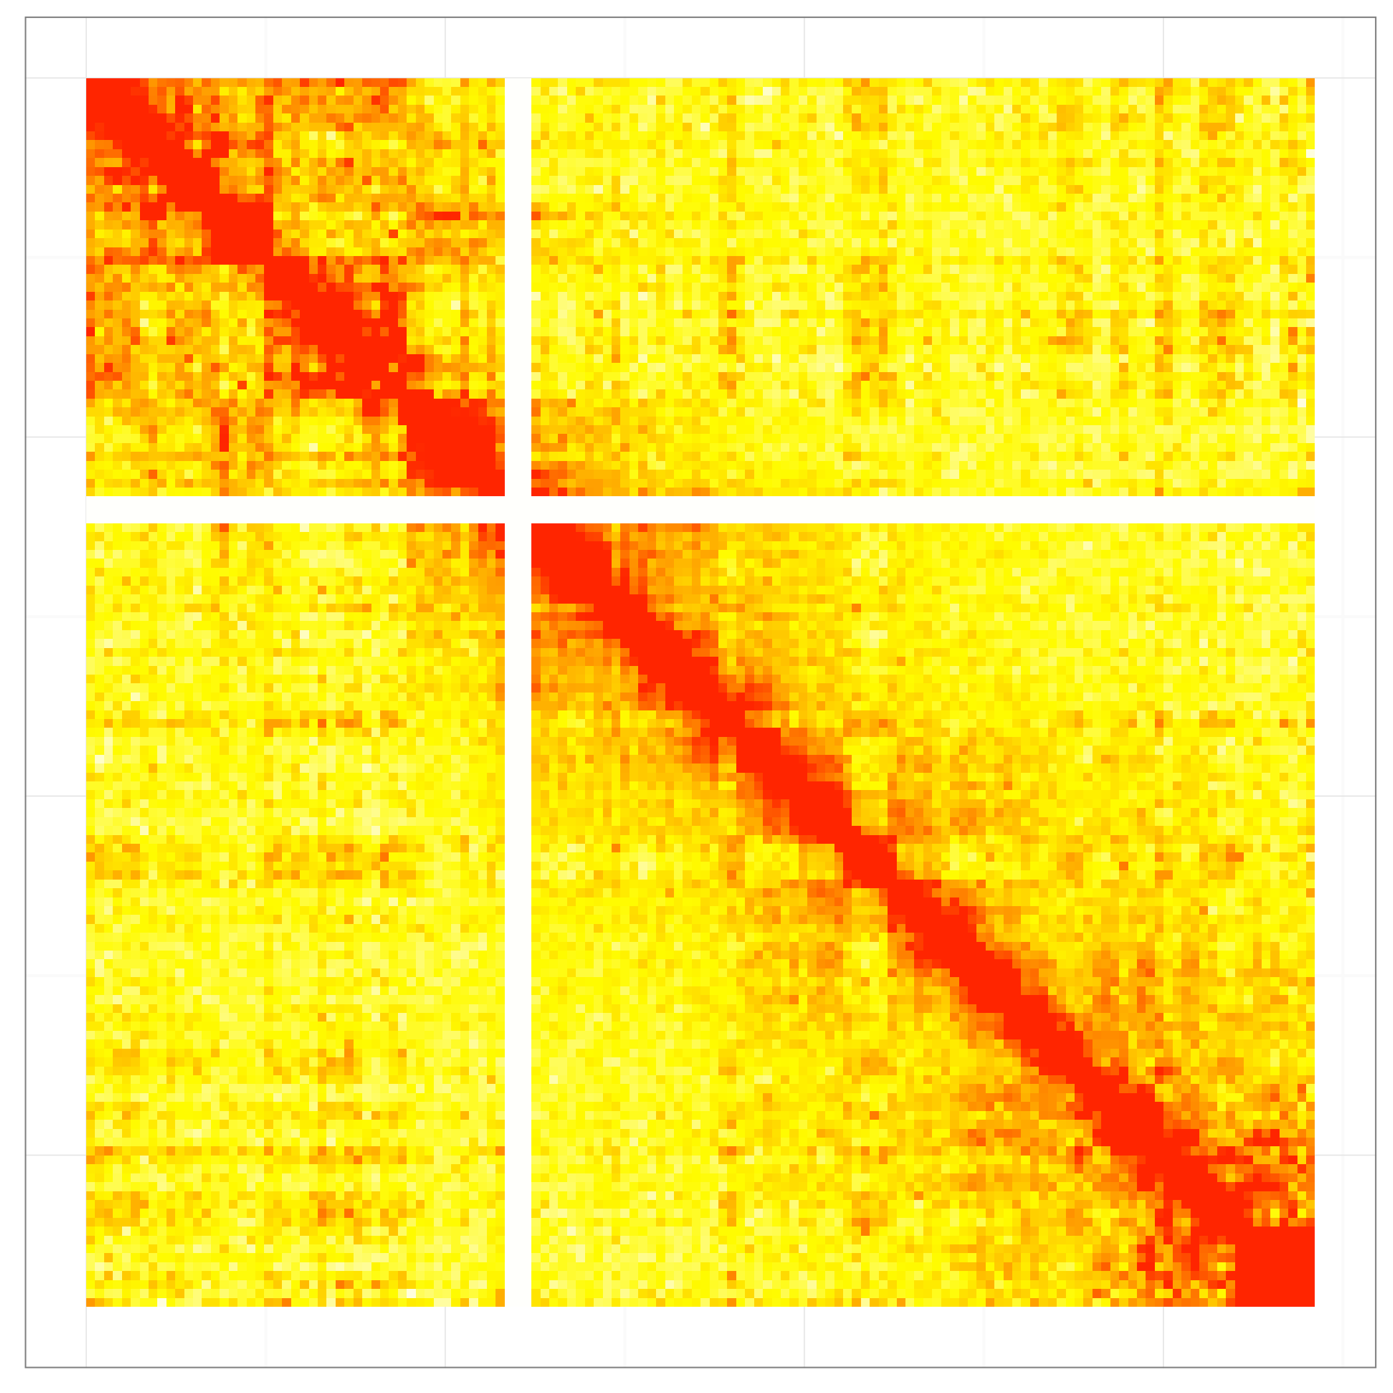
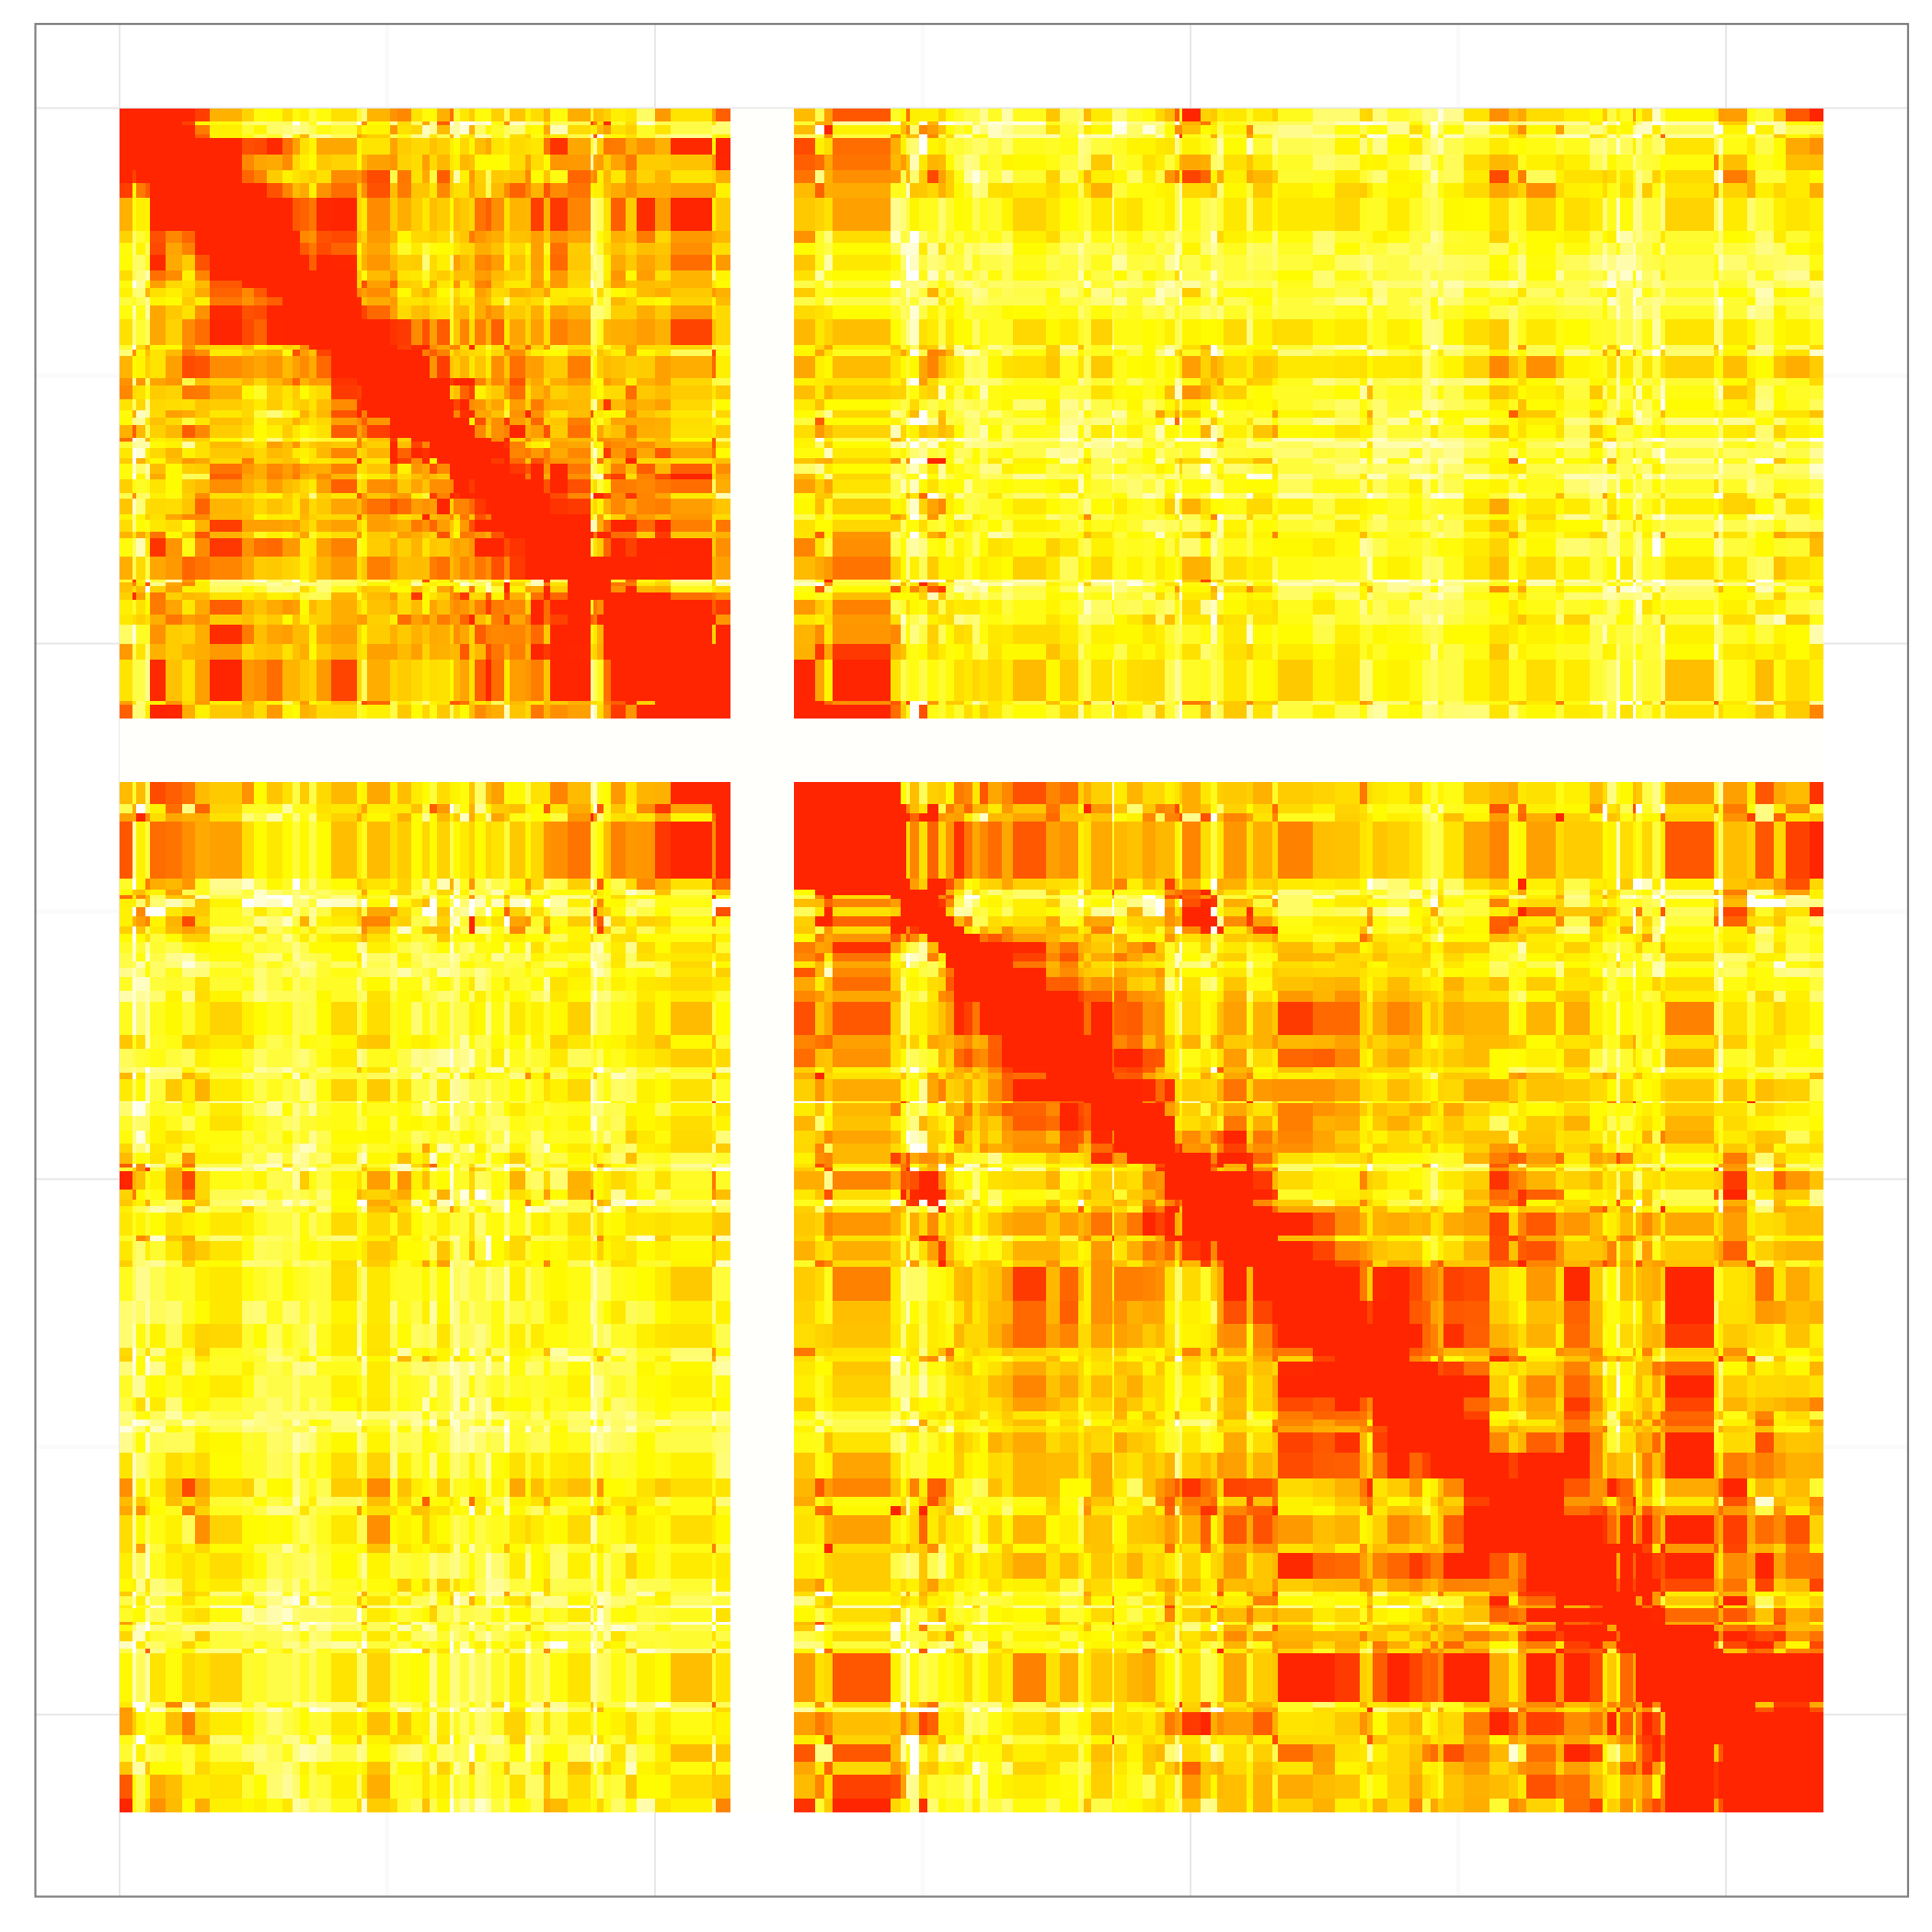
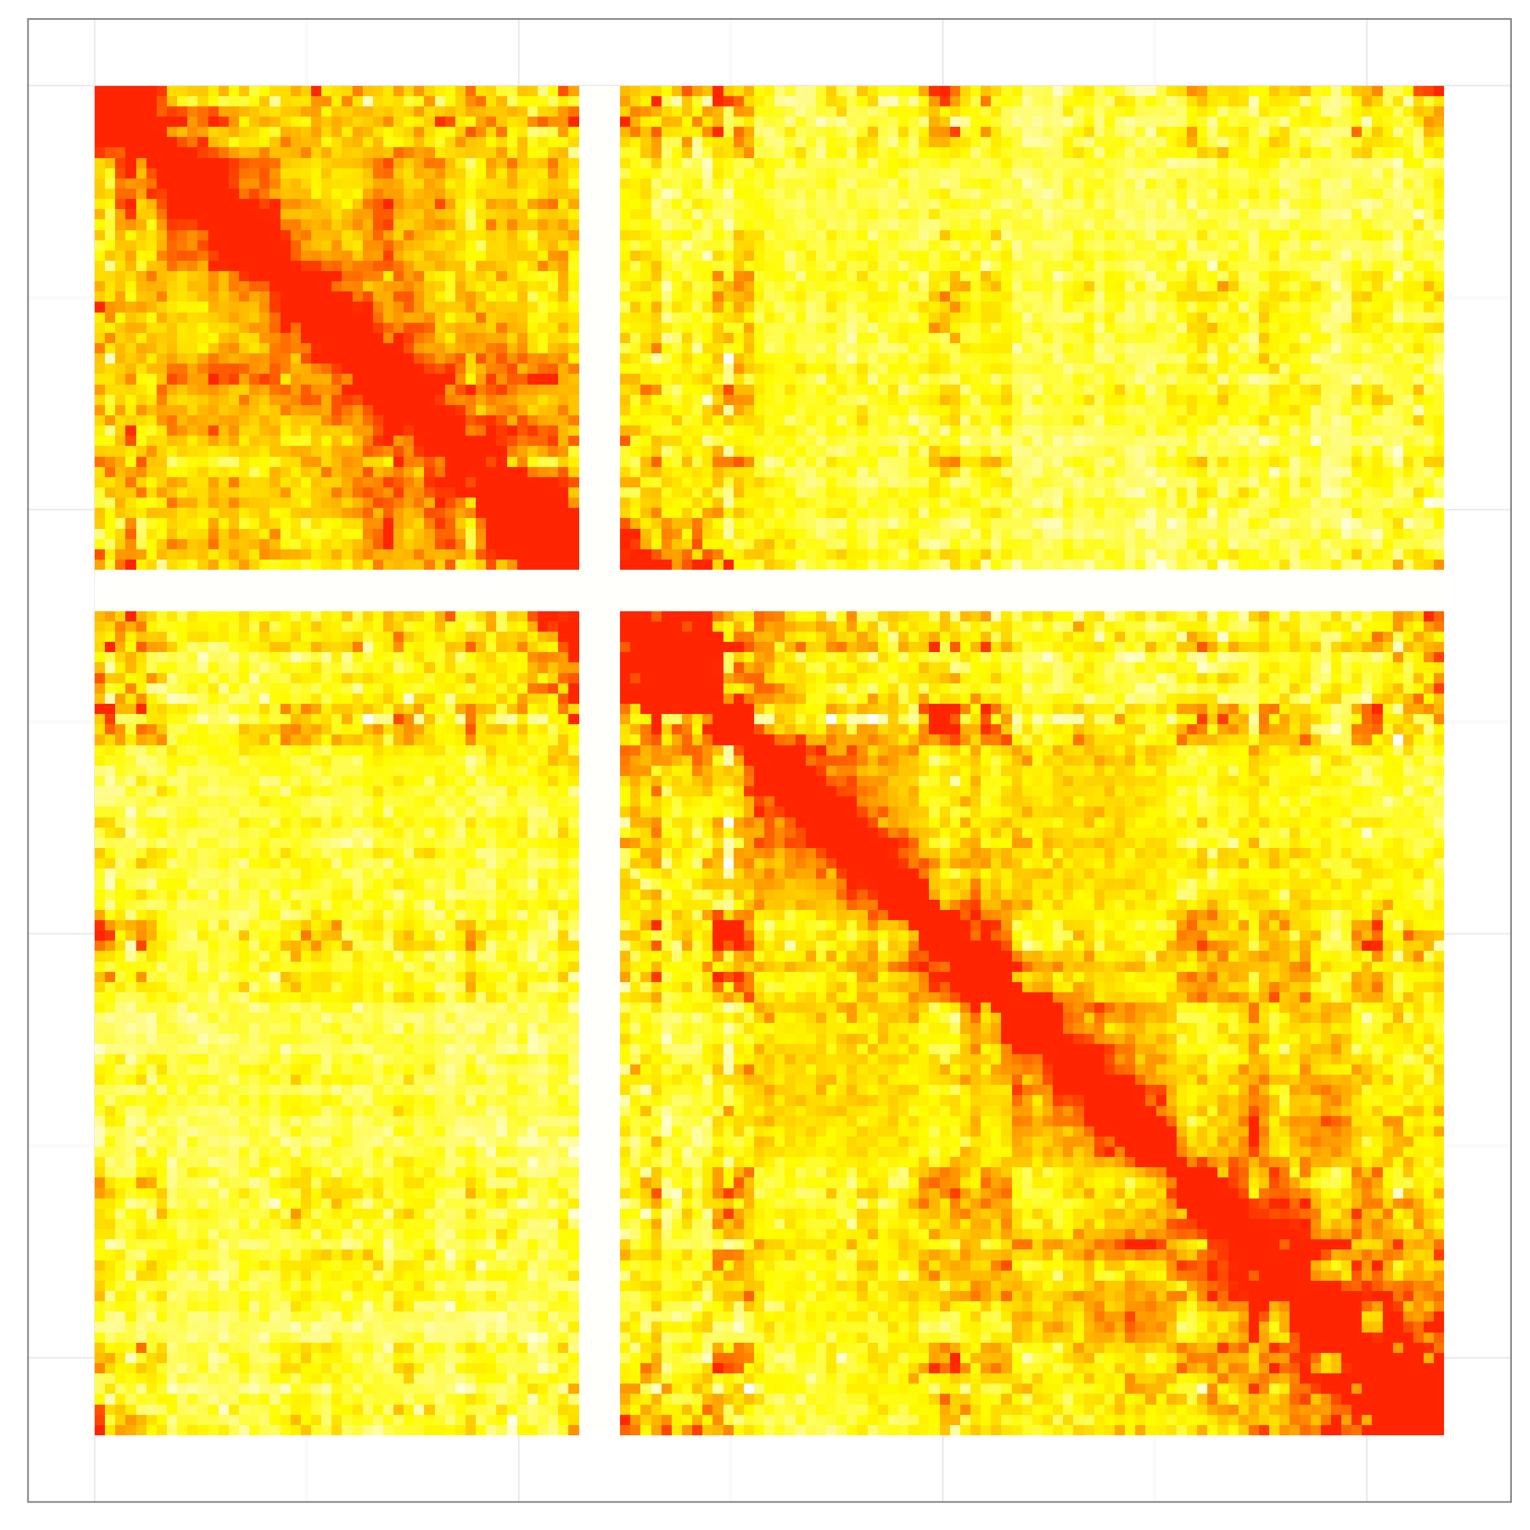
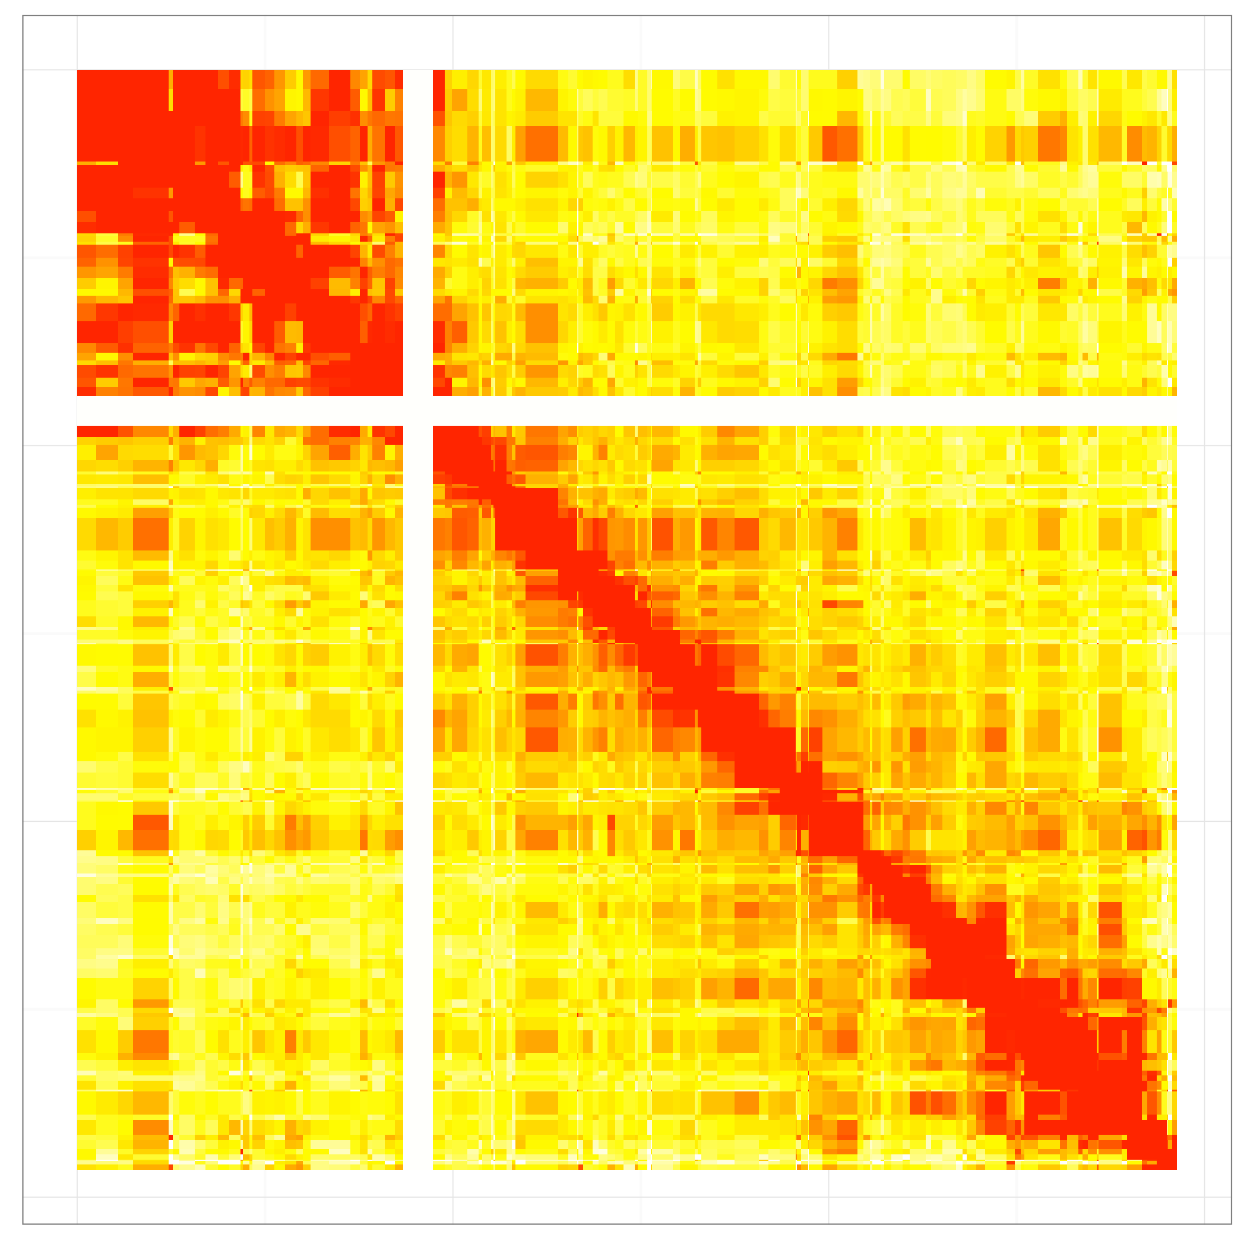
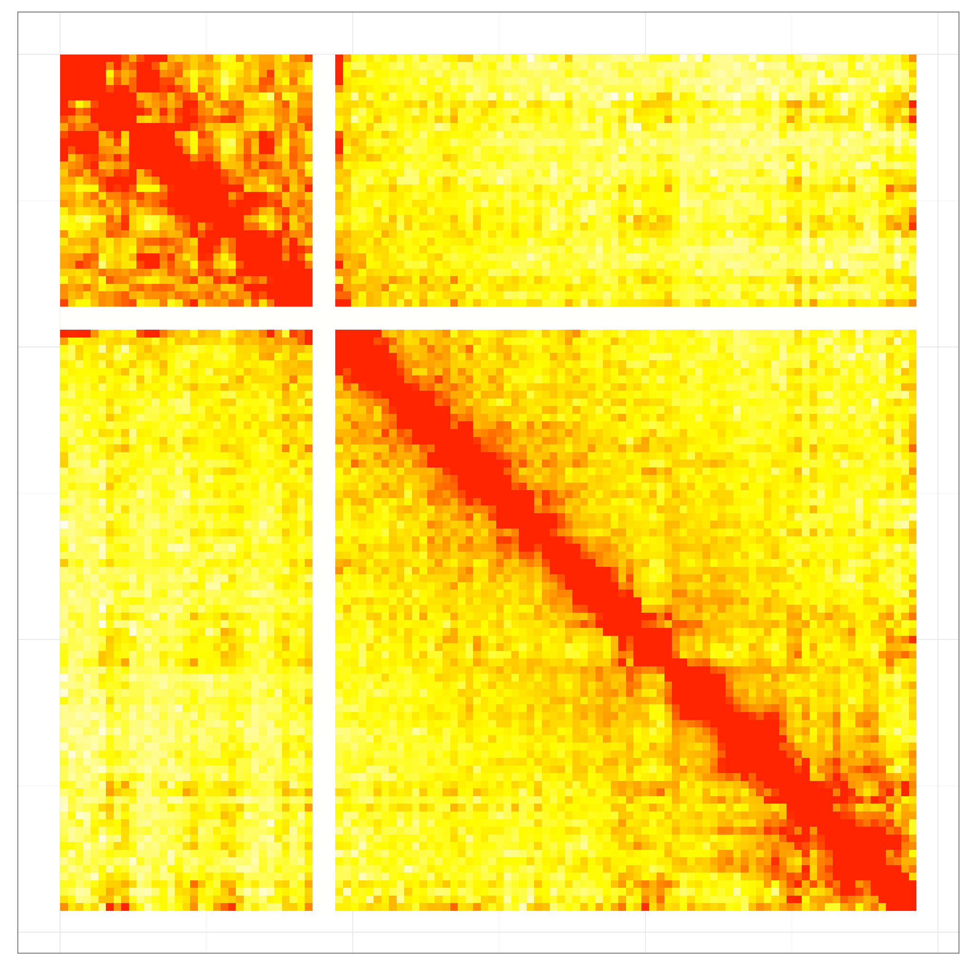
Chr 1
Chr 2
Chr 3
Chr 4
Chr 5
Chr 6
Chr 7
Chr 8
Figure S4. Comparison of contact maps between CCD biased binning and uniform size binning schemes. For each chromosome contact maps were generated using CCD biased binning (left) and uniform size binning (right) schemes. The sizes of tiles in the contact maps correspond to their genomic lengths. The same color scale was used for both contact maps in each chromosome.

Slide 6
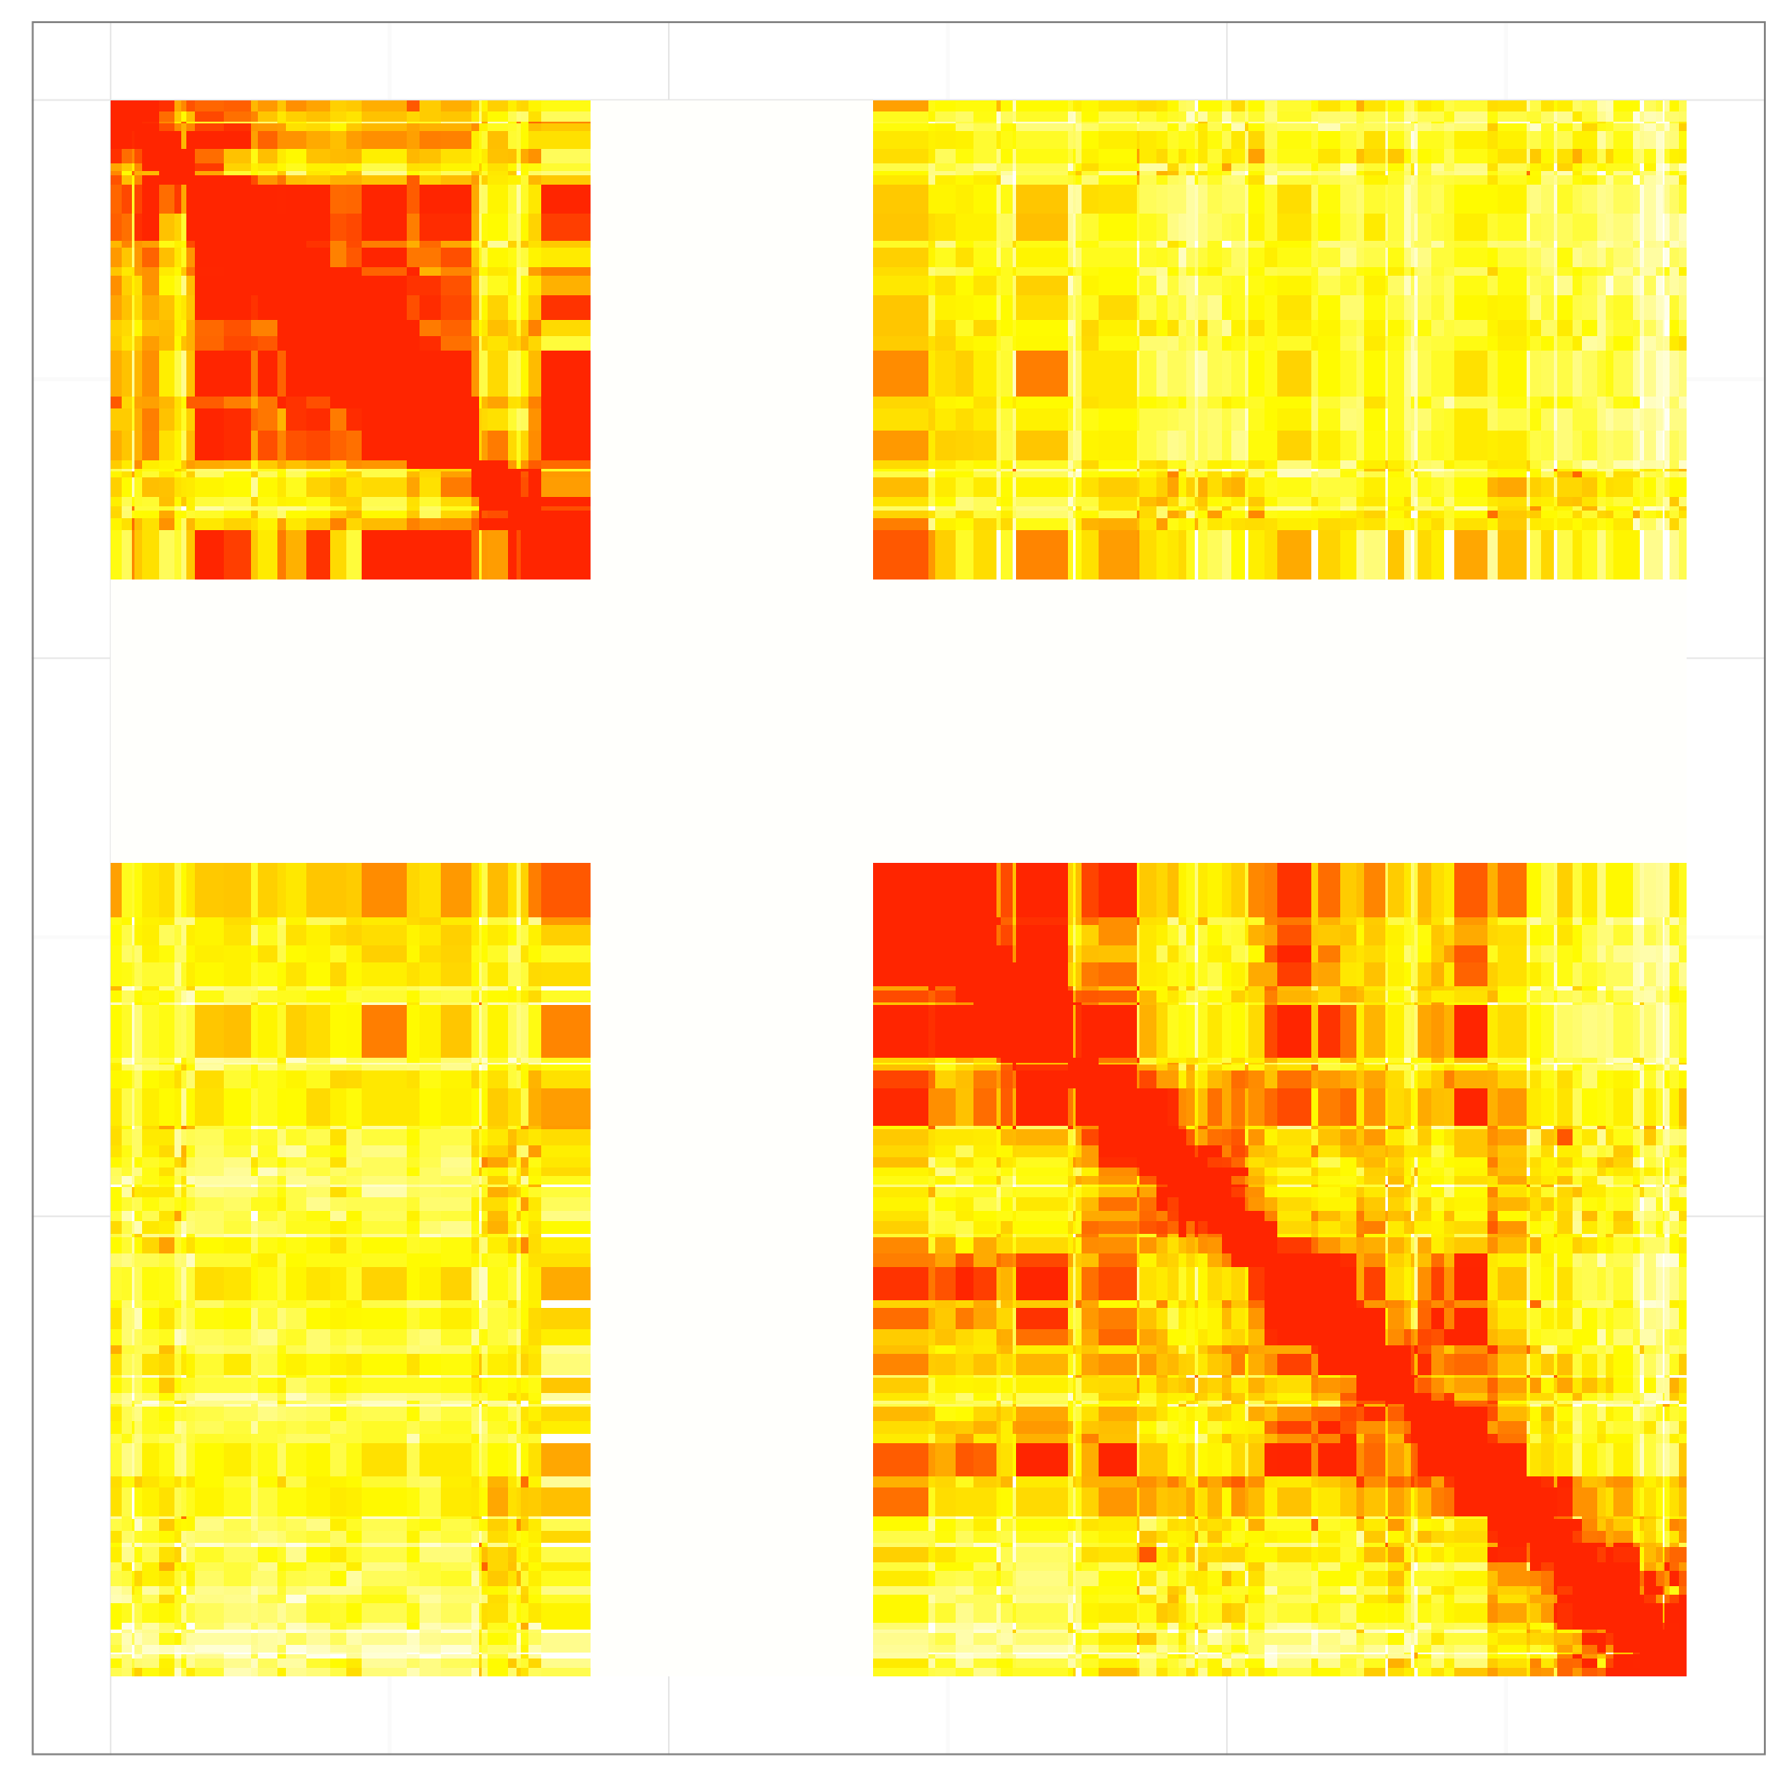
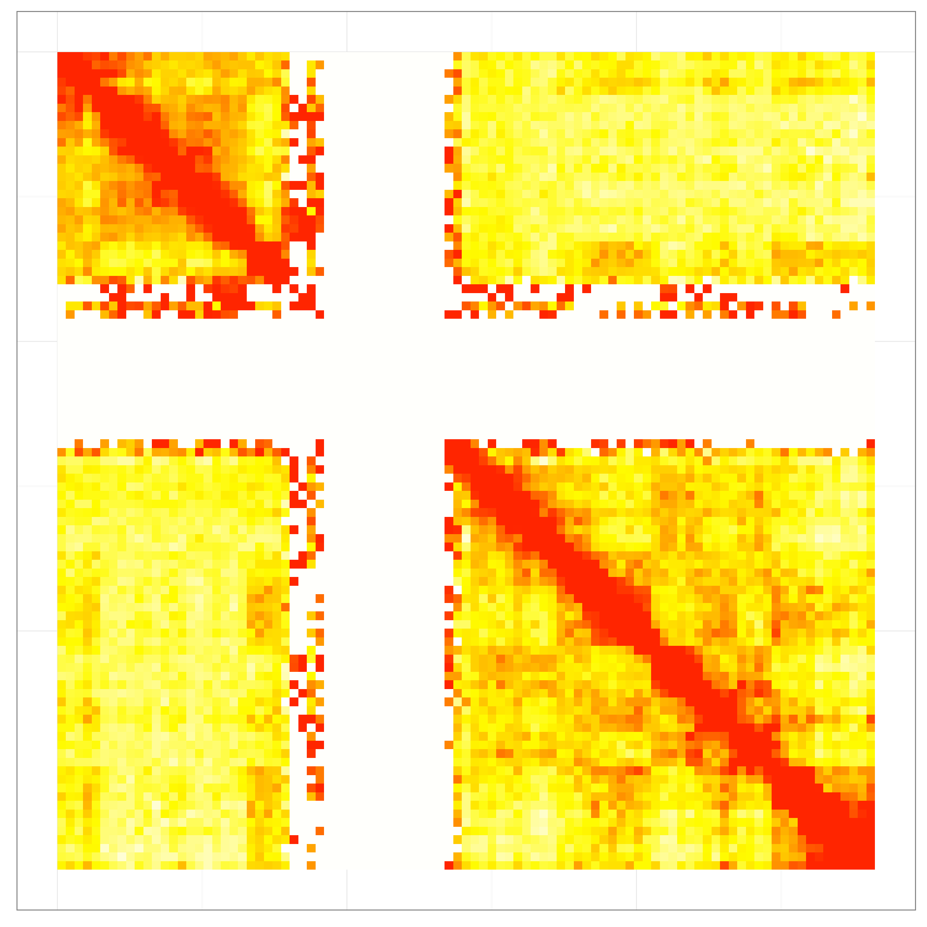
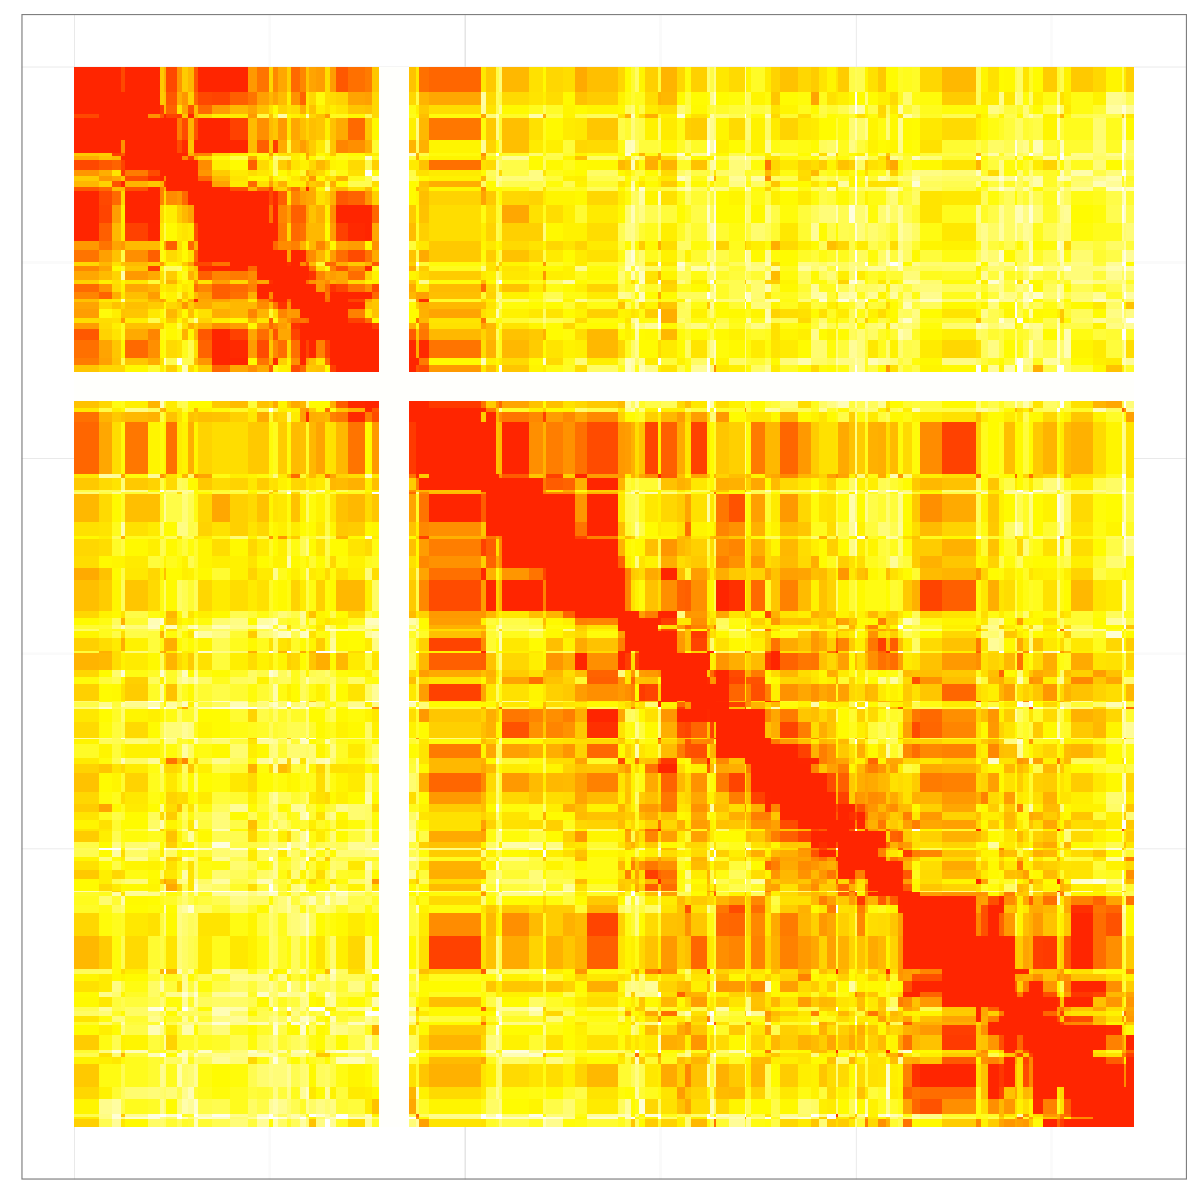
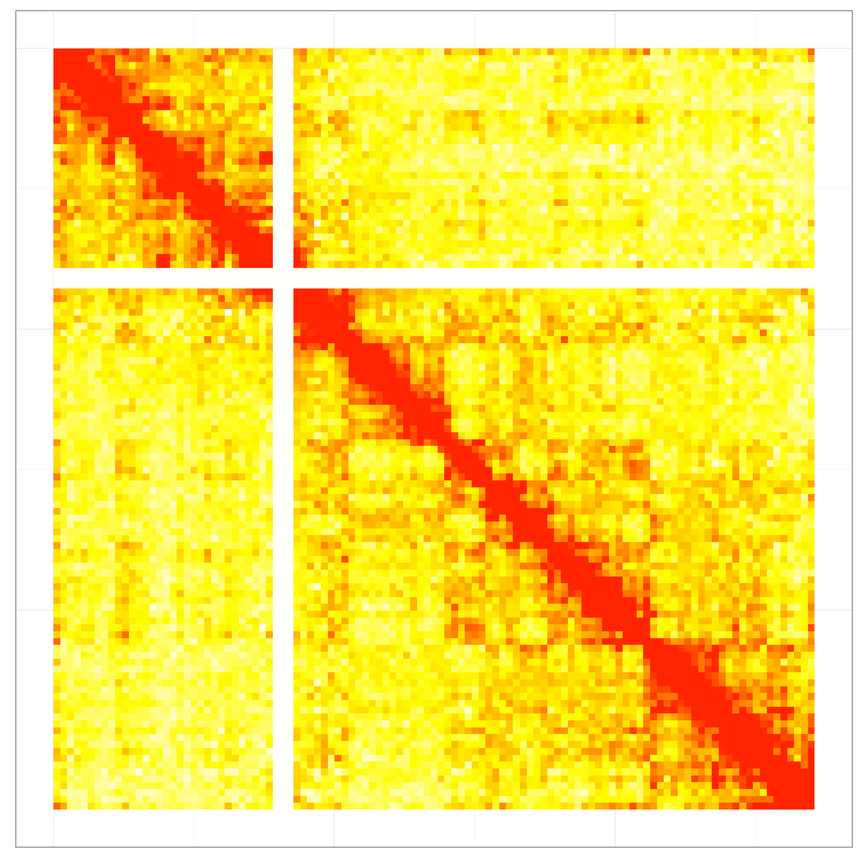
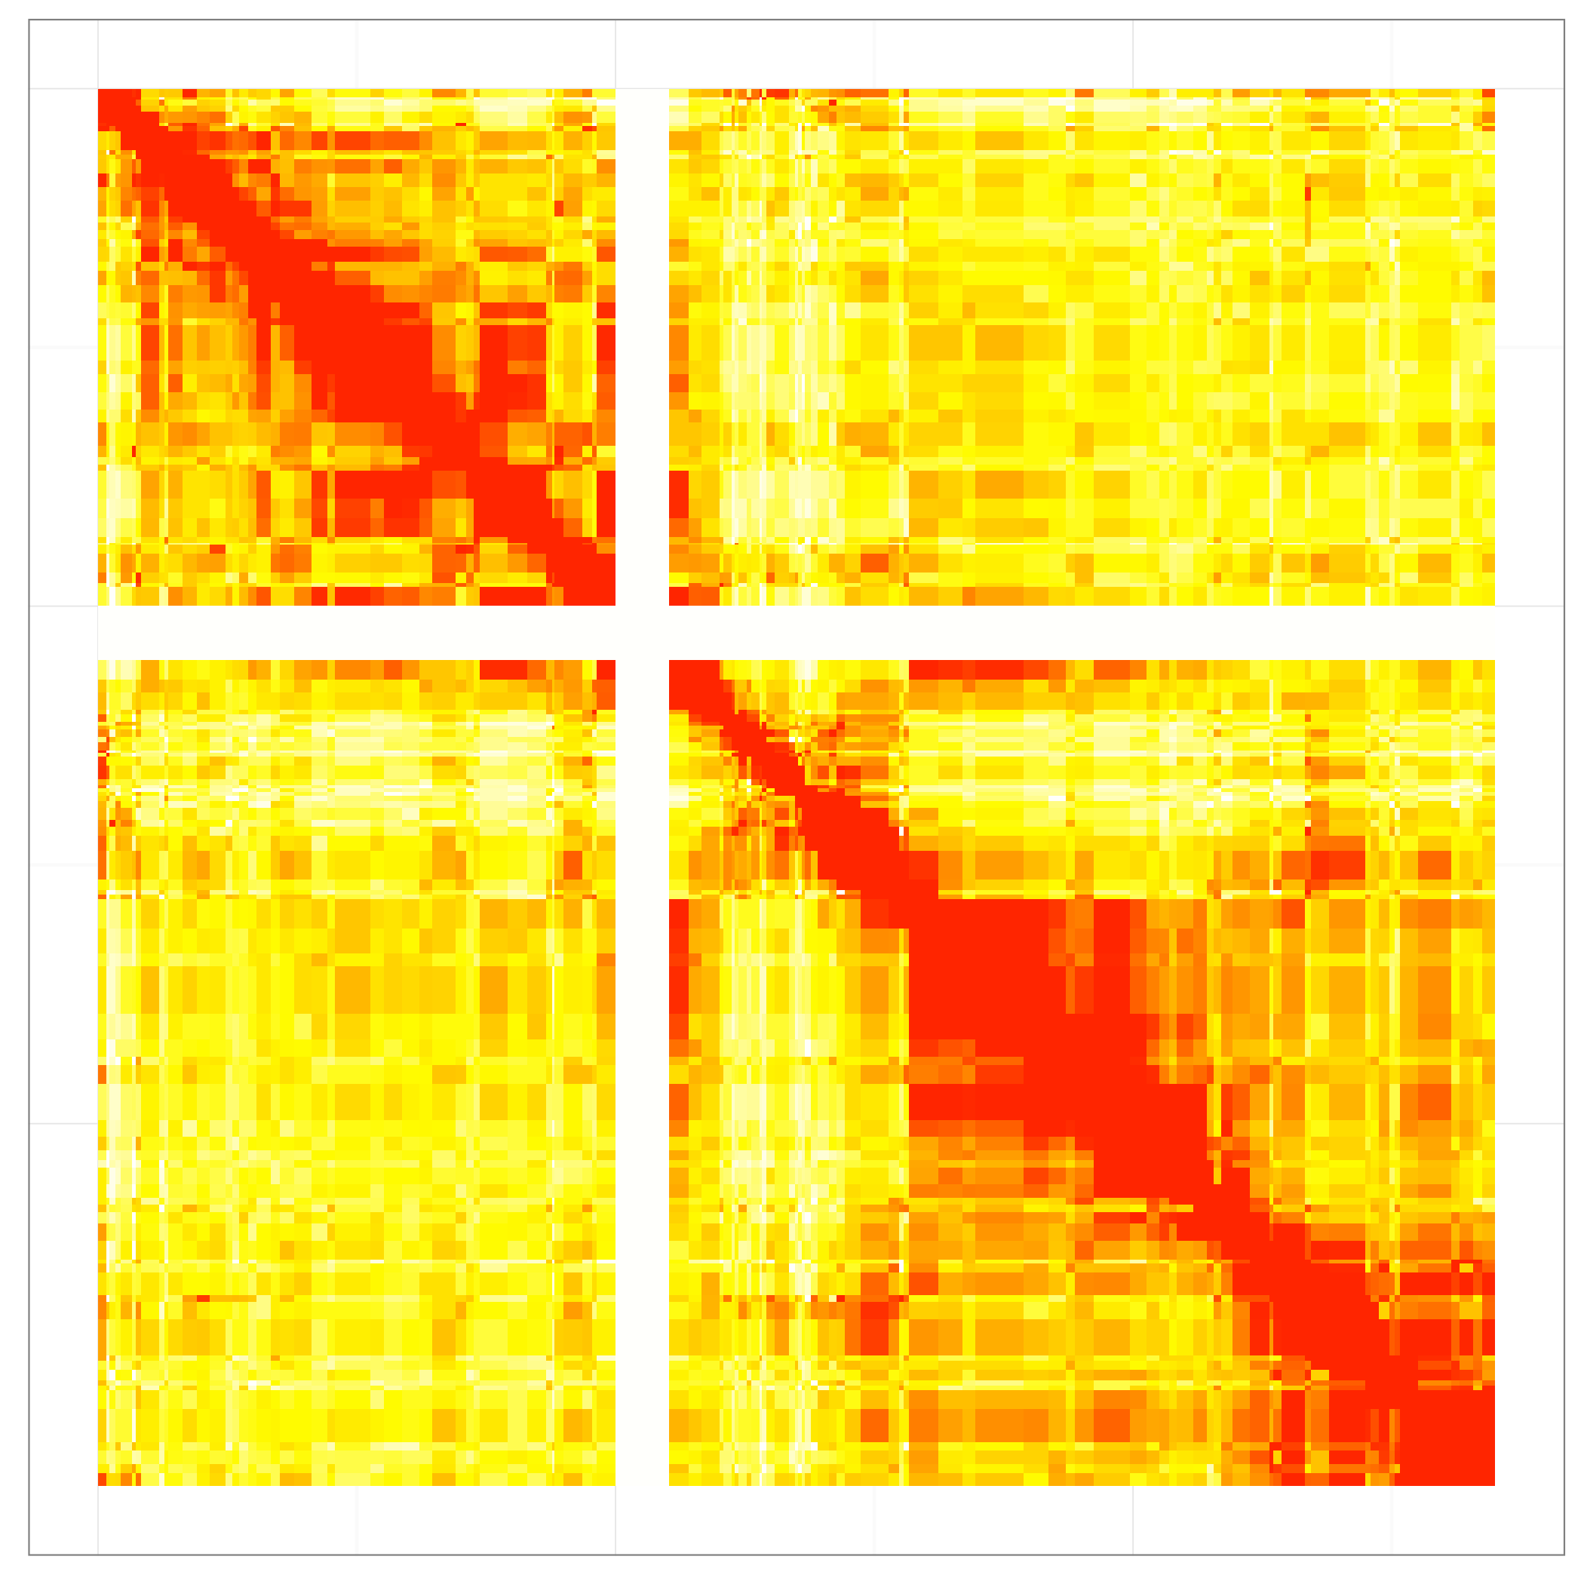
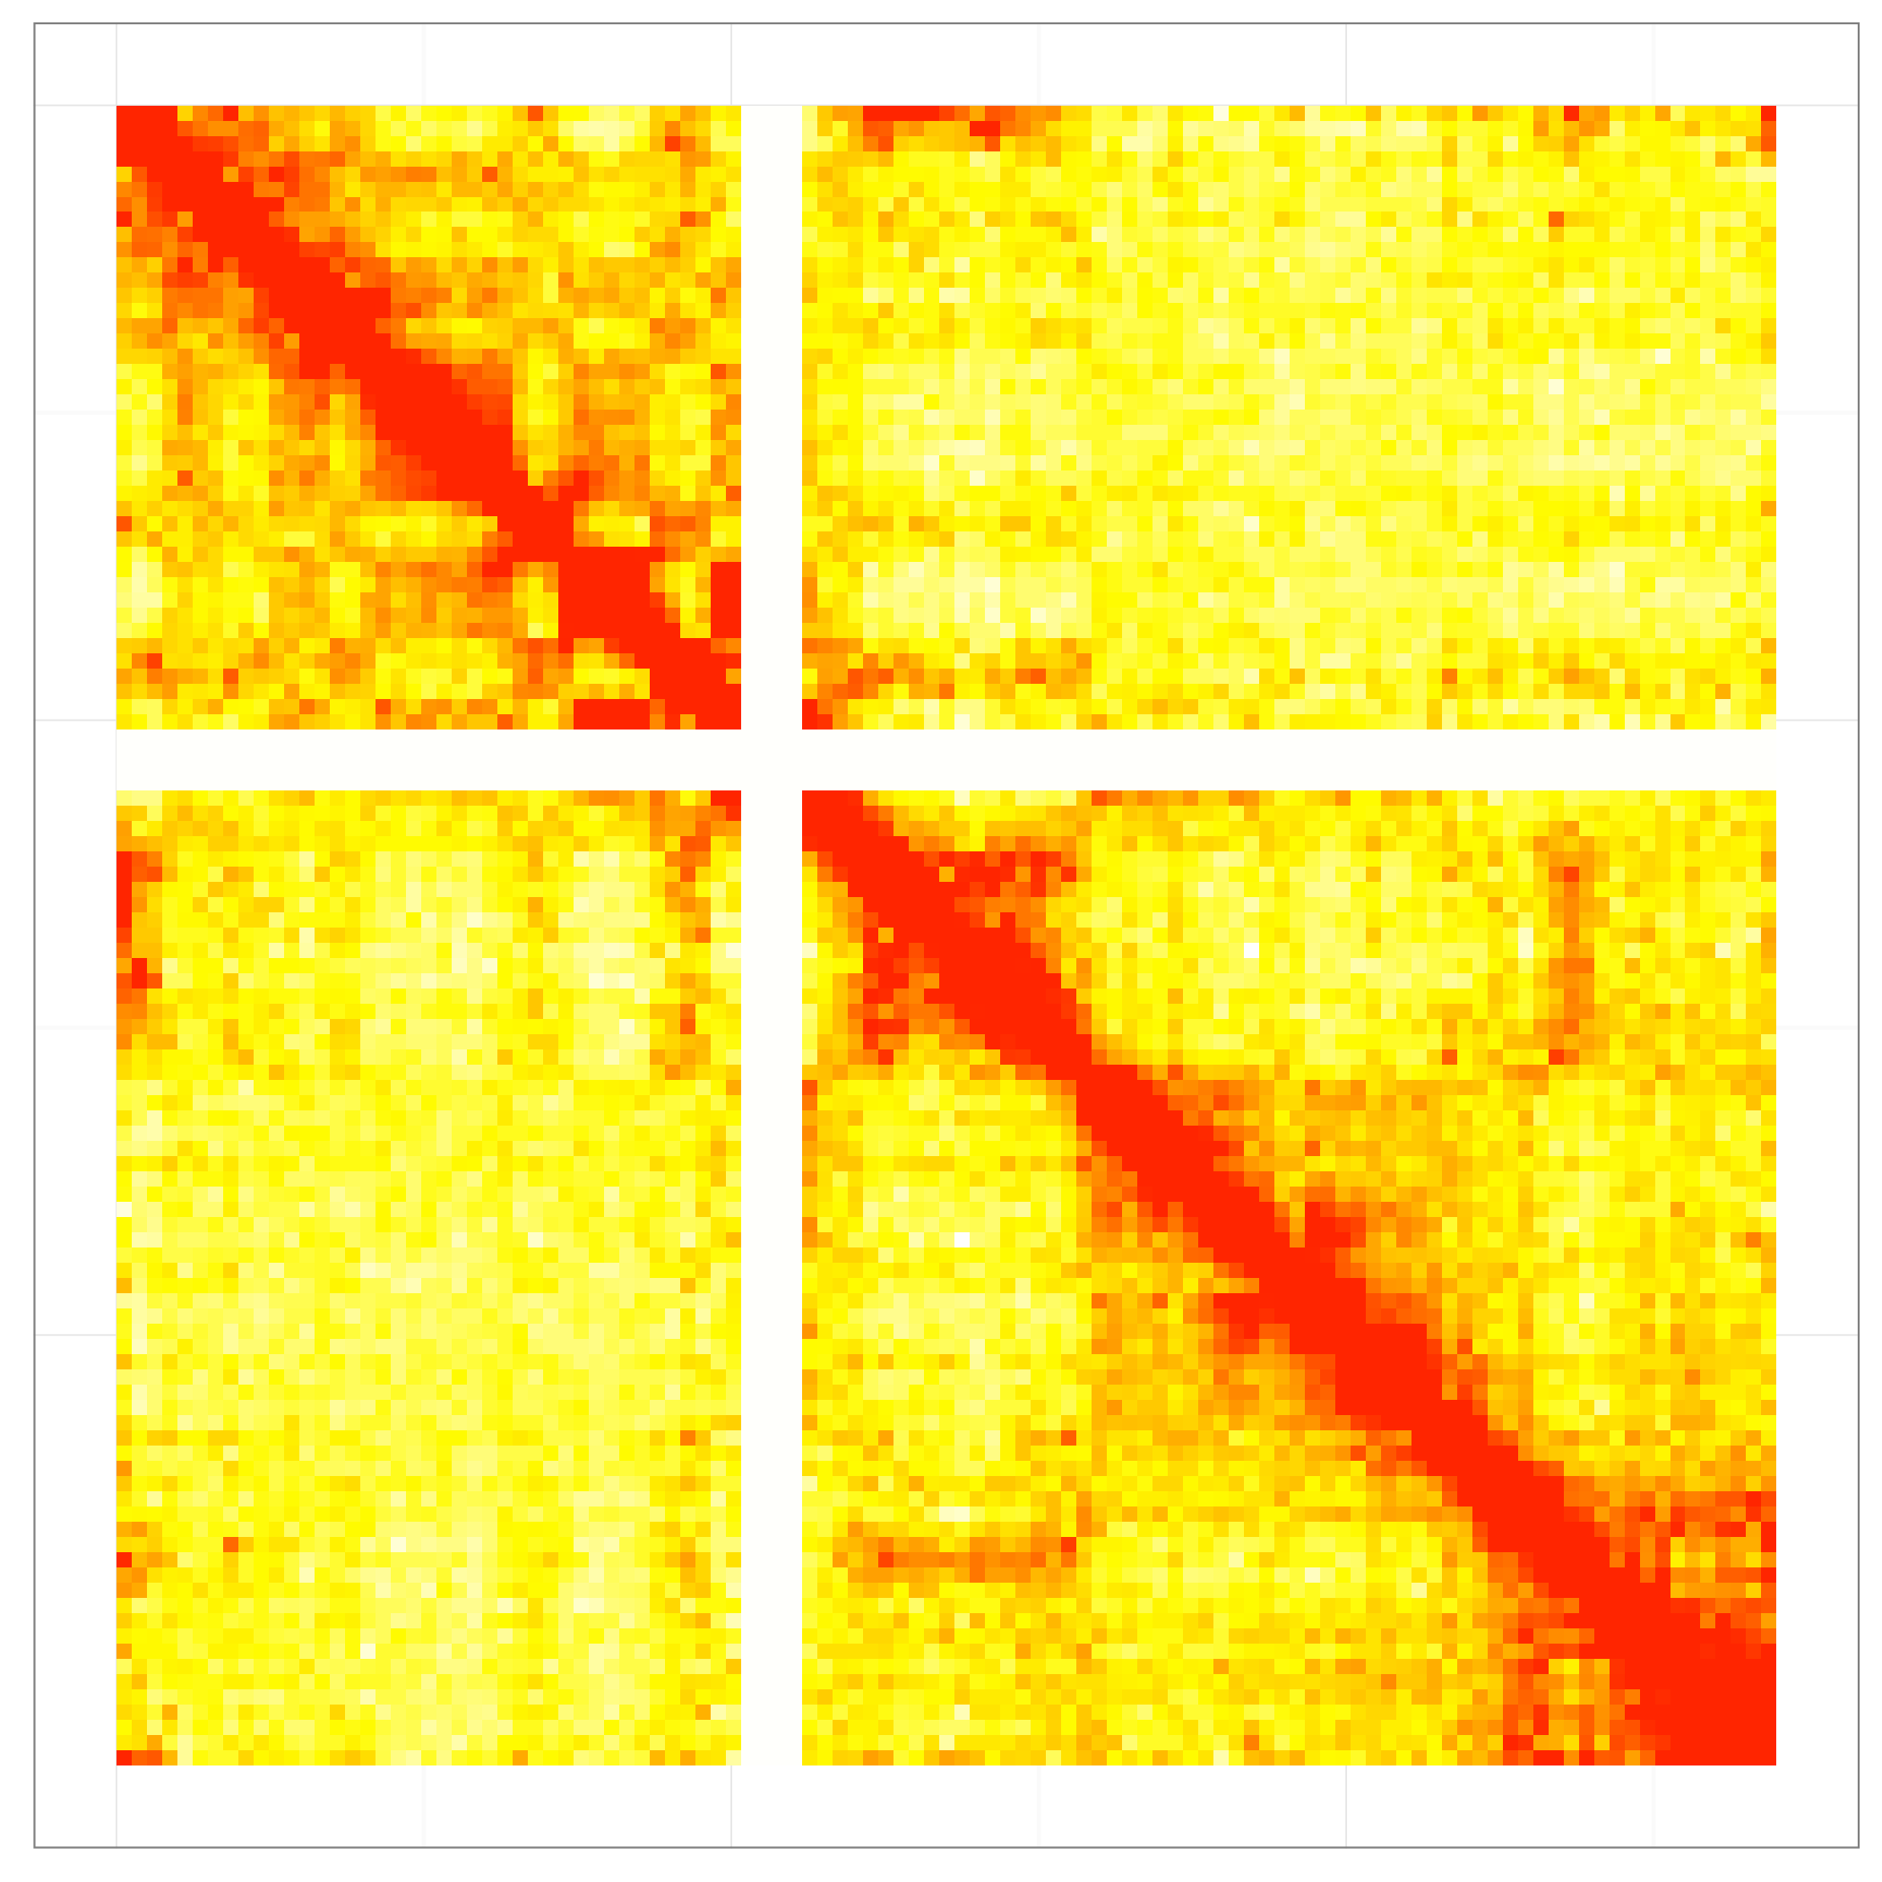
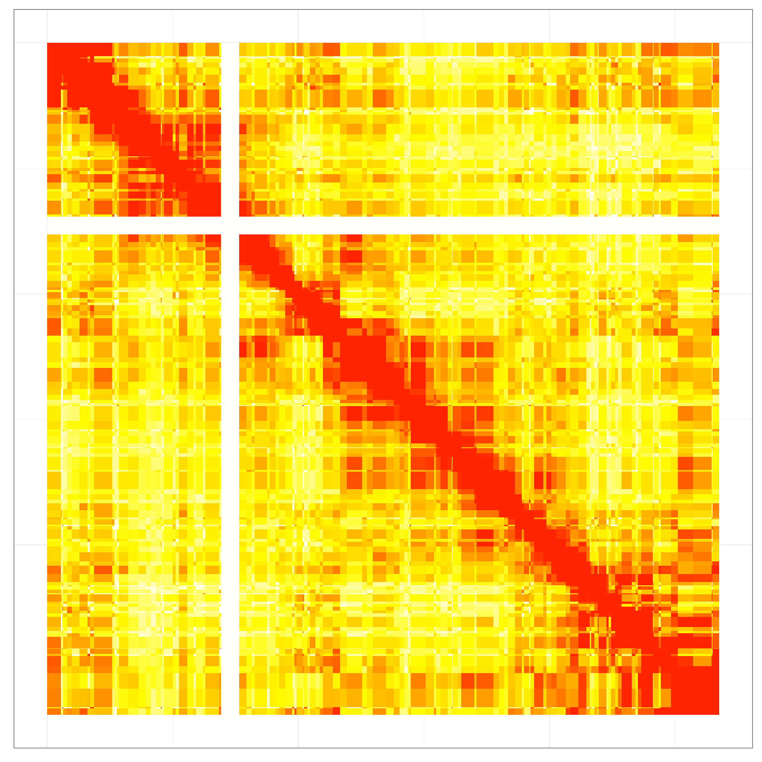
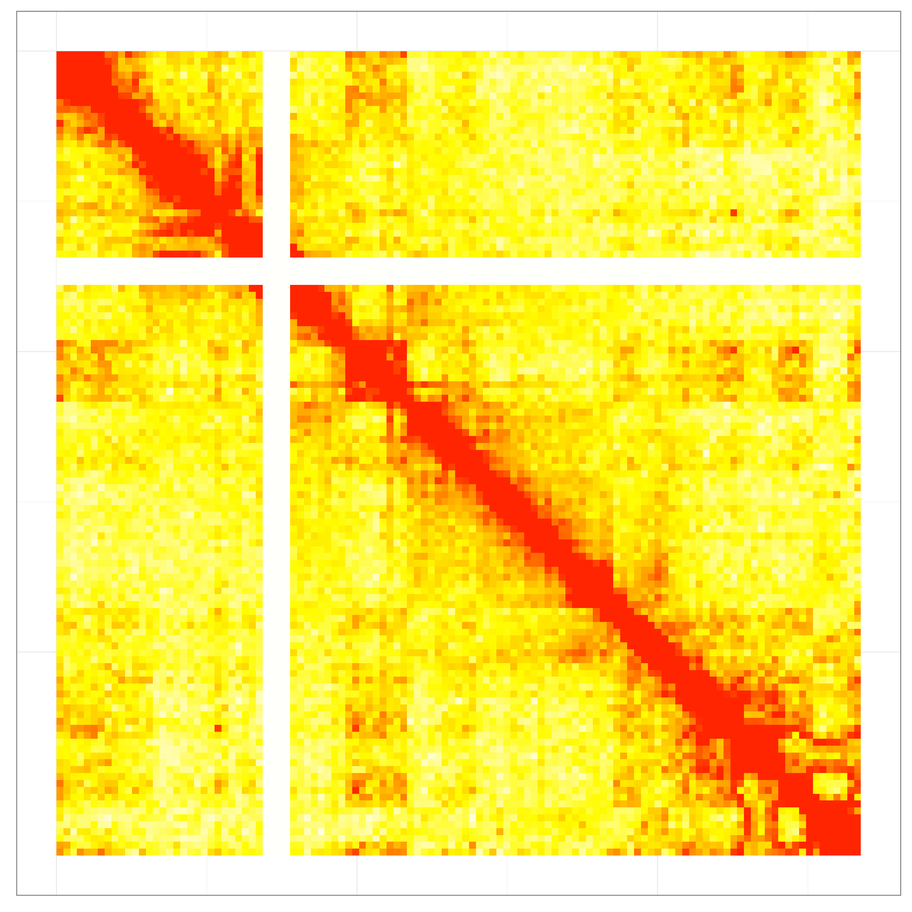
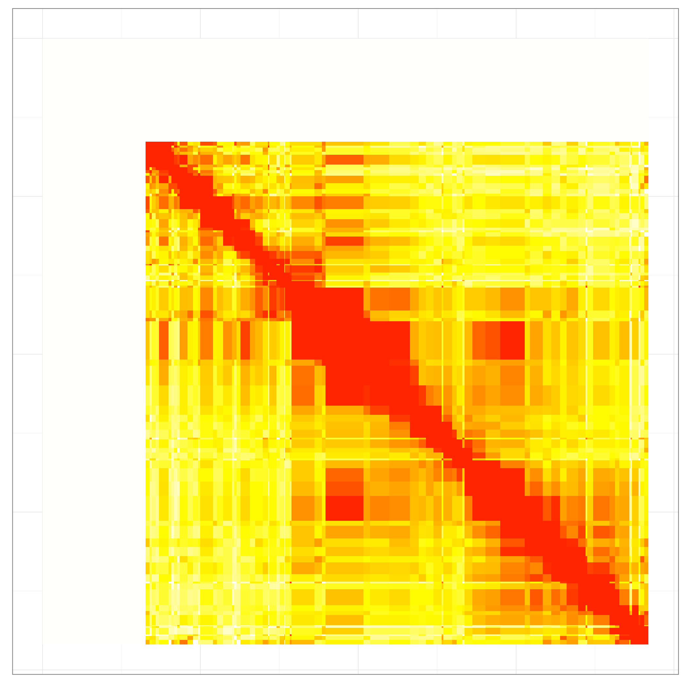
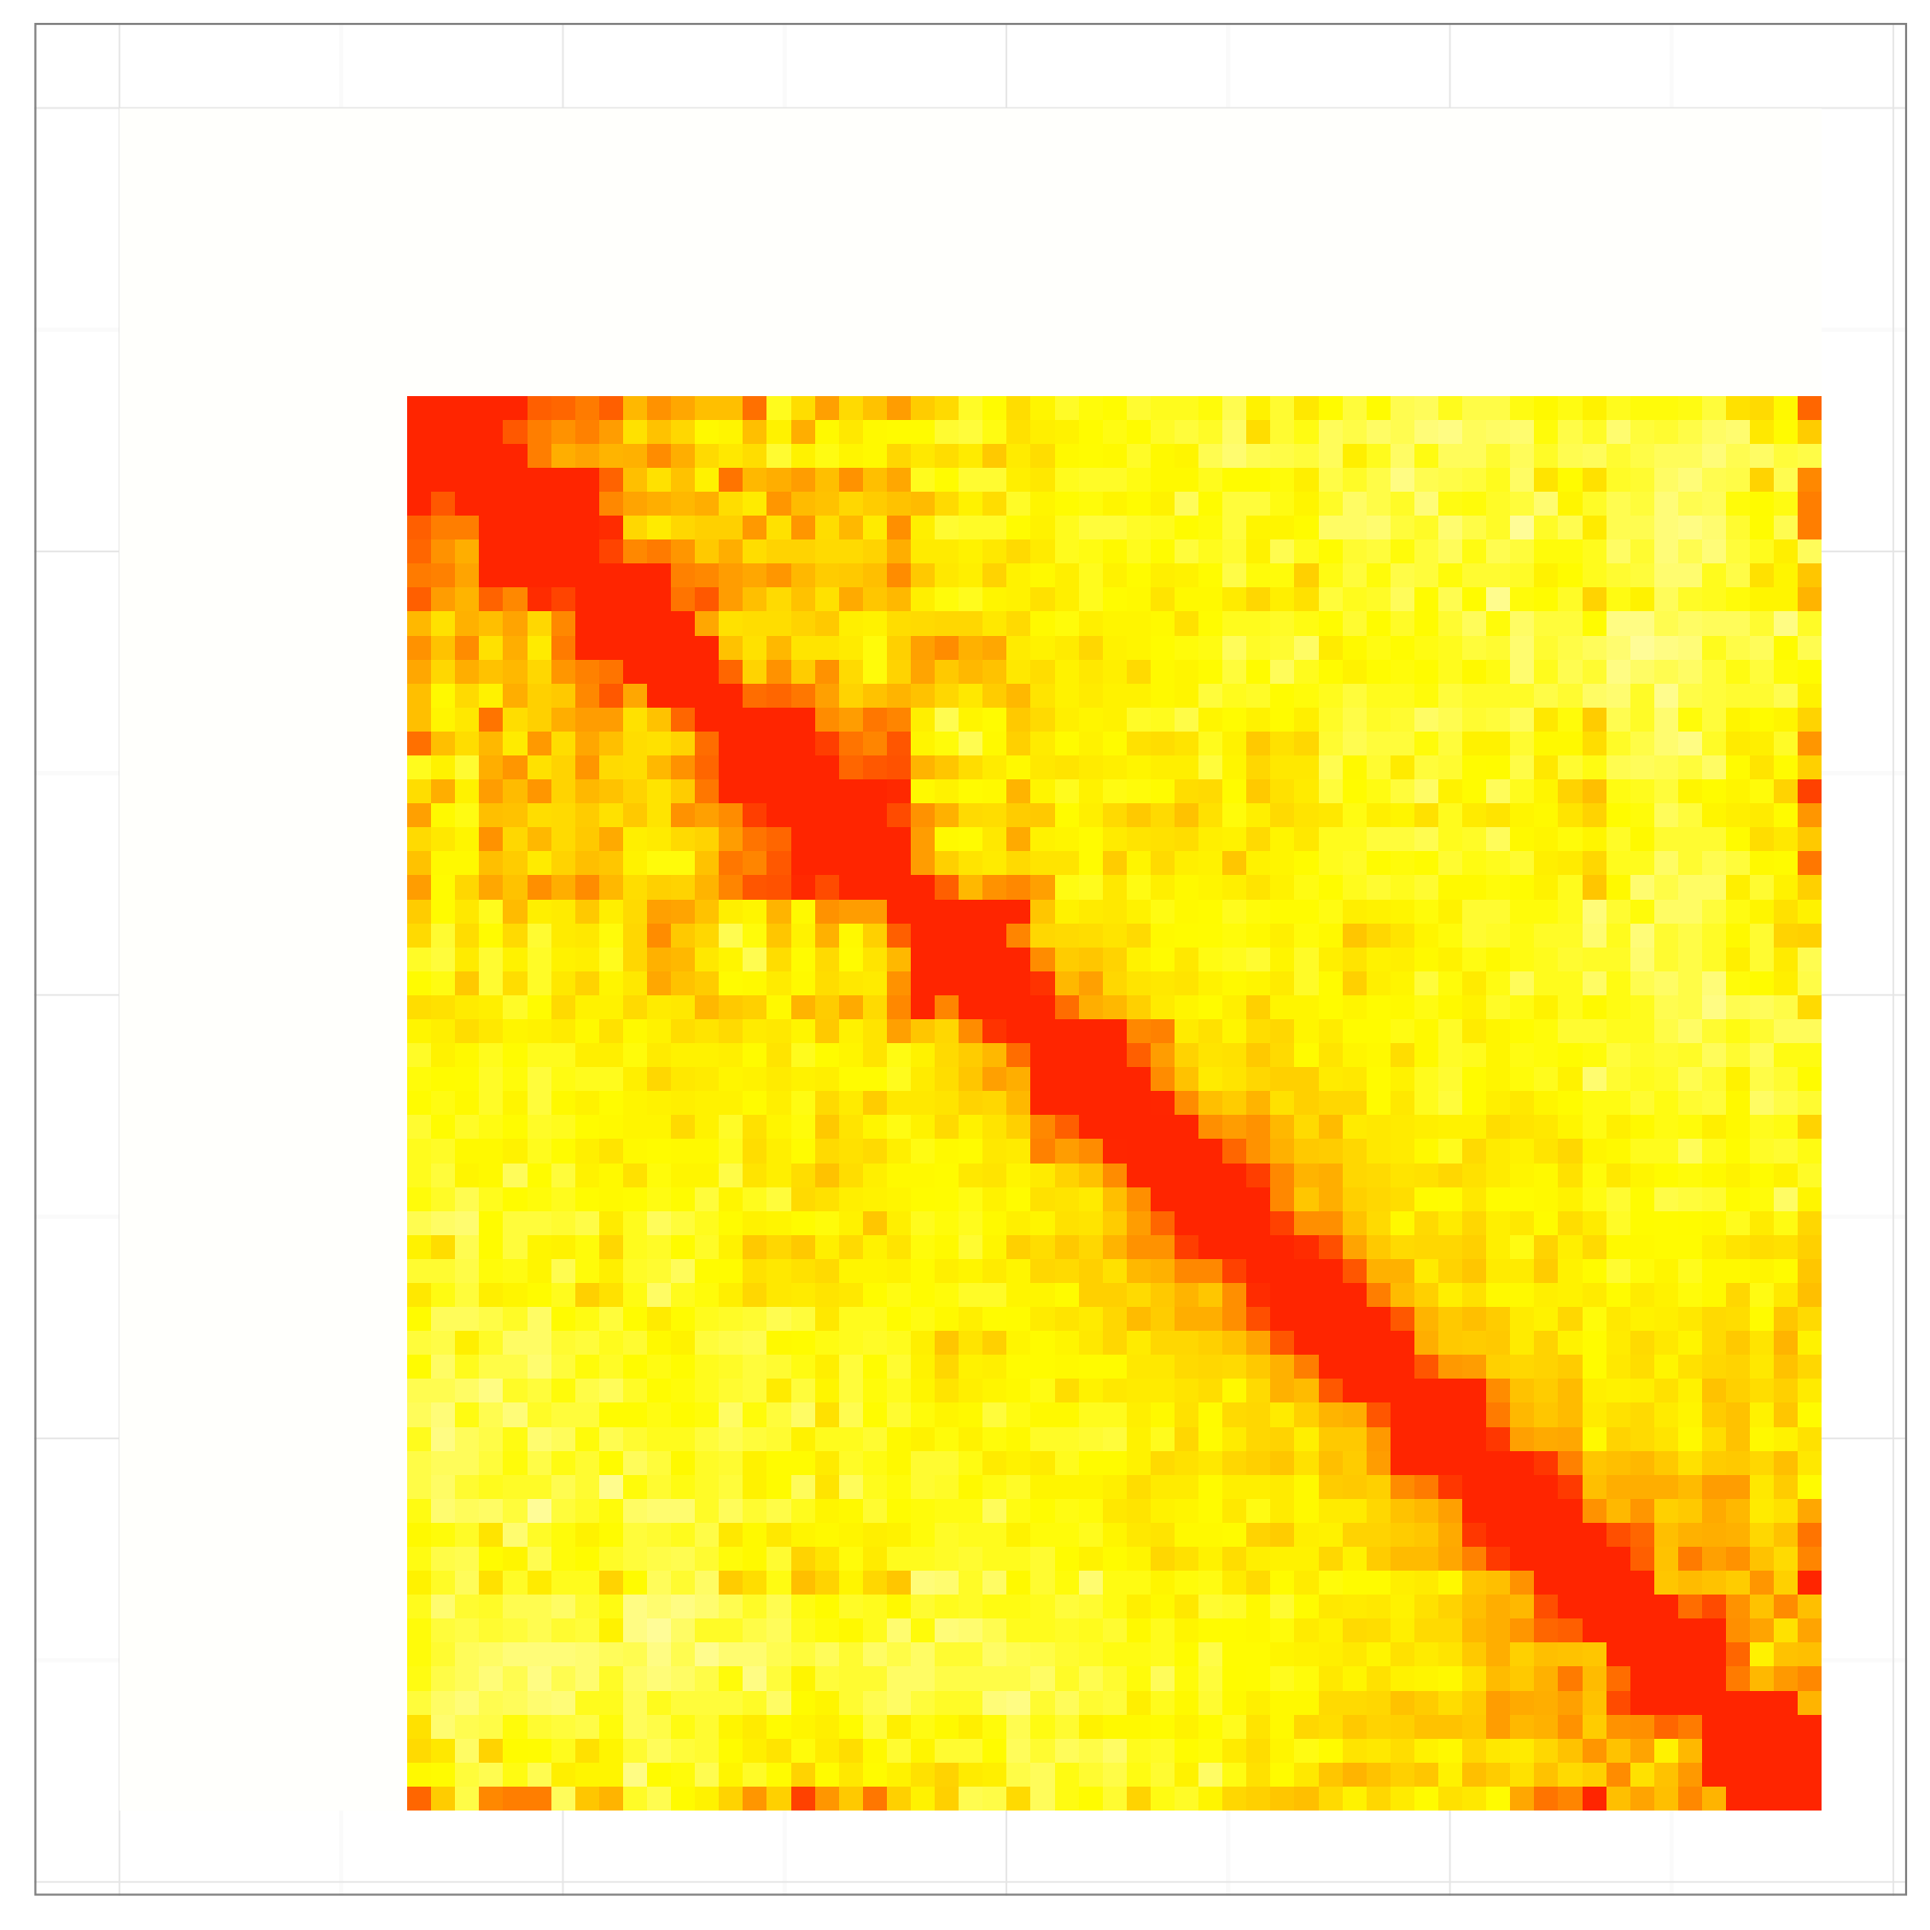
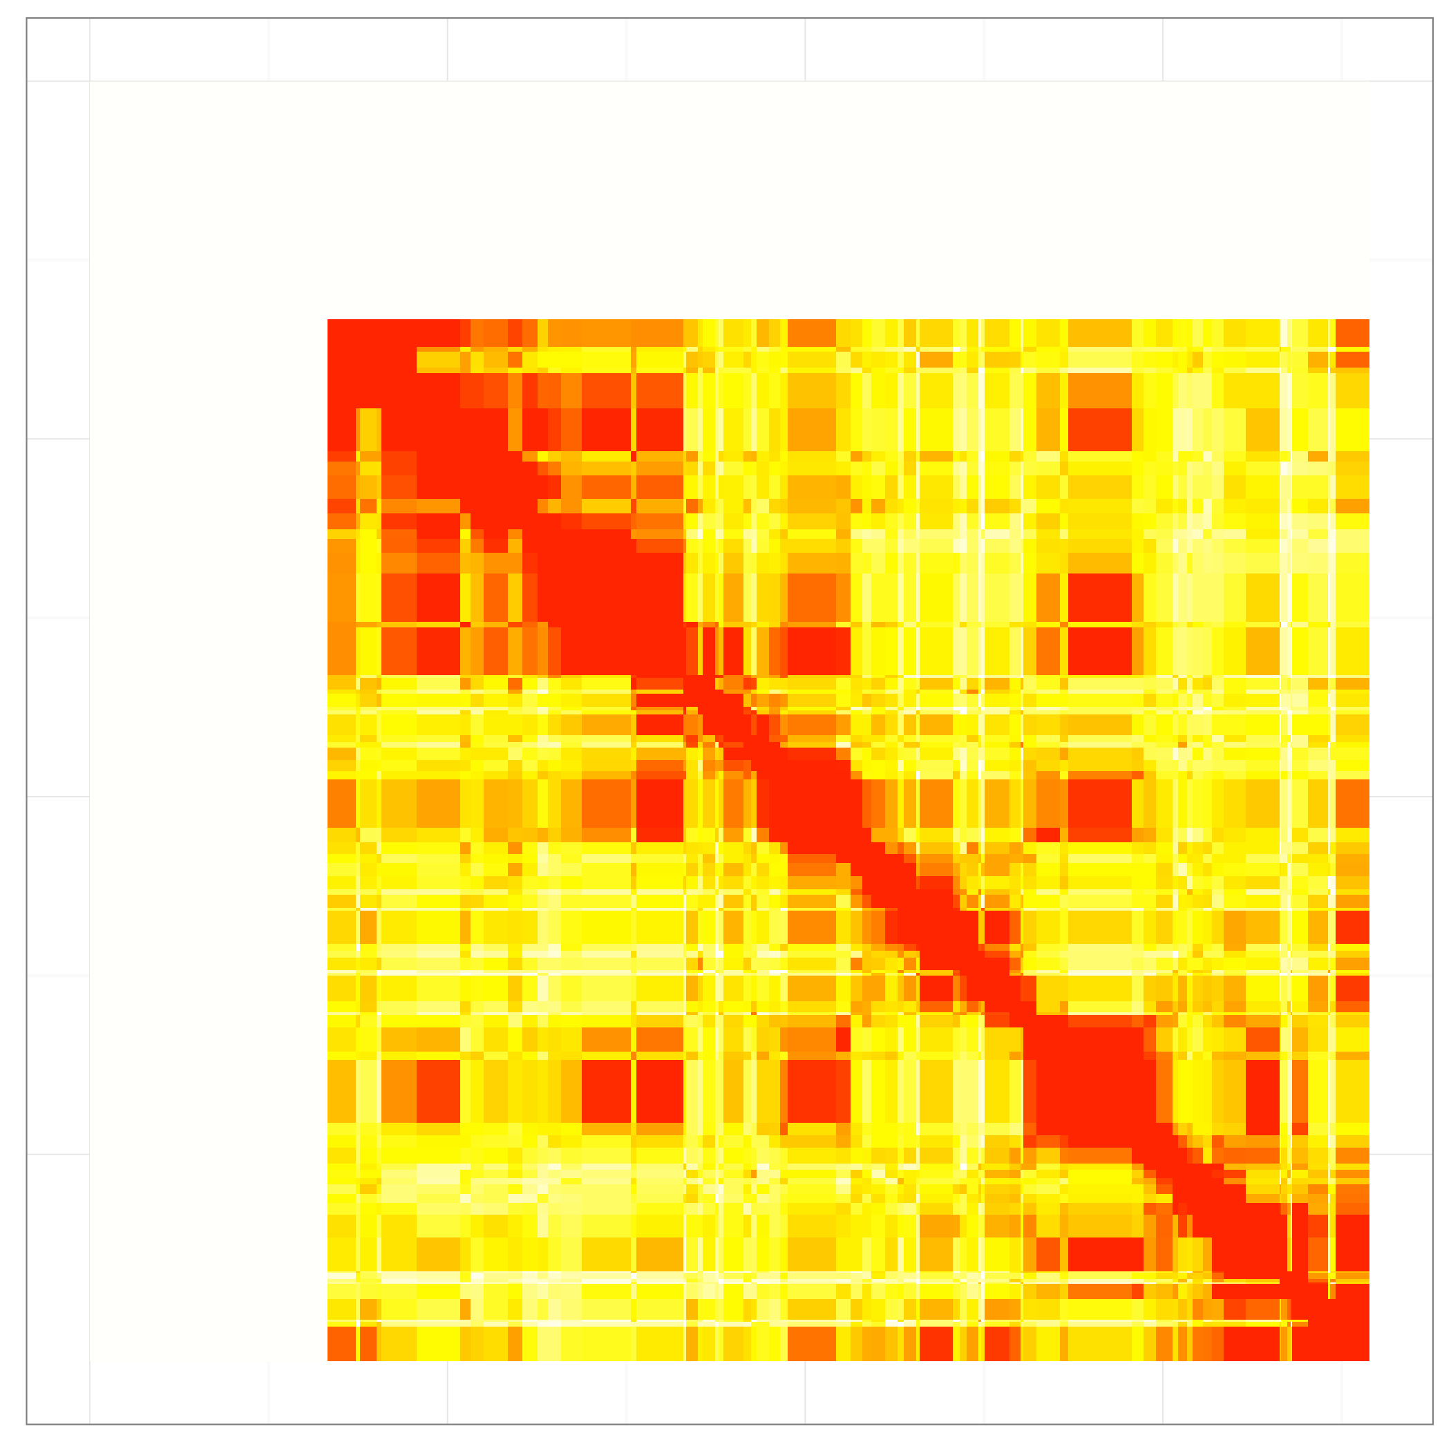
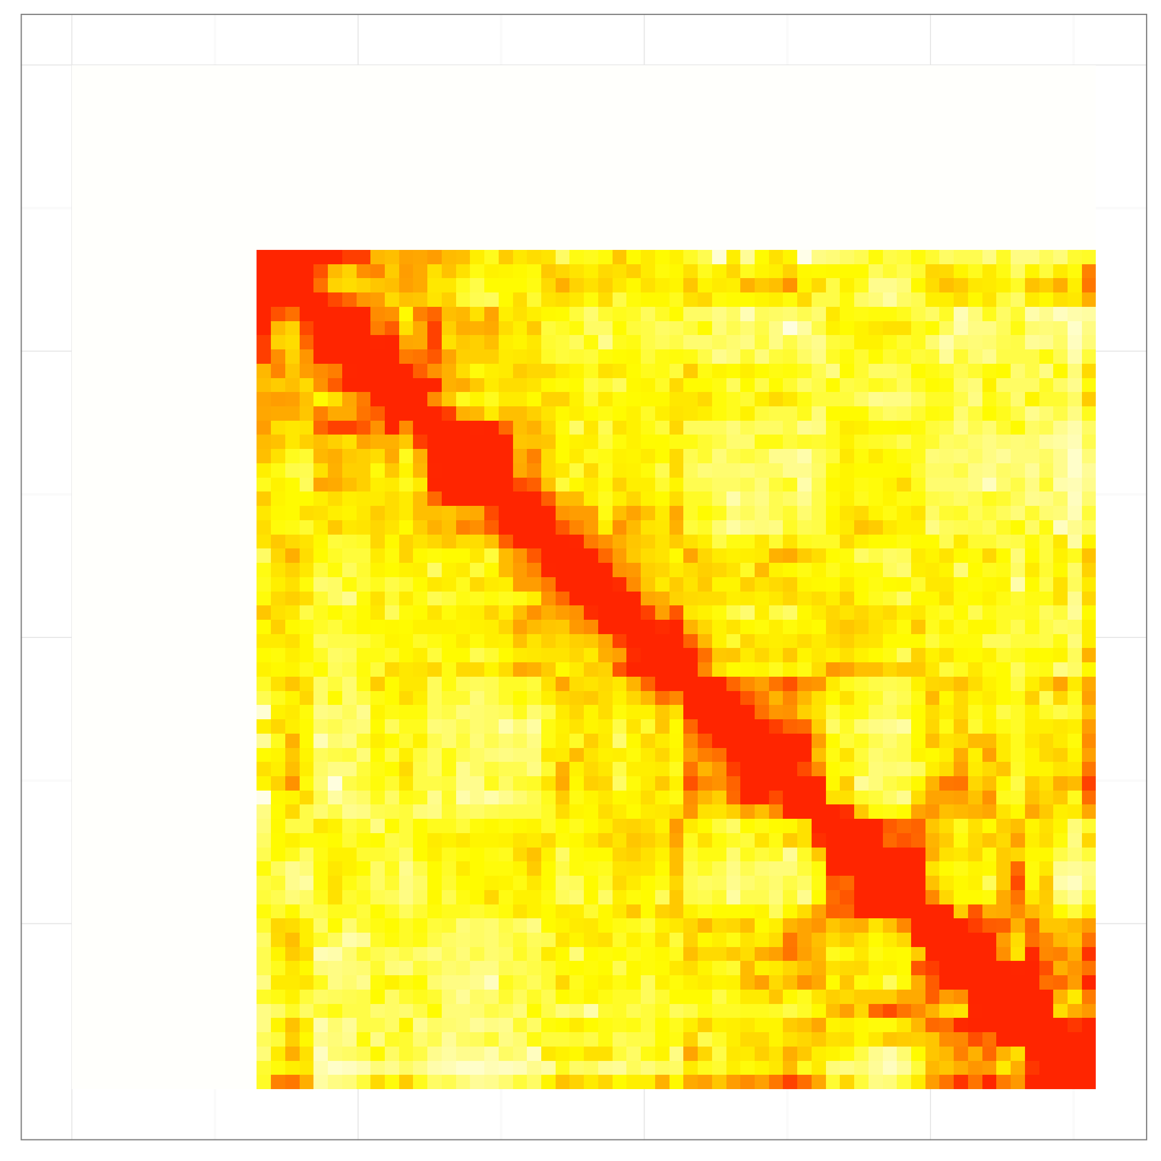
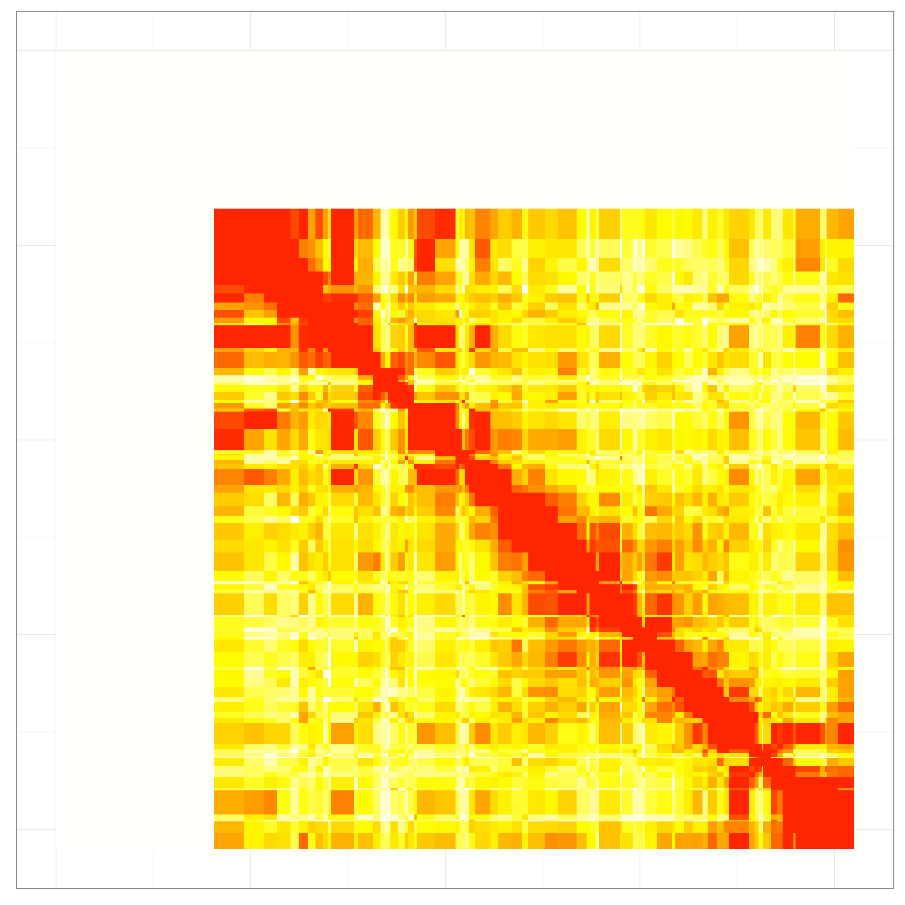
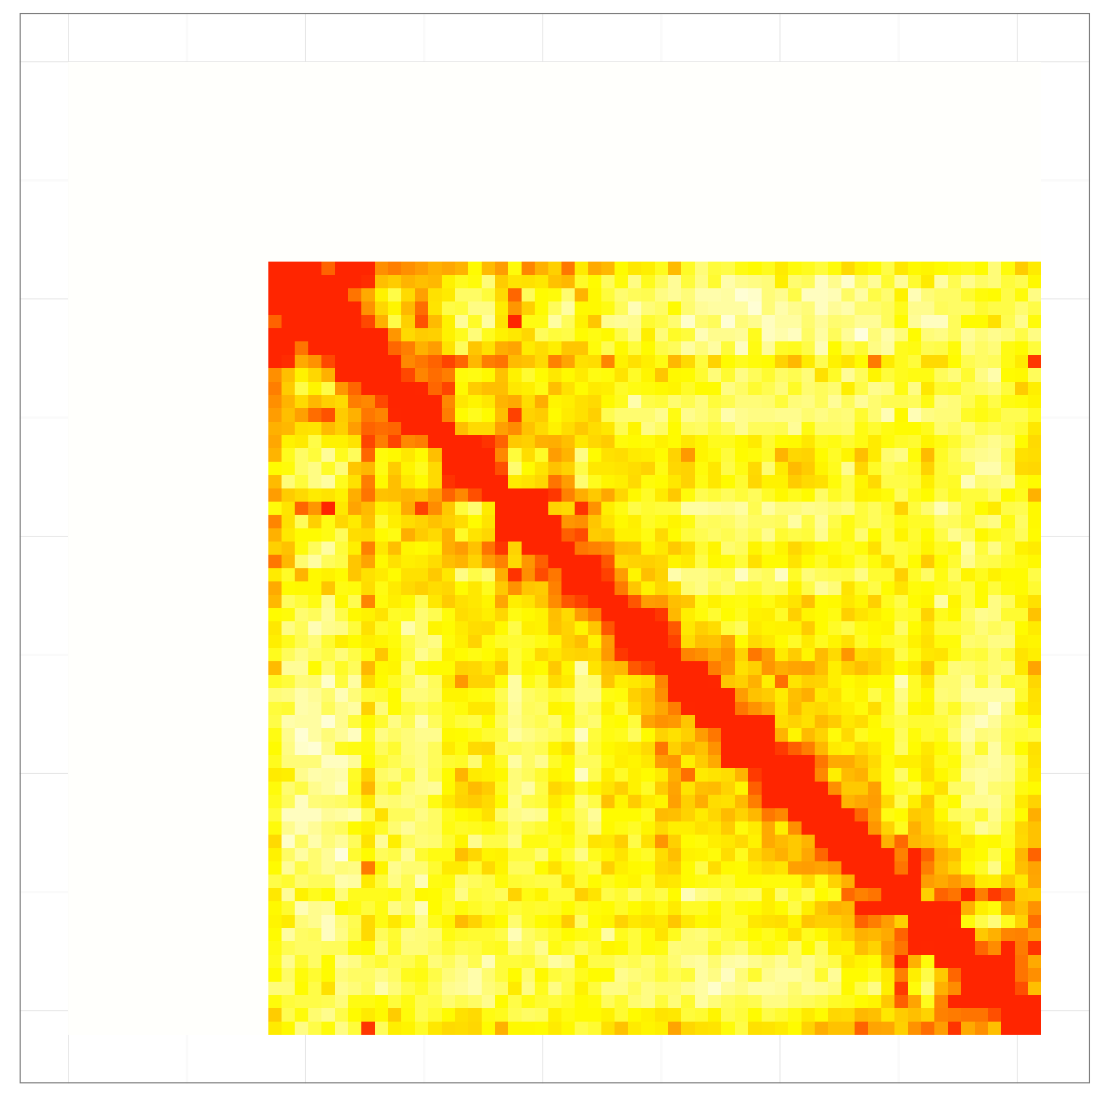
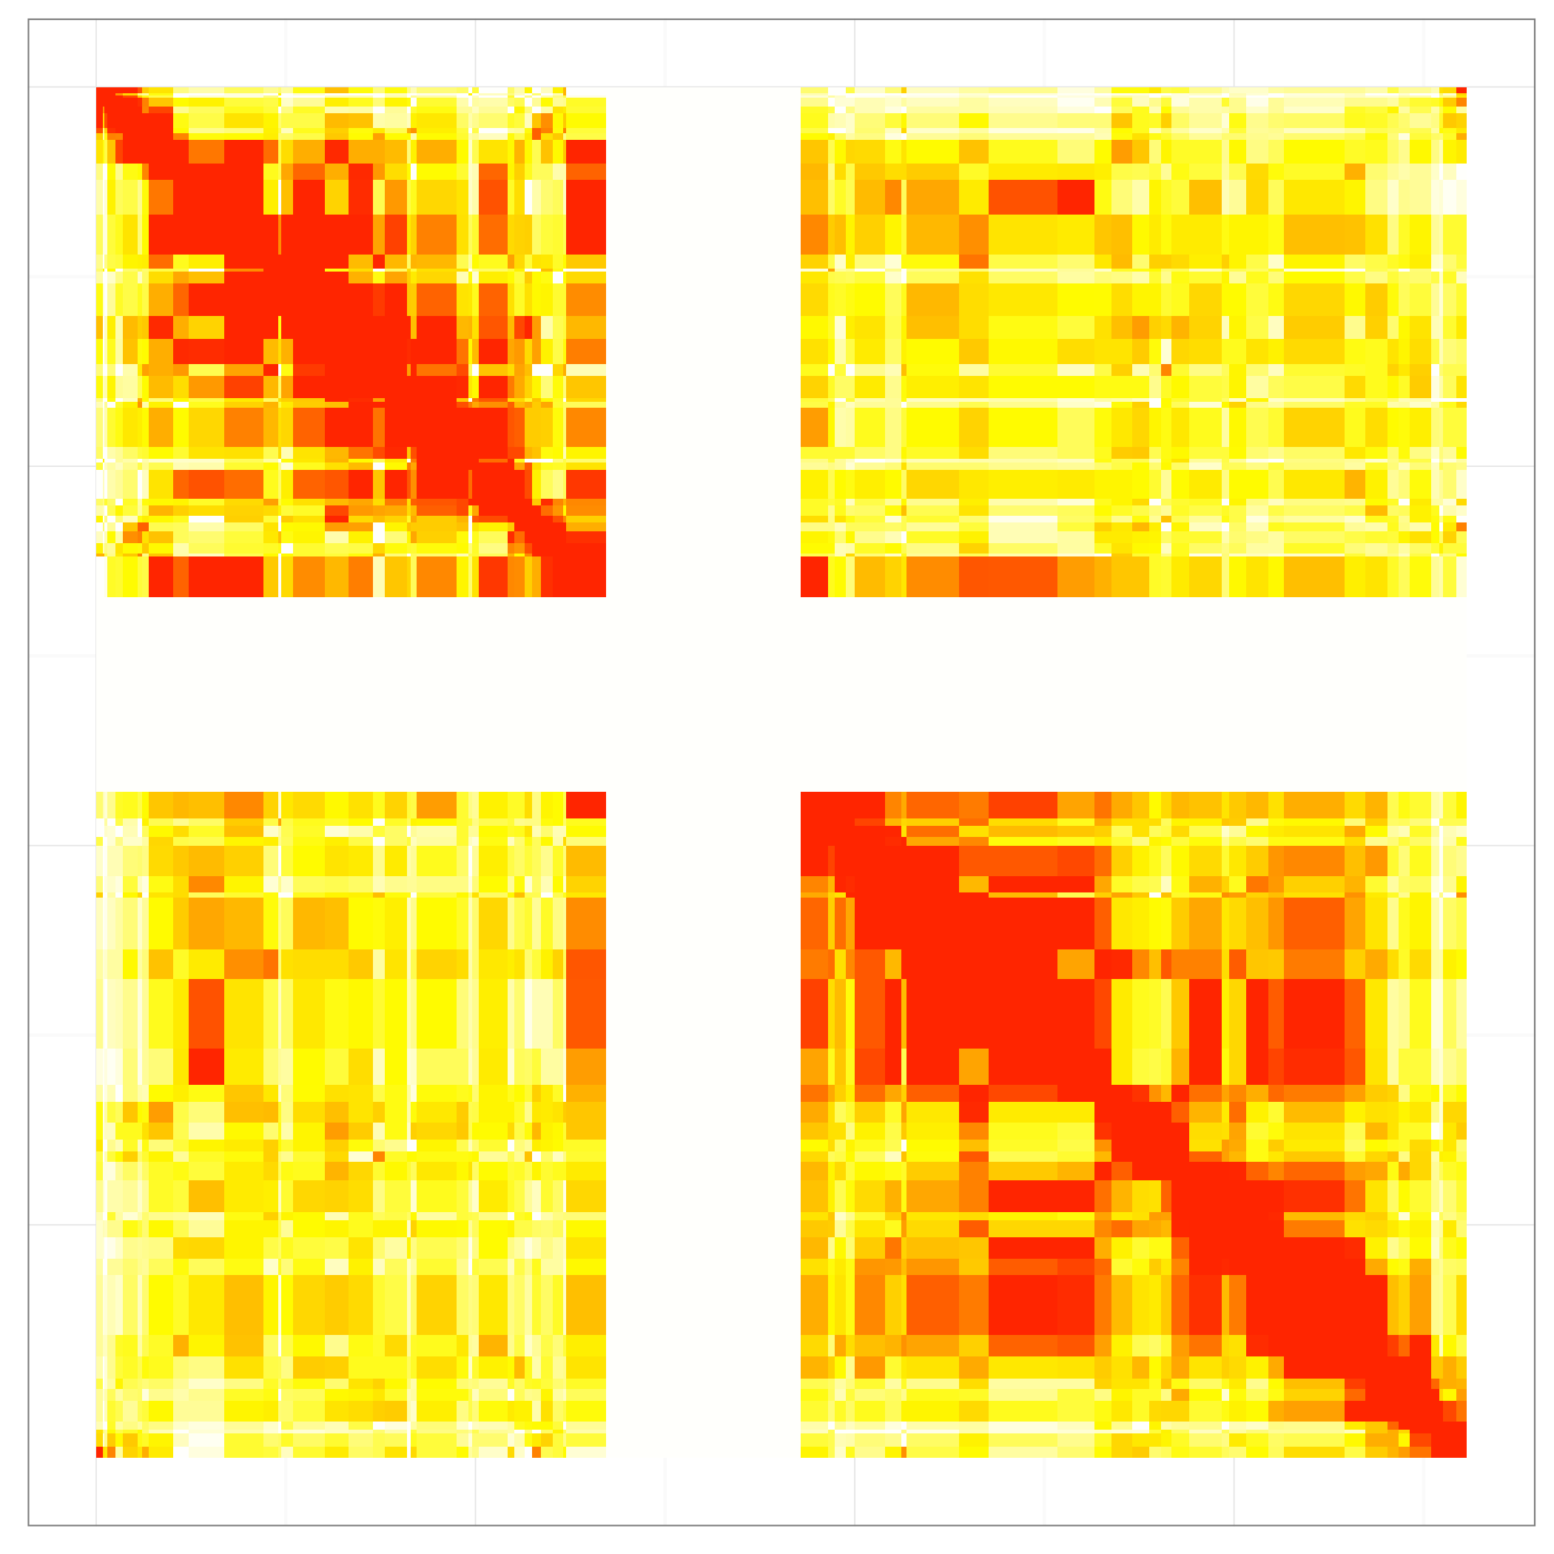
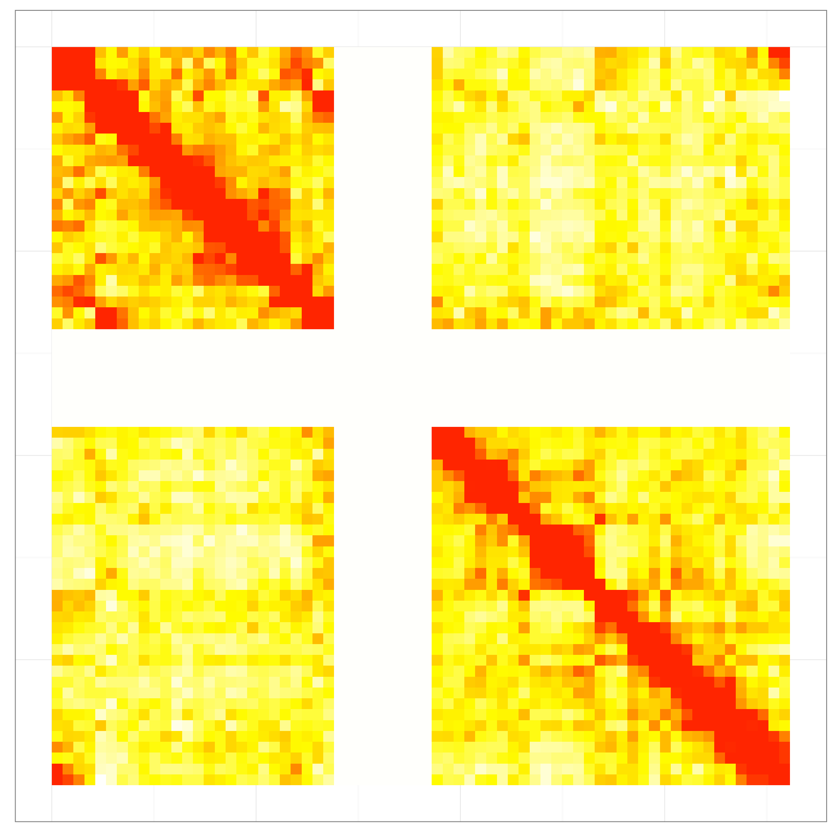
Chr 9
Chr 10
Chr 11
Chr 12
Chr 13
Chr 14
Chr 15
Chr 16
Figure S4, continued

Slide 7
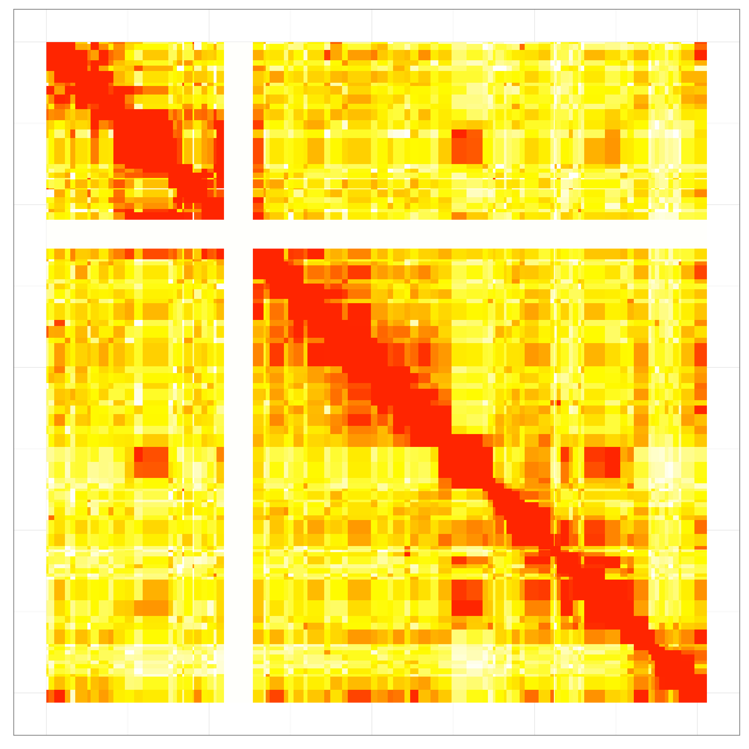
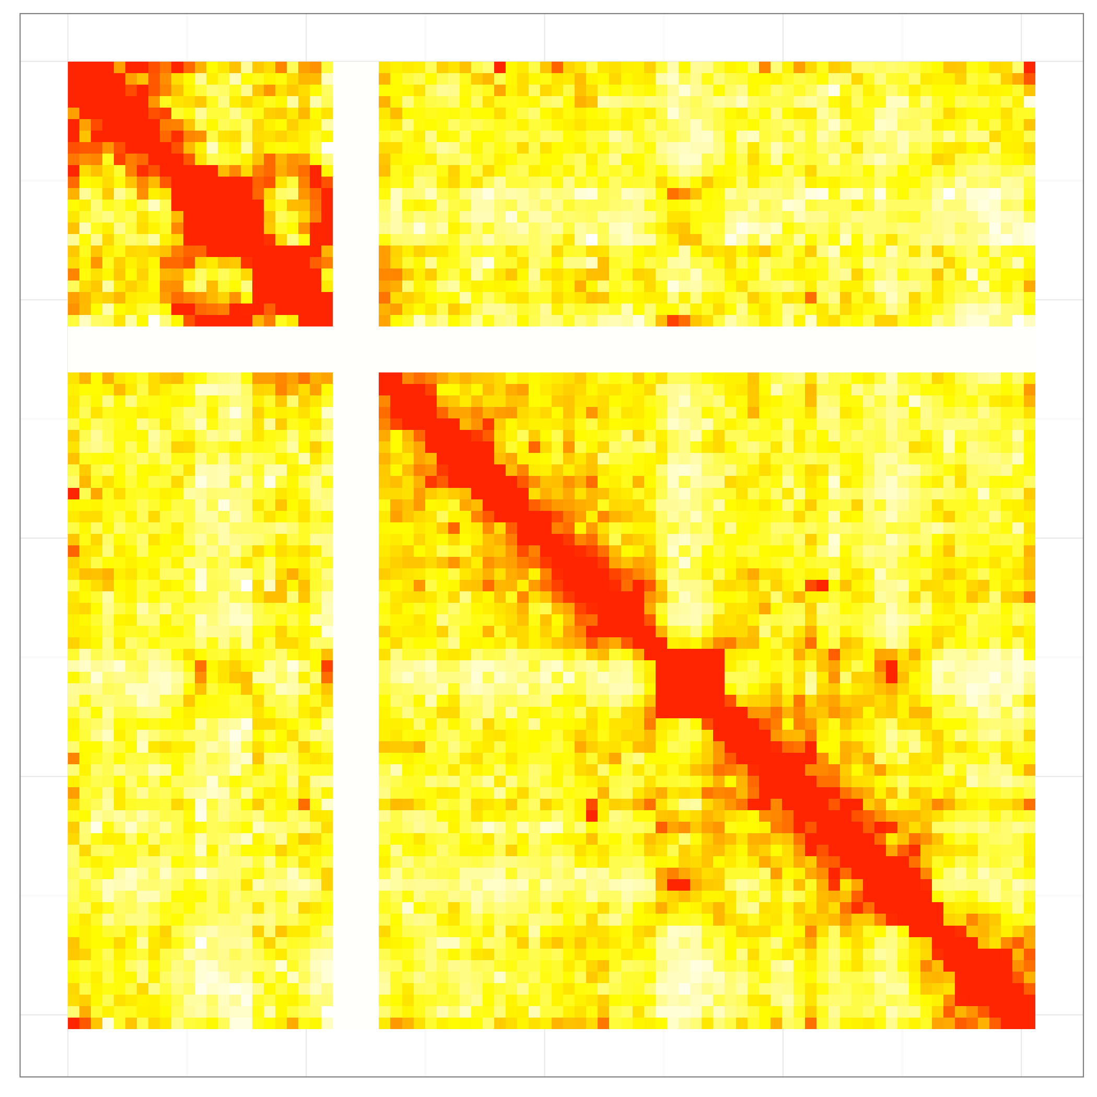
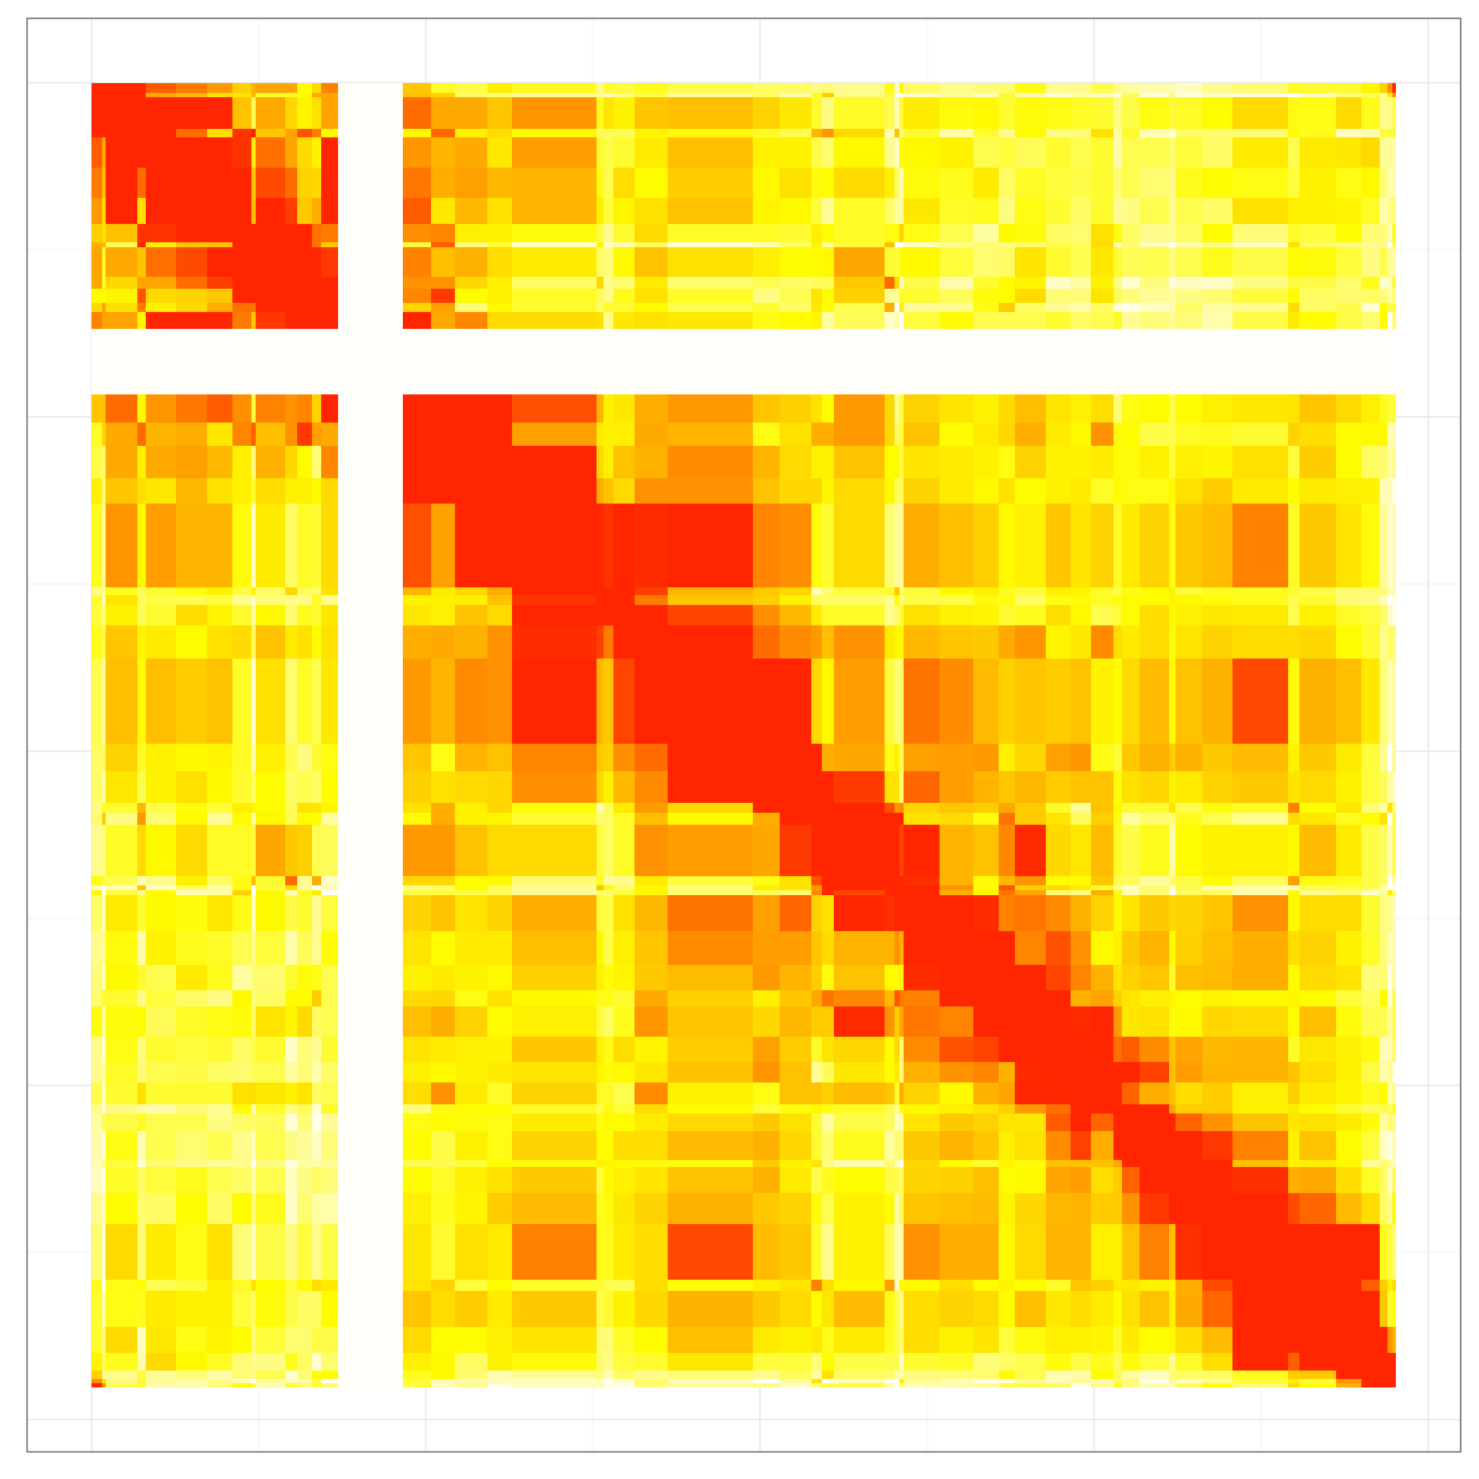
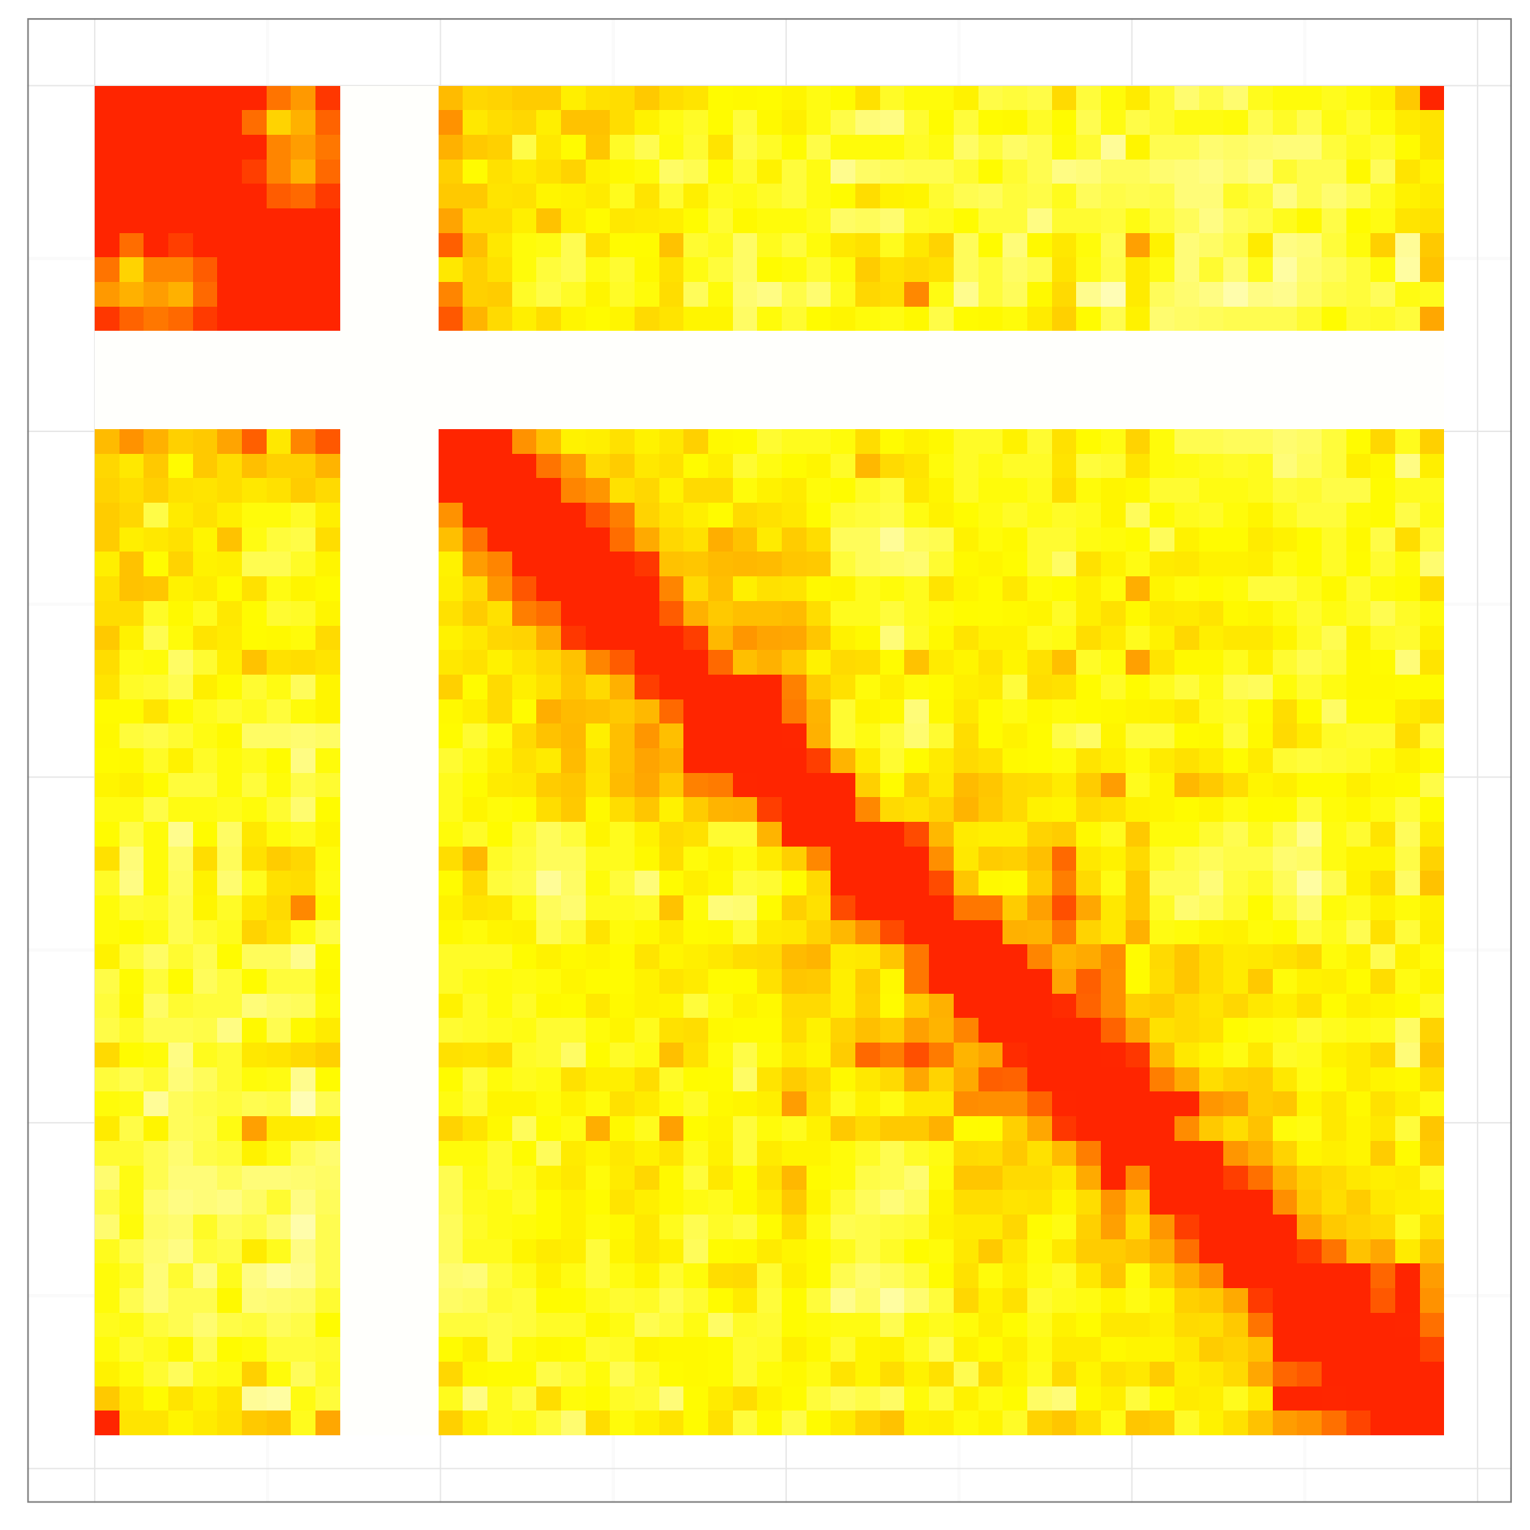
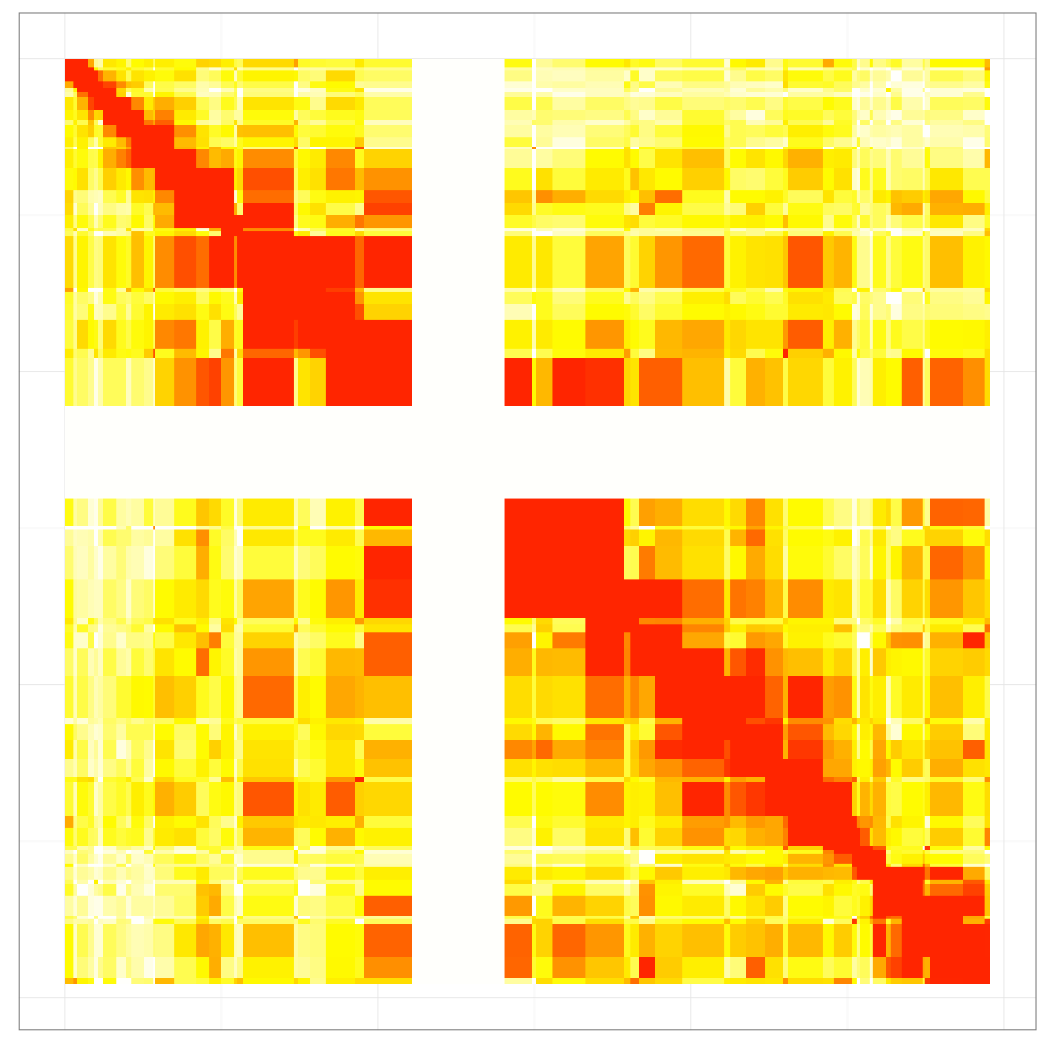
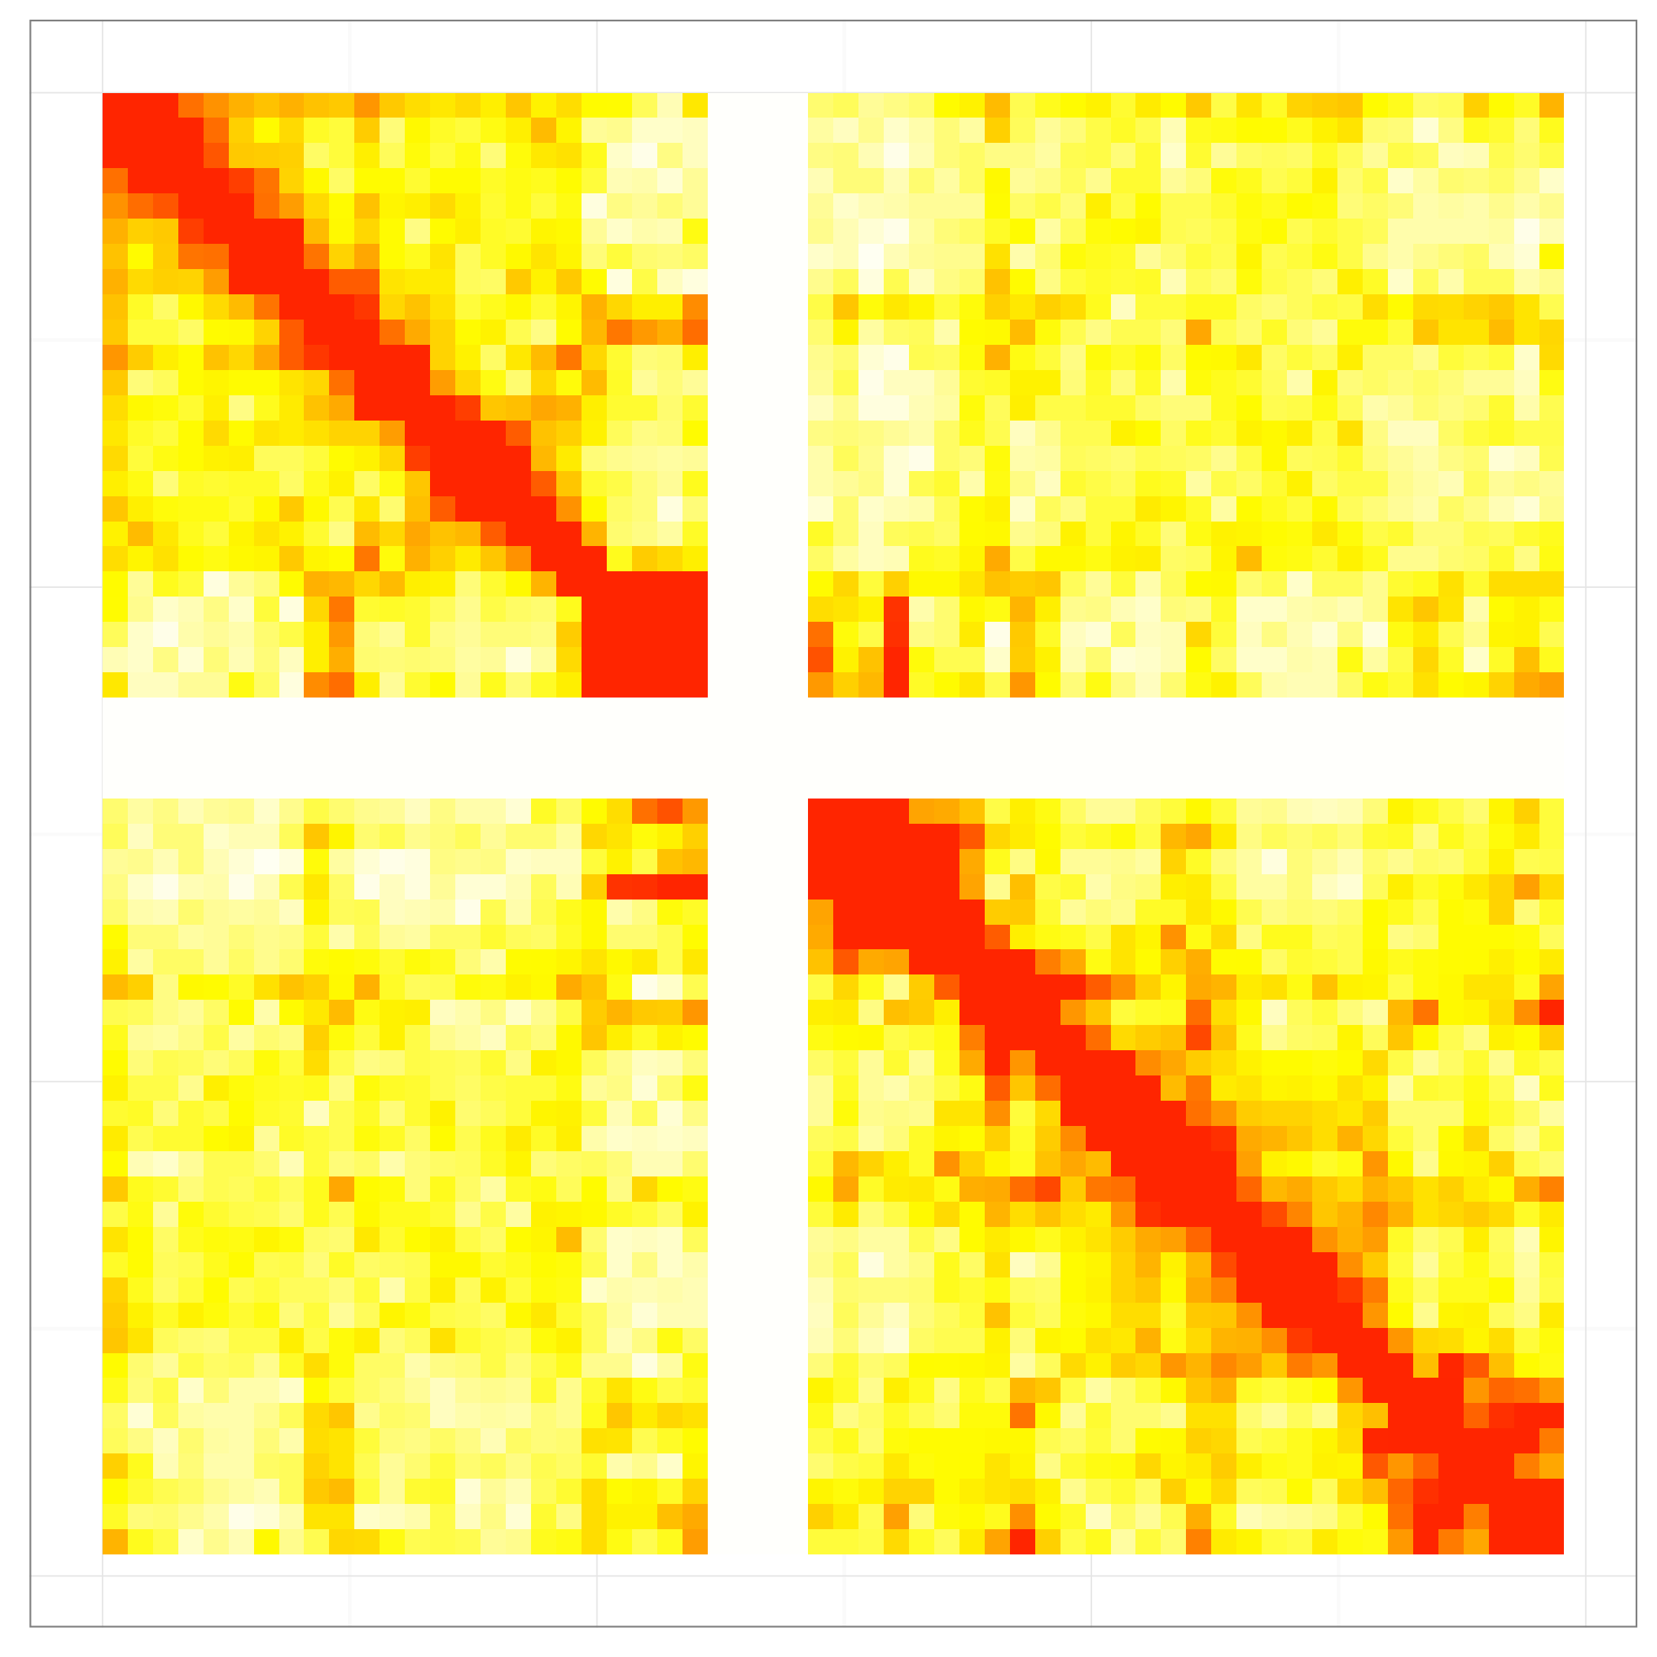
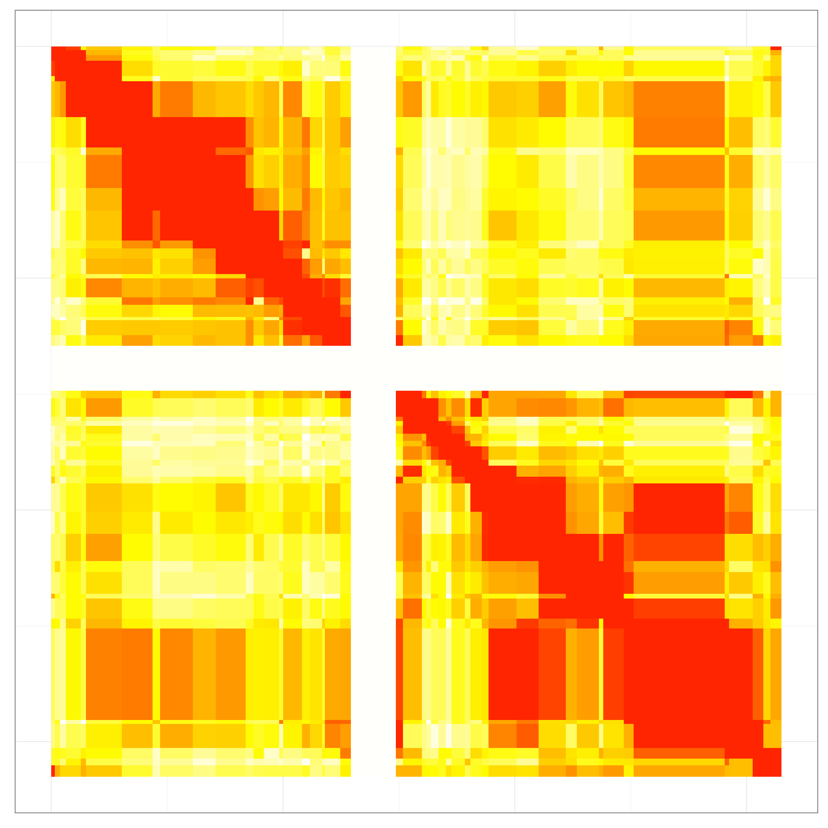
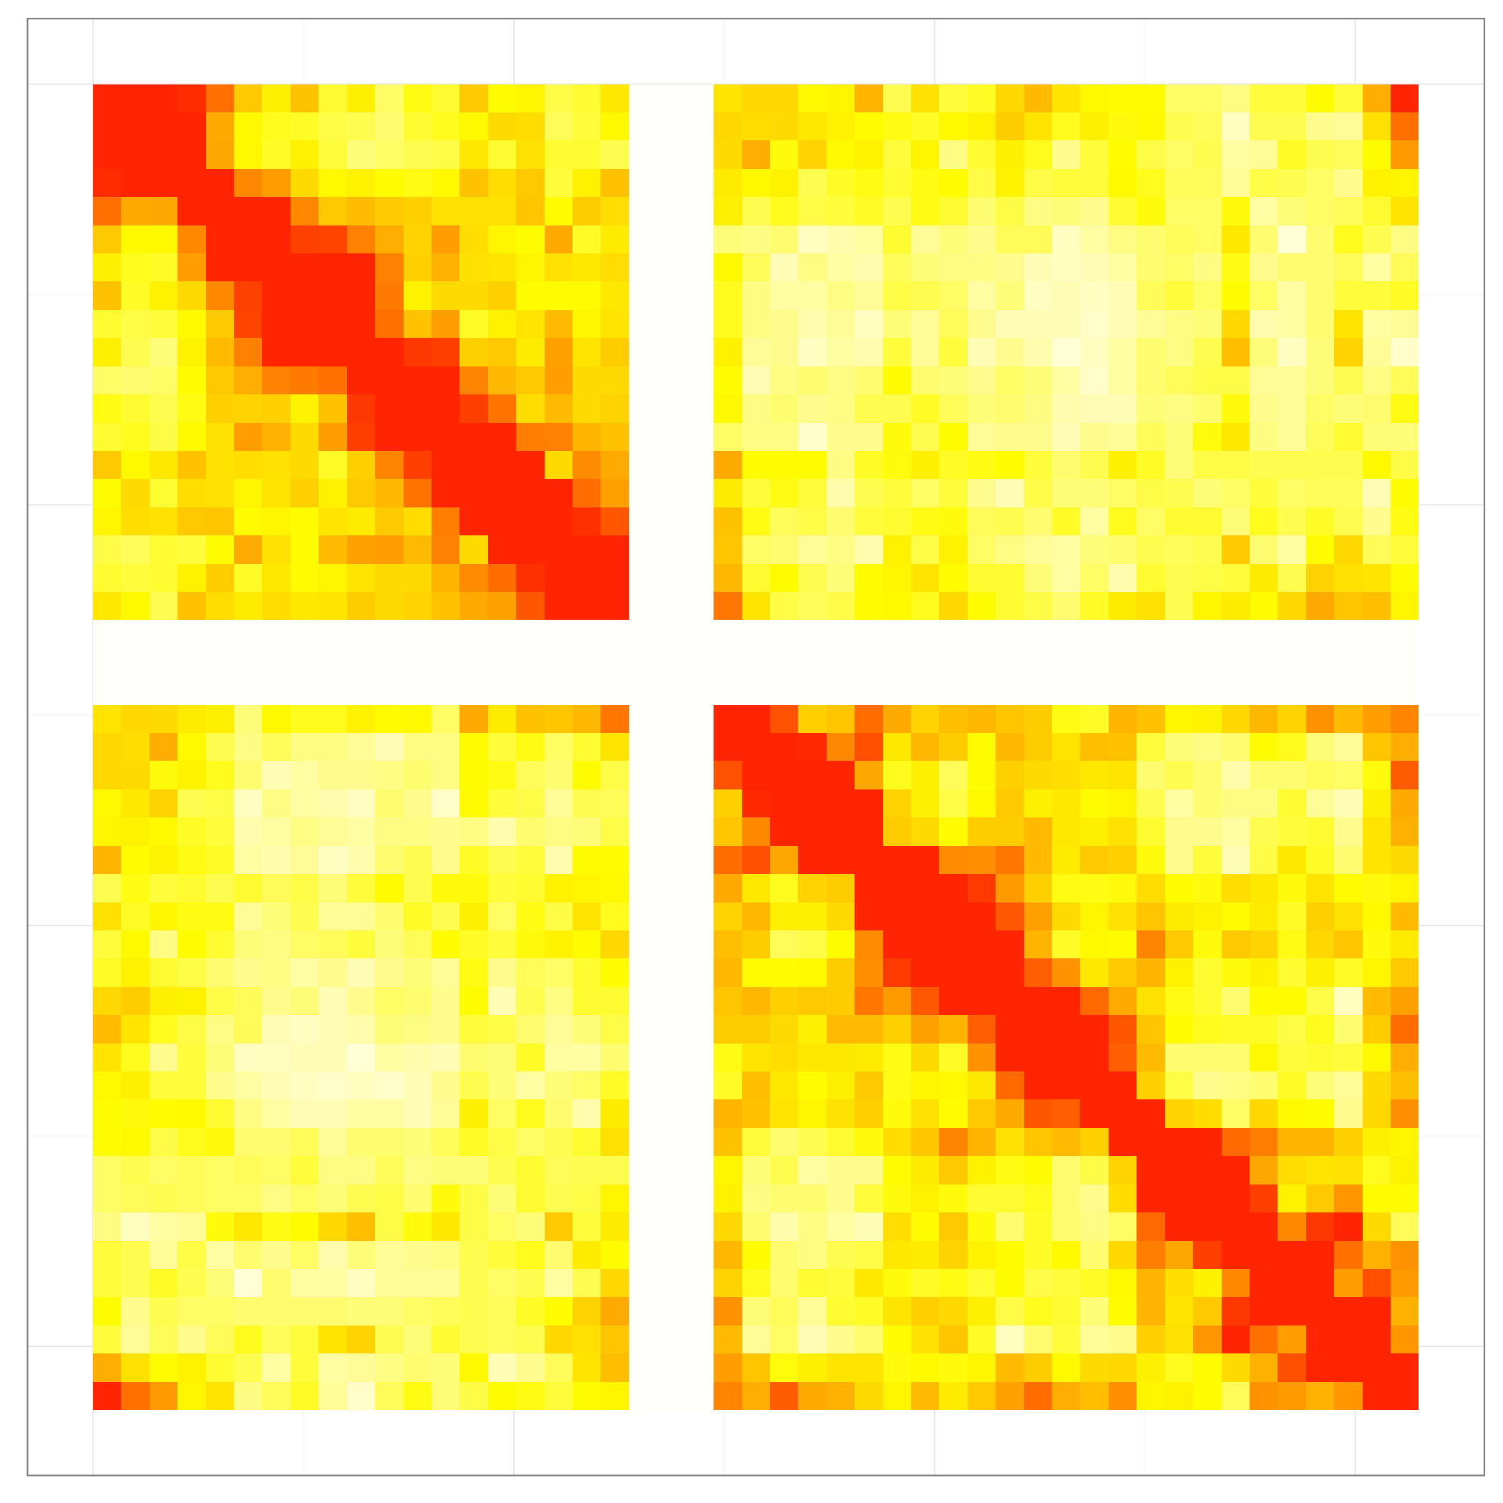
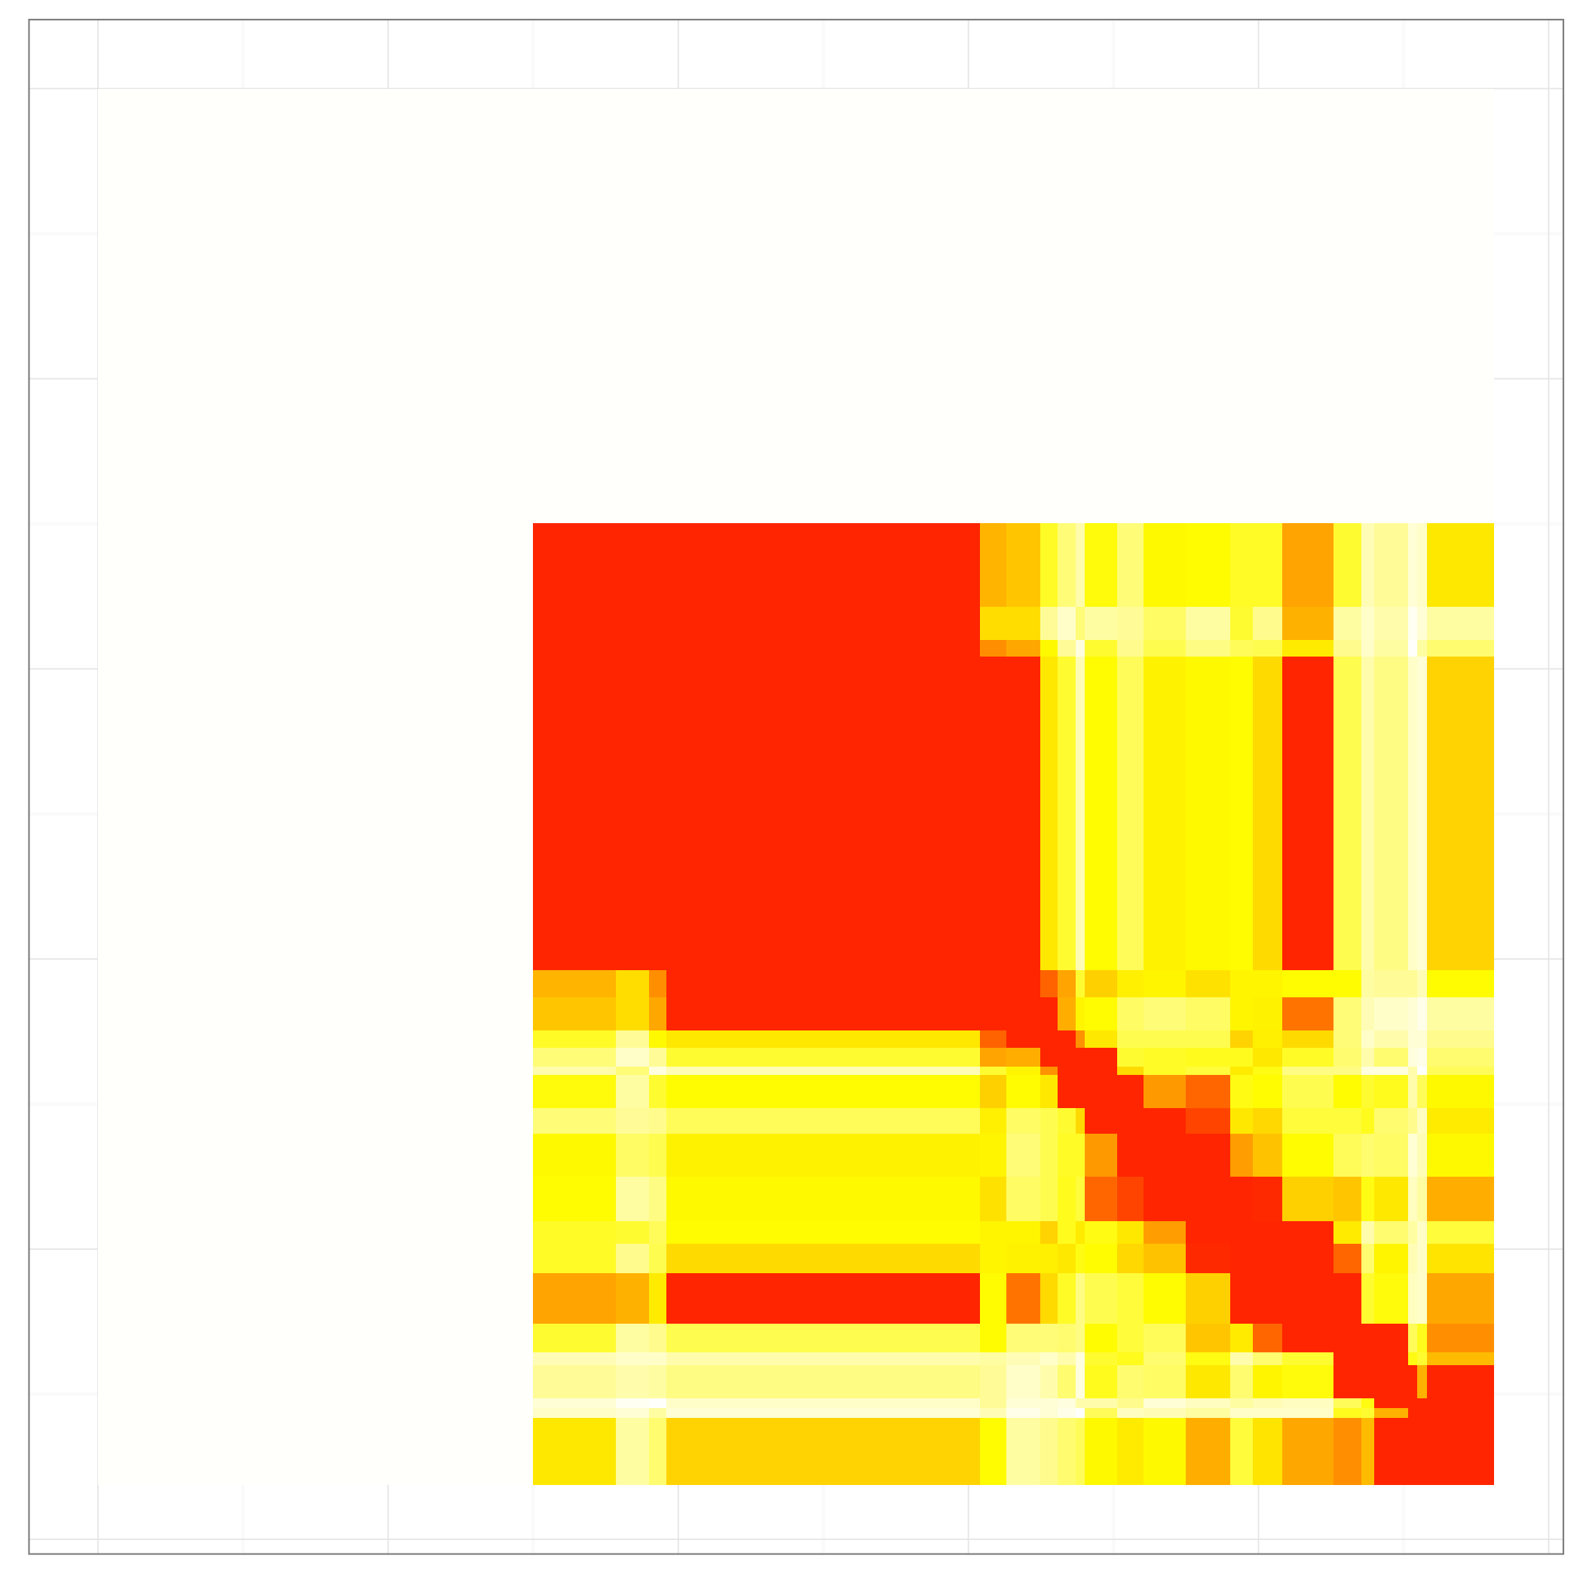
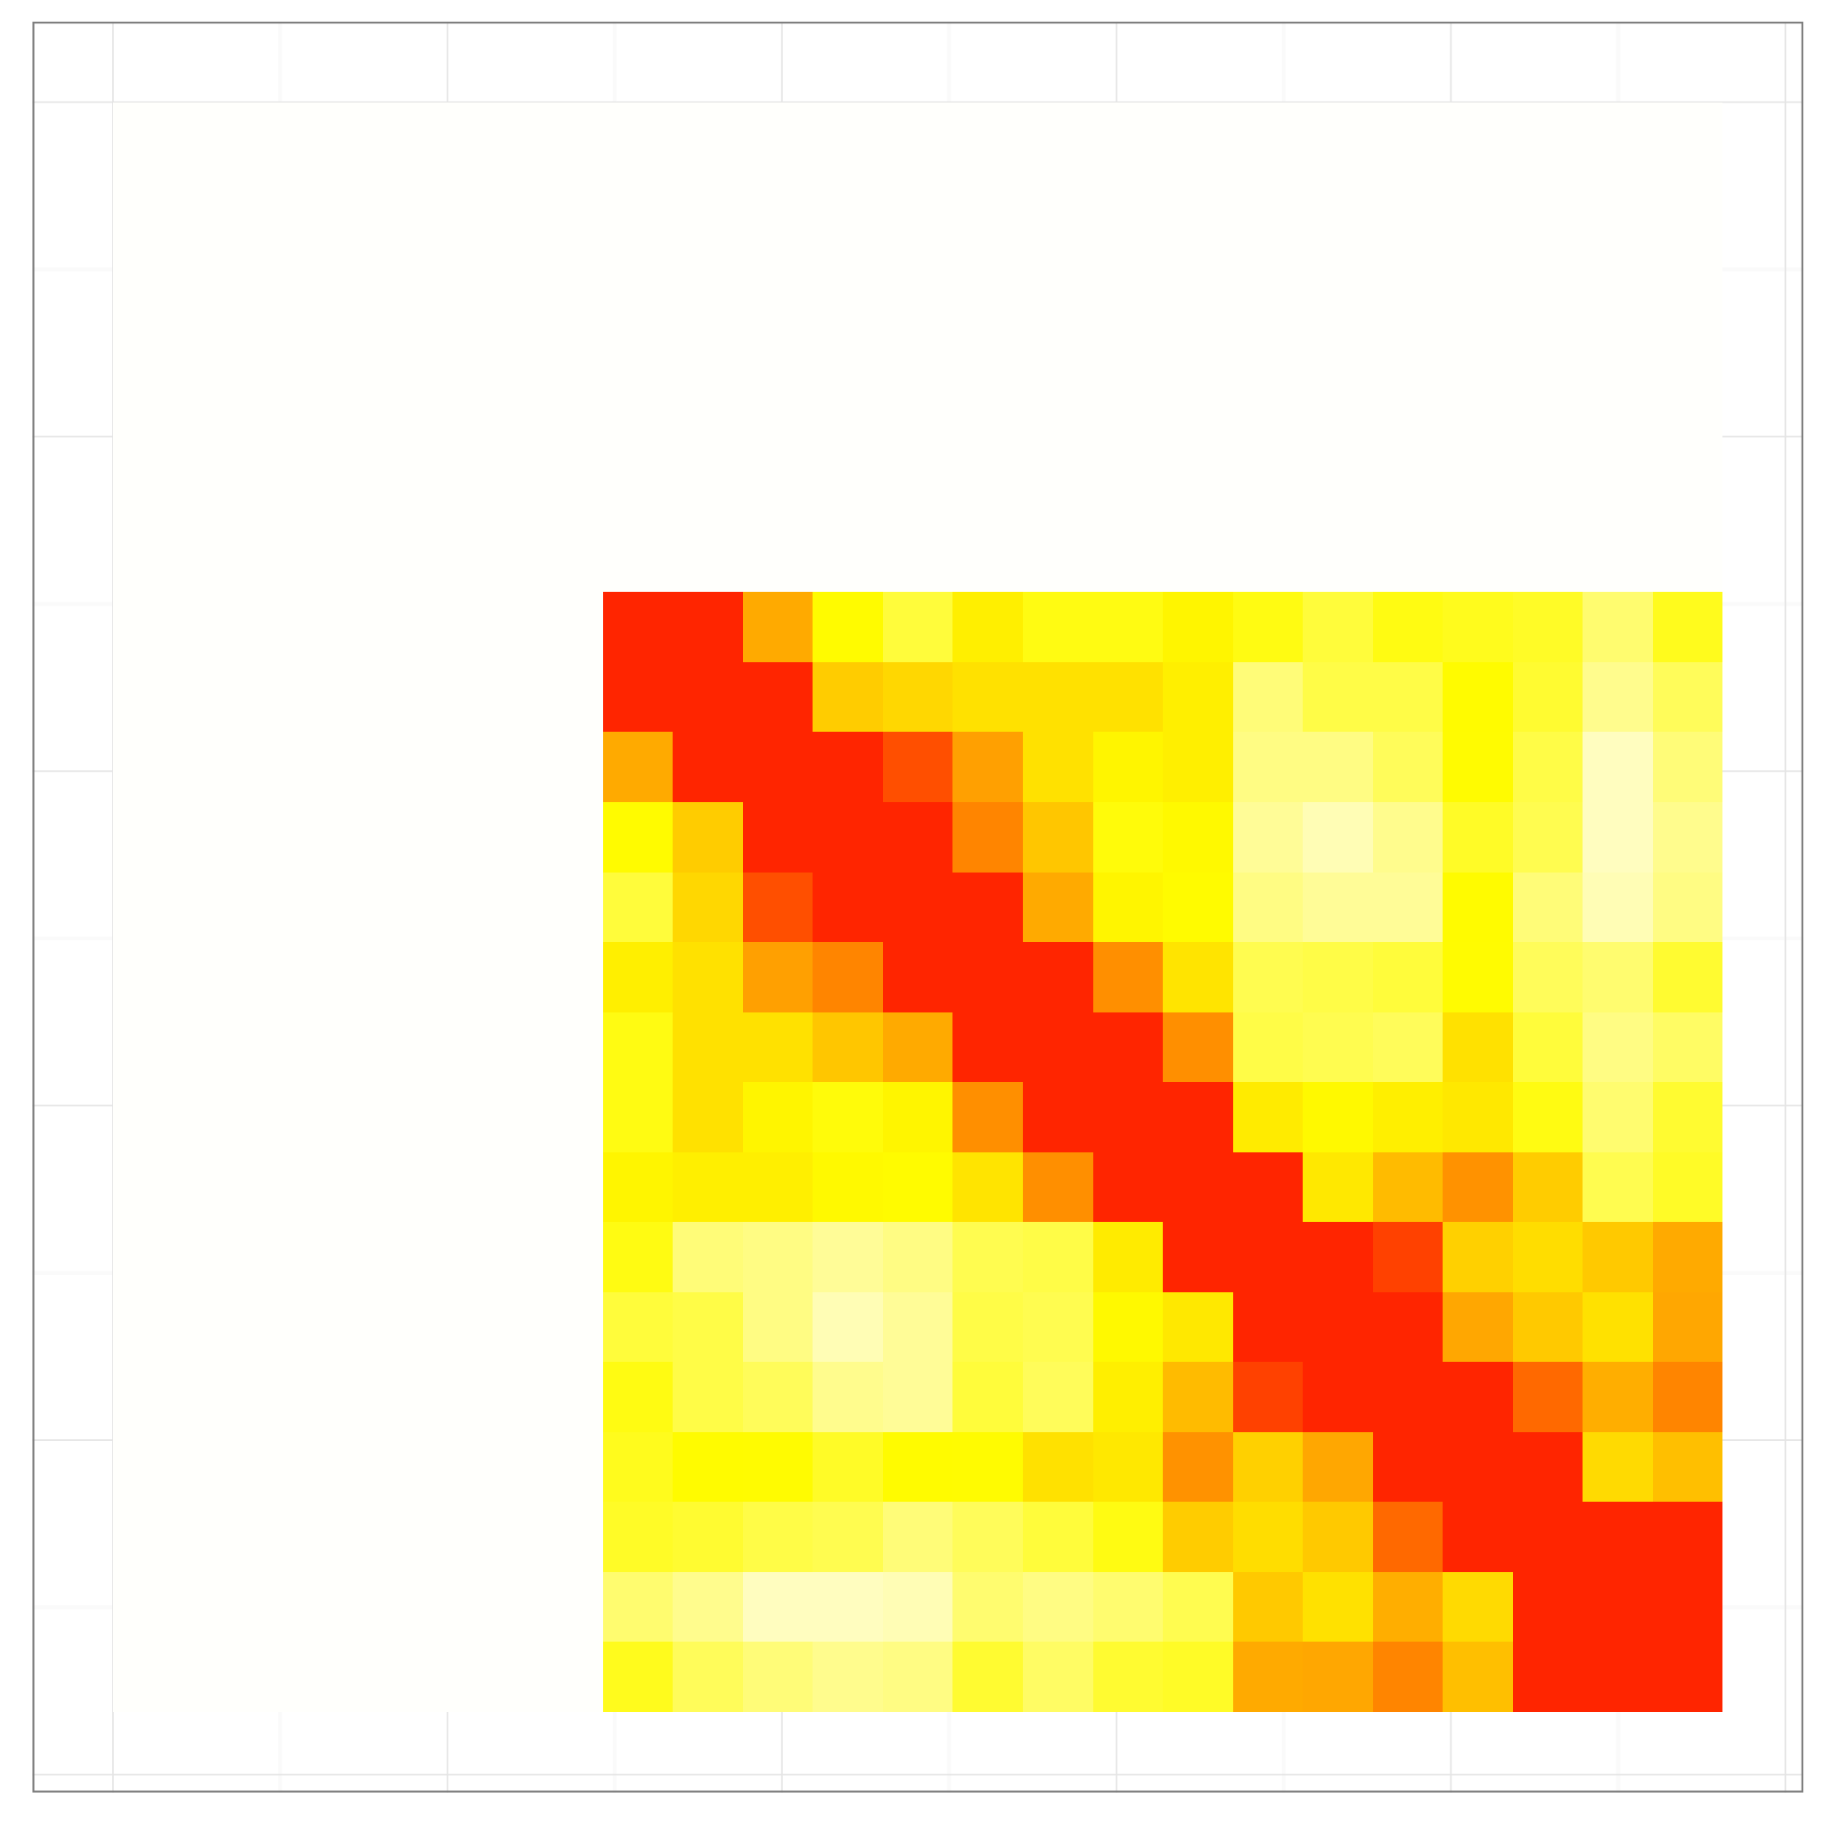




Chr 17
Chr 18
Chr 19
Chr 20
Chr 21
Chr 22
Chr X
Figure S4, continued

Slide 8

Figure S5. Initial low resolution 3D structures for all 23 human chromosomes constructed using MDS with graph distance corrections for middle resolution heatmaps, aggregated at macro-domain level. Single bead represents a meso-domain. Probabilistic T-norm was used for the graph distance map calculation.

Slide 9

Figure S6. ChIA-PET based structures. Structures for all chromosomes constructed using MDS and different probabilistic norms for the graph distance correction for middle resolution heatmaps. Structures are aggregated at macro-domain level, and a single bead represents a meso-domain. Colors indicate different probabilistic norms, and all structures are aligned by minimizing RMSD distance. Blue: standard arithmetic operators, red: probabilistic operators, described also in the appendix, yellow: Lukasiewicz operators, green: Hamacher operators.

Slide 10

Figure S7. Hi-C based structures. Structures for all chromosomes constructed using MDS and different probabilistic norms for the graph distance correction for middle resolution heatmaps. Structures are aggregated at macro-domain level, and a single bead represents a meso-domain. Colors indicate different probabilistic norms, and all structures are aligned by minimizing RMSD distance. Blue: standard arithmetic operators, red: probabilistic operators, described also in the appendix, yellow: Lukasiewicz operators, green: Hamacher operators.

Slide 11

Figure S8. Screen-shot of web-based viewer. The viewer shows the structure of Chromosome 3 at the highest resolution (~5kb). The panel on the right provides various display options, including highlighting regions of interest, highlighting specific protein binding factors, and uploading annotation files.

Slide 12
A
P < 2.2e-16
B
Chr | Number of CCD | Average size of CCD (bp) | Uniform bin size (bp)
Chr 1 | 191 | 1,052,109 | 1,194,506
Chr 2 | 180 | 1,073,754 | 1,324,314
Chr 3 | 167 | 977,670 | 1,168,116
Chr 4 | 120 | 1,206,995 | 1,568,439
Chr 5 | 134 | 1,053,933 | 1,327,623
Chr 6 | 138 | 953,468 | 1,217,774
Chr 7 | 131 | 953,284 | 1,187,377
Chr 8 | 112 | 1,058,045 | 1,280,372
Chr 9 | 95 | 1,165,027 | 1,294,514
Chr 10 | 111 | 964,478 | 1,193,792
Chr 11 | 109 | 1,005,594 | 1,210,373
Chr 12 | 117 | 975,629 | 1,118,635
Chr 13 | 71 | 1,289,867 | 1,354,118
Chr 14 | 72 | 1,247,343 | 1,225,747
Chr 15 | 73 | 1,160,446 | 1,131,163
Chr 16 | 68 | 1,053,495 | 1,167,617
Chr 17 | 84 | 782,115 | 931,093
Chr 18 | 55 | 1,179,509 | 1,363,134
Chr 19 | 58 | 750,345 | 965,893
Chr 20 | 47 | 1,186,444 | 1,275,253
Chr 21 | 23 | 1,800,473 | 1,469,121
Chr 22 | 33 | 1,354,258 | 1,068,064
Chr X | 101 | 960,173 | 1,506,452
Figure S9. Comparison of CCD-based and unifom binning.
(A) Distribution of the signal ratio for neighboring bins for CCD and uniform bins. CCD-based bins exhibit a wider range of values, indicating higher signal to noise ratio.
(B) Summary of number of CCD, average size of CCD and uniform bin size for each chromosome.

Slide 13

Figure S10. The histogram of small values from inter-chromosomal heatmaps shows an approximately Gaussian distribution. The graph shows the actual frequency for bins of width 0.001. For this normalized heatmap distribution, the best-fit Gaussian has mean 0.0245 and standard deviation 0.047.

Slide 14

Figure S11. Graph distances distributions are shown for the whole nucleus for four different T-norm operators: standard arithmetic operators (blue), probabilistic operators (red), Lukasiewicz operators (yellow), and Hamacher operators (green). All forms produce approximately normal distributions, but with differing means and standard deviations.

Slide 15

Figure S12. The graph distance map for the whole nucleus. The graph distance was calculated using combined data from the CTCF and Pol II ChIA-PET libraries with the use of standard matrix operators.

Slide 16

Figure S13. Heatmaps for middle resolution of ChIA-PET heatmaps, aggregated at macro-domain level. Single bead represents a meso-domain. For each chromosome: (a) original heatmaps constructed from raw reads, (b) heatmaps after graph distance calculation, and (c) heatmaps after MDS. Graph distances were generated with the probabilistic operators described in the text.

Slide 17

Figure S14. (A) Four key stages of GD+MDS protocol for 3D structure determination from ChIA-PET heatmaps for Chromosome 1. The raw heatmap (upper left) is converted to a graph distance map (upper right), which is rescaled into a physical distance map (lower left). The physical distance map is the input to MDS, which produces an ensemble of low-resolution 3D structures (lower right). The GD+MDS procedure runs in a multistart mode with different initial seeds (starting coordinates), therefore providing the structural variability in final model.

Slide 18
Figure S15. (A) Different levels of the hierarchical model used for the nucleome structure. (B) Three main scales are distinguished in the model. The highest scale represents the relative placement of chromosomes inside the nucleus, and every bead corresponds to a single chromosome (top). The second scale represents the rough, low resolution structures of chromosomes, and beads correspond to topological domains (center). The last scale captures the internal organization of the topological domains, with beads corresponding either to anchors or to chromatin loops fragments (bottom). First two scales correspond to chromosome and segment levels, respectively. The third scale corresponds to the combined anchor and sub-anchor levels.

Slide 19



Figure S16. (A, B) The genomic length of (A) CCDs and (B) segments for each chromosome. (C) The distribution of the count of CCDs contained in segments. The vast majority of segments contain only 1 or 2 IBs.

Slide 20



A
B
Figure S17. Comparison of the structures obtained with different power scaling.
(A) Distribution of the pairwise distances between ensemble structures using the contact distance. (B) Ensemble visualization for α=0.6 (left) and α=1.0 (right).

Slide 21
Figure S18. Low resolution models of Chromosome 10 derived using the MDS pipeline. The models are overlaid with various function annotations: (A) CTCF binding sites from ChIP-seq, (B) H3K27 acetylation, (C) H3K4 mono-methylation, and (D) H3K4 tri-methylation. All data from ENCODE.

Slide 22
Figure S19. Distributions of distances calculated between structures reconstructed from perturbed contact matrices and structures recovered from initial, denoised contact matrix plotted against a ratio of a noise level to the mean contact frequency value of the initial matrix. (legend continued on next page)

Slide 23
Figure S19, continued. The plots are shown with visualizations of aligned three-dimensional structures reconstructed from perturbed contact matrices of selected noise levels. The initial denoised matrix was calculated from the coordinates of a 50 points long structure artificially created by random walk. Figures in the top half of the panel present the results obtained with MMC algorithm. Figures in the bottom half of the panel present MDS algorithm results. For each of the algorithms there are two box plots shown: one where the distance measure applied was contact measure and the other where RMSD was used as distance measure. Whiskers of the plots represent data points, which lie within 1.5 IQR of the lower and upper quartiles. The visualized structures are aligned to a centroid found in an ensemble of denoised structures (colored in cyan). The random walk structure is yellow. The best aligned to the centroid structure is also colored, and the rest of the models is gray. The noise levels for which the 3D models were visualized are written below corresponding figures.

Slide 24
Figure S20. Analogous to Figure S19, but for synthetic structure of length of 100 points.

Slide 25
Figure S21. Box plots for Chromosome 14 presented along with visualizations of three-dimensional chromosome structures reconstructed from perturbed contact matrices of selected noise levels. The input data were real ChIA-PET singleton matrices. Figures in the top half of the panel present the results obtained with MMC algorithm. (legend continued on next page)

Slide 26
Figure S21, continued. Figures in the bottom half of the panel present MDS algorithm results. For each of the algorithms there are two box plots shown: one where the distance measure applied was contact measure and the other where RMSD was used as distance measure. In the plots distributions of a distance measure values are plotted against a ratio of a noise level to the mean contact frequency value of the denoised matrix. Whiskers of the plots represent data points, which lie within 1.5 IQR of the lower and upper quartiles. The visualized structures are aligned to a centroid found in an ensemble of denoised structures (colored in cyan). The best aligned to the centroid structure is colored, the rest of the models is gray. The noise levels for which the 3D models were visualized are written below corresponding figures.

Slide 27
Figure S22. Analogous to Figure S21, but for Chromosome 3.

Slide 28
Figure S23. Hierarchical clustering of three-dimensional structures of Chromosome 3 and Chromosome 14 reconstructed with MMC algorithm from experimental data. The colors of the marked clusters correspond to the colors of the frames by which the visualizations are surrounded.

Slide 29
A
B
D
C
Figure S24 Comparison of the whole genome GM12878 CCDs, GM12878 TADs called in [8] and human IMR90 fibroblast TADs downloaded from Bing Ren laboratory web pages as reported in [9]. The whole-genome Hilbert curves visualizing with RED and GREEN channels, respectively (clockwise from top-left): A) CCD vs Rao, B) CCD vs IMR90, C) Rao vs IMR90, and finally D) at bottom-left: the Venn diagram comparing all three sources, displaying percentages of the area of their union.

Slide 30
A
B
D
C
Figure S25. Analogous to Figure S24, but for Chromosome 1.

Slide 31
A
B
D
C
Figure S26. Analogous to Figure S24, but for Chromosome 9.

Slide 32
A
B
D
C
Figure S27. Analogous to Figure S24, but for Chromosome 14.

Slide 33











A
Single CTCF Contact Domain (CCD)
C
Polymer modeling
Singleton interactions
Preliminary
structures
B
Distance
matrices
Subanchor singleton heatmap
Average distance matrix
D
Ensemble of refined distance matrixes
...
...
E
Final ensemble of subanchor looping structures
Figure S28. Sub-anchor level reconstruction. (A) During the simulation every CCD is considered separately. (B) A subanchor singleton heatmap. (legend continued on next page)

Slide 34
Figure S28, continued. (C) A number of preliminary structures are generated based only on polymer interactions, and for each structure a distance heatmap is calculated. The distance heatmaps are combined to produce an average distance heatmap. (D) The singleton heatmap is used to modify the values in the distance matrix, resulting in a set of refined distance matrixes comprising ensemble conformations. (E) Final structures based on the refined distance heatmaps. Each ensemble member structure is constructed using different refined distance matrix.

