Slide 1
Supplementary Figure 1
Fraction of breakpoints assembled
0 20 100 200 400 1000
Breakpoint homology (bp)
Homology measured by Fosmid ESP in Kidd et al. Cell (2010),
562 deletion breakpoints were included in this experiment. Assessed were 8 low coverage samples in the 1000G Phase 3

Slide 2
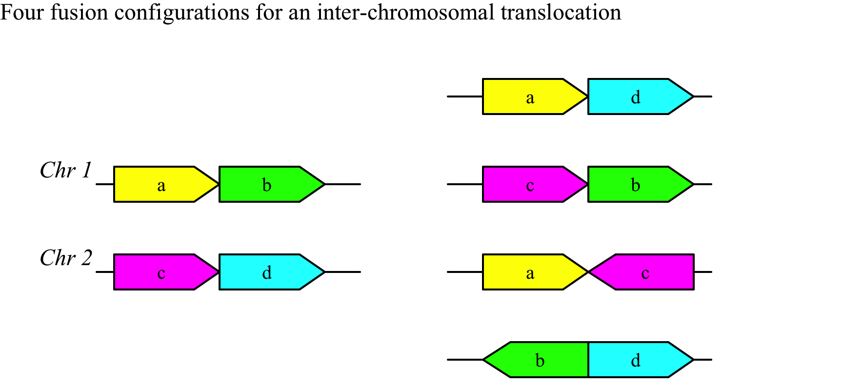
Supplementary Figure 2

Slide 3
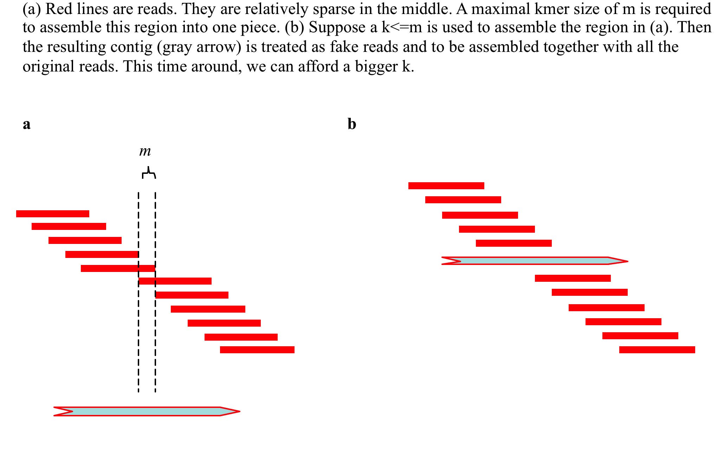
Supplementary Figure 3

Slide 4
Supplementary Figure 4
Unique1
Unique3
Repeat
Unique2
Unique4

Slide 5
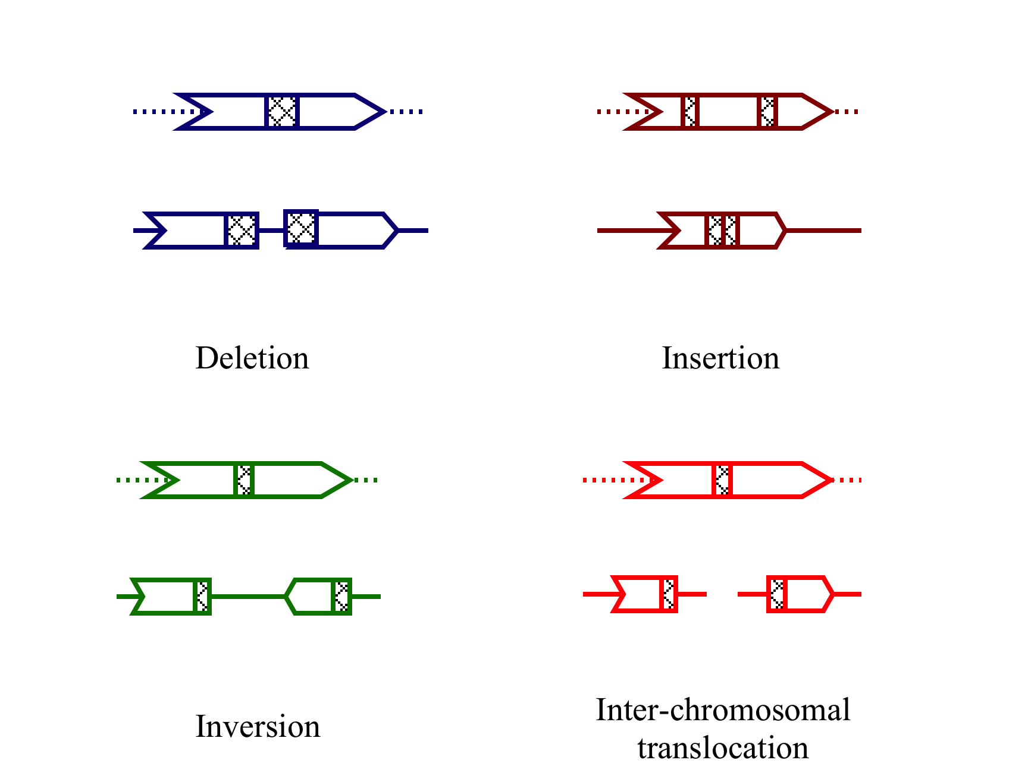
Supplementary Figure 5
homology
Reference
Contigs
Reference
Contigs

