Slide 1
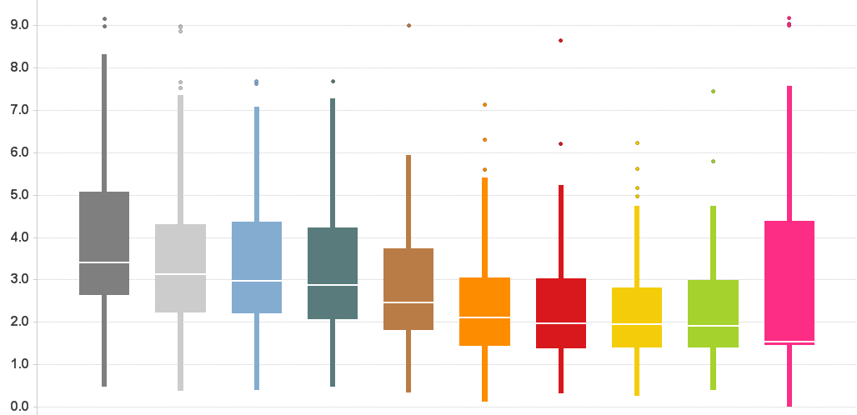
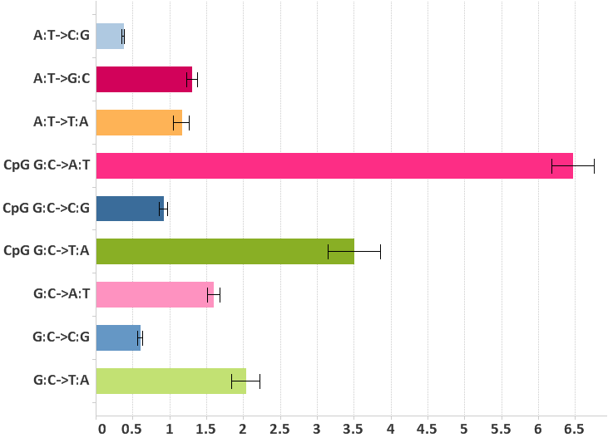
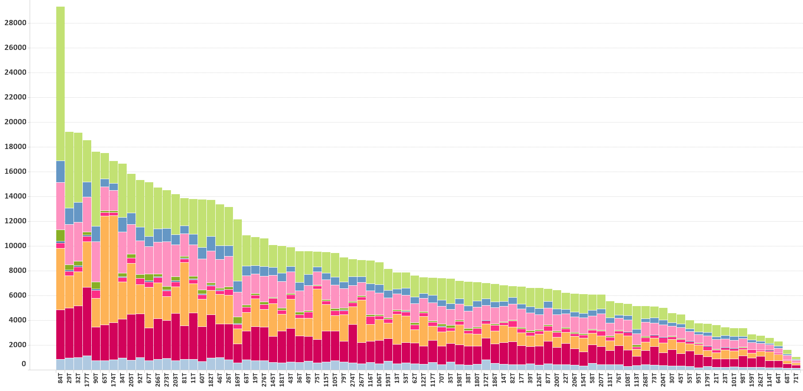
Supplementary Figure 1. Somatic mutation spectrum
a
b
# Substitutions per Mb
Repeats
Intron
Promoter
CDS
5’ UTR
3’ UTR
Pseudogenes
Splice sites
Whole genome
Non-coding RNA
# Substitutions per Mb
c
# Substitutions

Slide 2
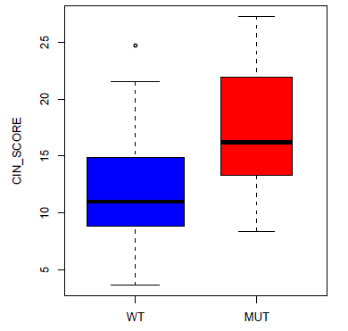
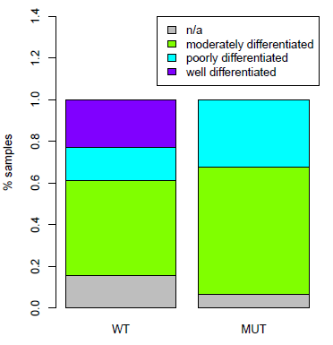
Supplementary Figure 2. TP53 mutations associated with chromosomal instability and clinical variables
CIN ( p = 3.12e-05)
c.
a.
DFS
1.0
0.8
0.6
Survival Probability
p53 wild type: n=51
0.4
0.2
p53 mutation: n=31
b.
Tumour Grade ( p = 0.0075)
p = 0.136
0.0
20
40
60
80
100
120
Months

Slide 3
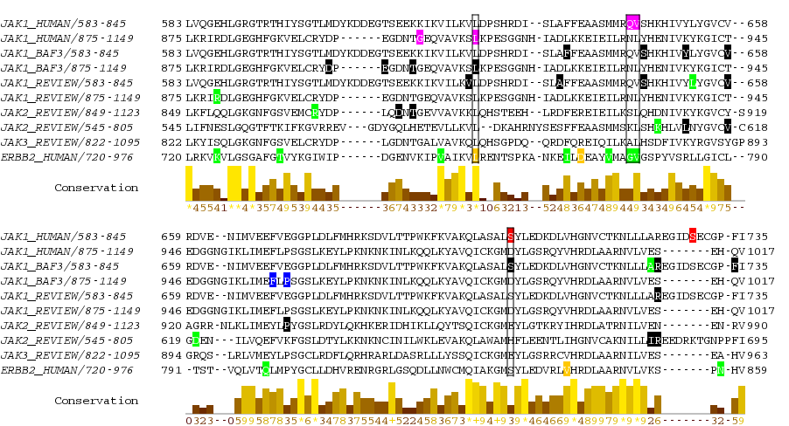
Supplementary Figure 3. Alignment of the mutations in kinase domains of JAK1, JAK2, JAK3 and ERBB2
Nucleotide-binding
ATP-binding
JAK1:L910P
JAK1: Q644H,V645F
ERBB2: L755P,S
ERBB2: G776S
V777A,L,M
JAK1: S703I
ACRG-HCC mutation
ACRG-HCC mutation (recurrent)
Known mutation
Known mutation (recurrent)
Known mutation (activating)
Known mutation (resistant)

Slide 4



Supplementary Figure 4. JAK inhibitors inhibit JAK1 S703I mutant-mediated activation of p-STAT3 in Ba/F3 cells
Ruxolitinib
BMS-911543
DMSO
pStat3
Stat3
Actin

Slide 5
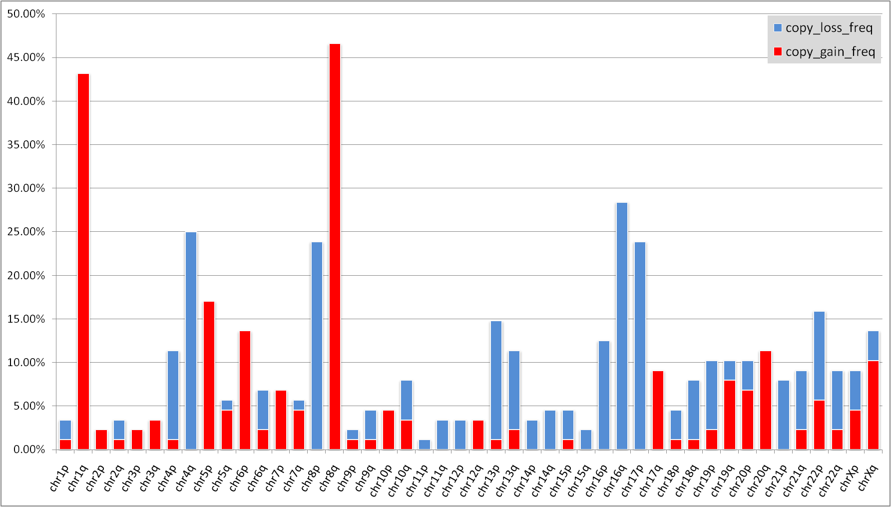
Supplementary Figure 5. Frequencies of copy number gain and loss for chromosomal arms
% Tumour Samples

Slide 6
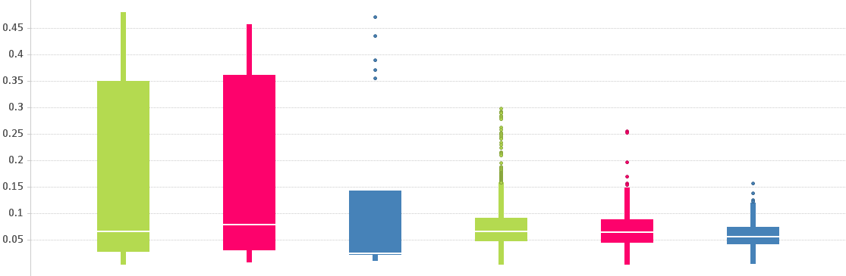
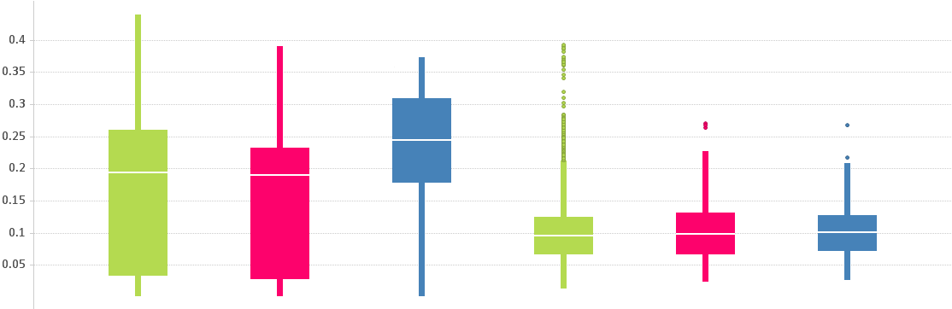
Supplementary Figure 6. Selective amplification and deletion of cancer genes
a
CNV Regions
Non-CNV Regions
G-score Amplification
b
Other
Oncogene
Tumor Suppressor
Other
Oncogene
Tumor Suppressor
CNV Regions
Non-CNV Regions
G-score Deletion
Other
Oncogene
Tumor Suppressor
Other
Oncogene
Tumor Suppressor

Slide 7
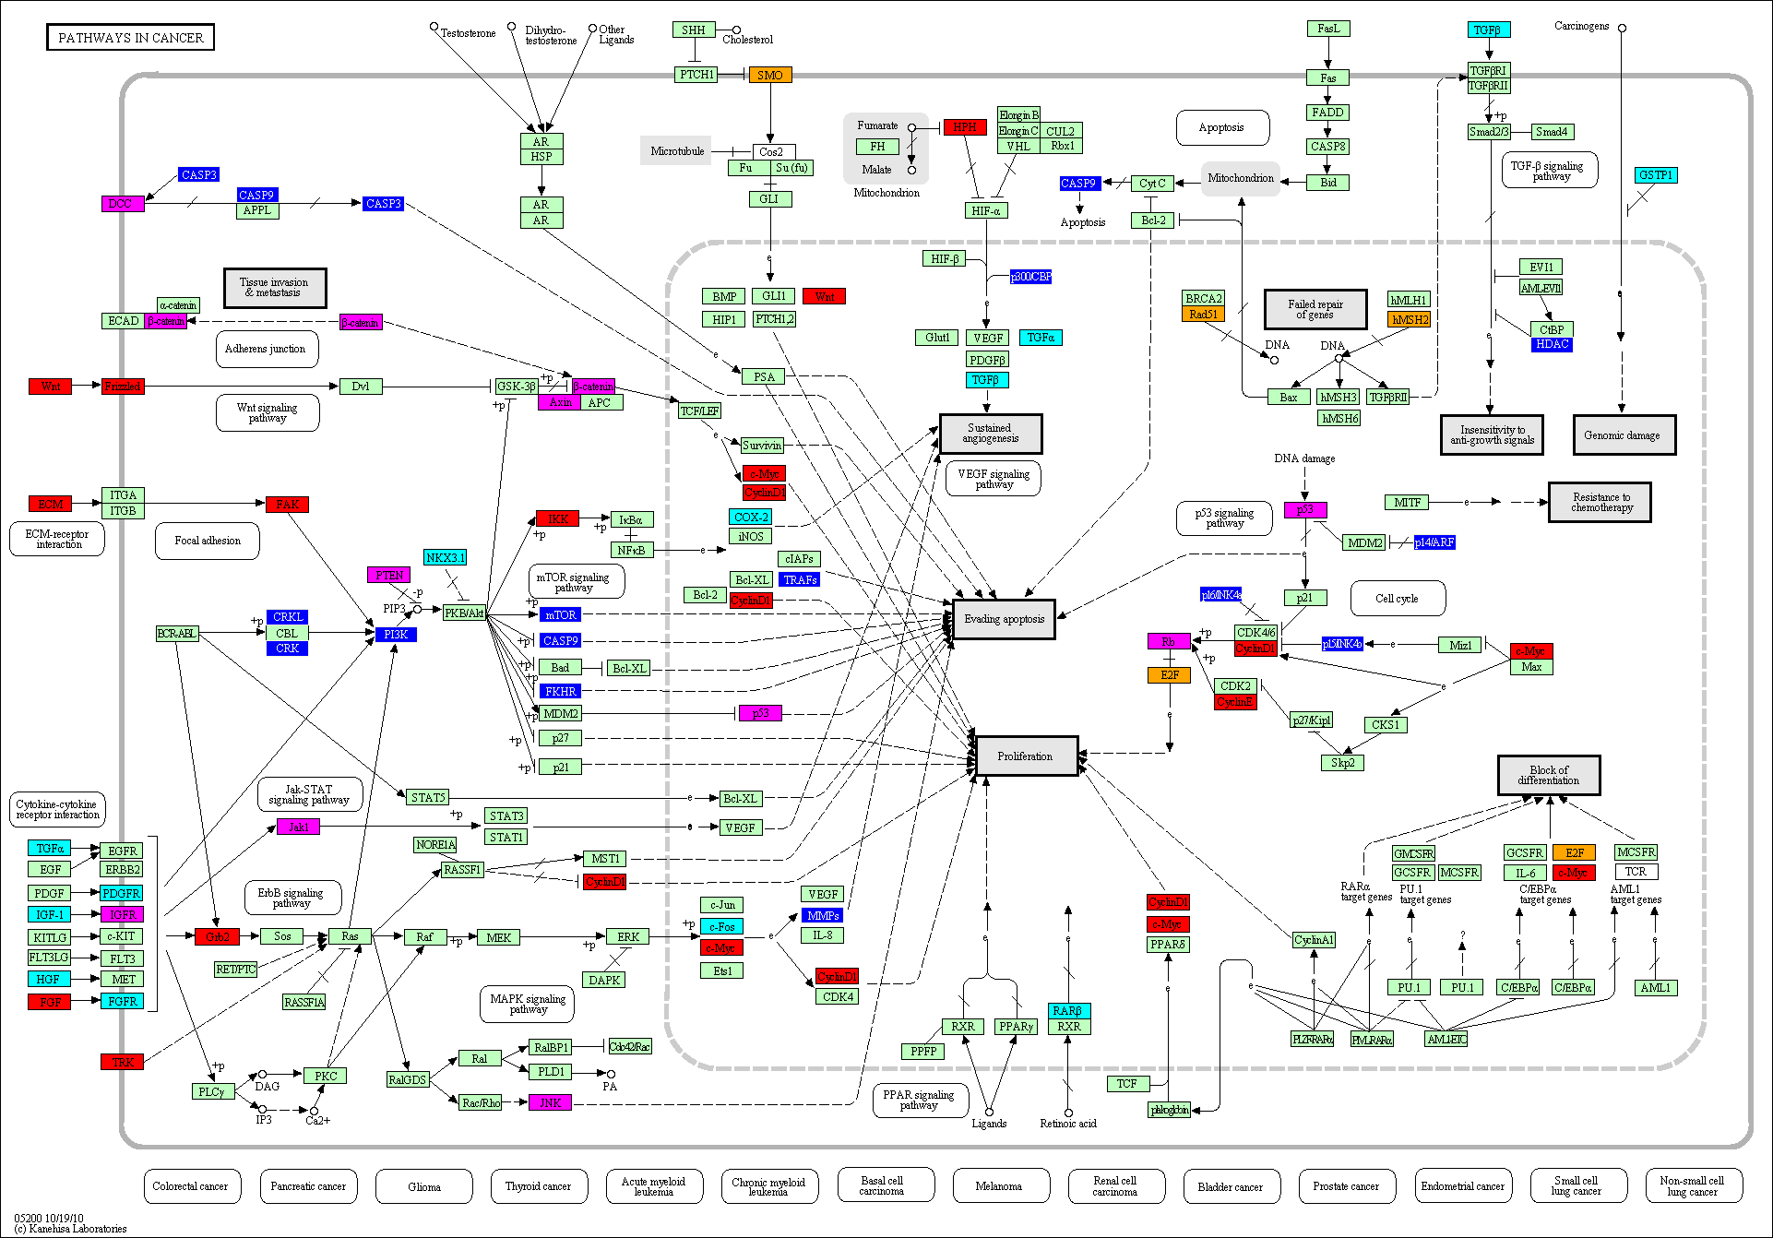
Supplementary Figure 7. Overview of cancer pathways impacted by genomic alterations
Mutation
Amplification
Deletion
Up Regulation
Down Regulation
No Change

Slide 8
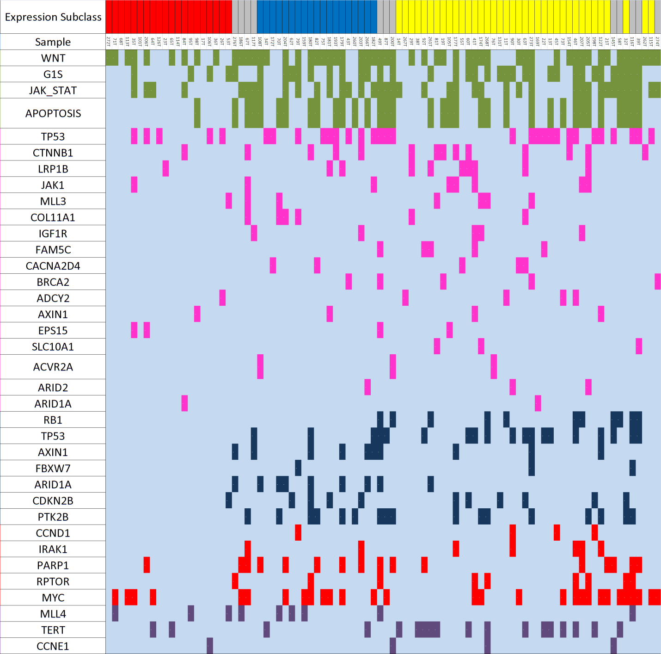
Supplementary Figure 8. Genomic alterations of key genes and pathways across three subclasses
S1
S2
S3
Alteration Status
Not altered
Pathway alteration
Mutation
Deletion
Amplification
HBV Integration

Slide 9
Supplementary Figure 9. Somatic SNV detection work flow
Performed on tumour and normal separately
QC sequence reads
Map to reference genome hg19 (SOAP2)
Collect read support info on all sites
Predict mutant alleles in tumors (SOAPsnv)
Tumor vs. Normal
mutant allele frequency
Fisher’s Exact test
p < 0.01
Y
Y
Read Support
Binomial test
p > 0.01
Y
Quality Score
Wilcoxon rank sum test p > 0.01
Read Depth ≥ 10
Y
Mutant allele enriched within 10 bps of read ends?
N
Mutant allele enriched in repeatedly aligned reads?
Y
Mutant allele frequency difference
≥ 20%
N
Predicted somatic mutation
Sequenom validation
497

