Slide 1
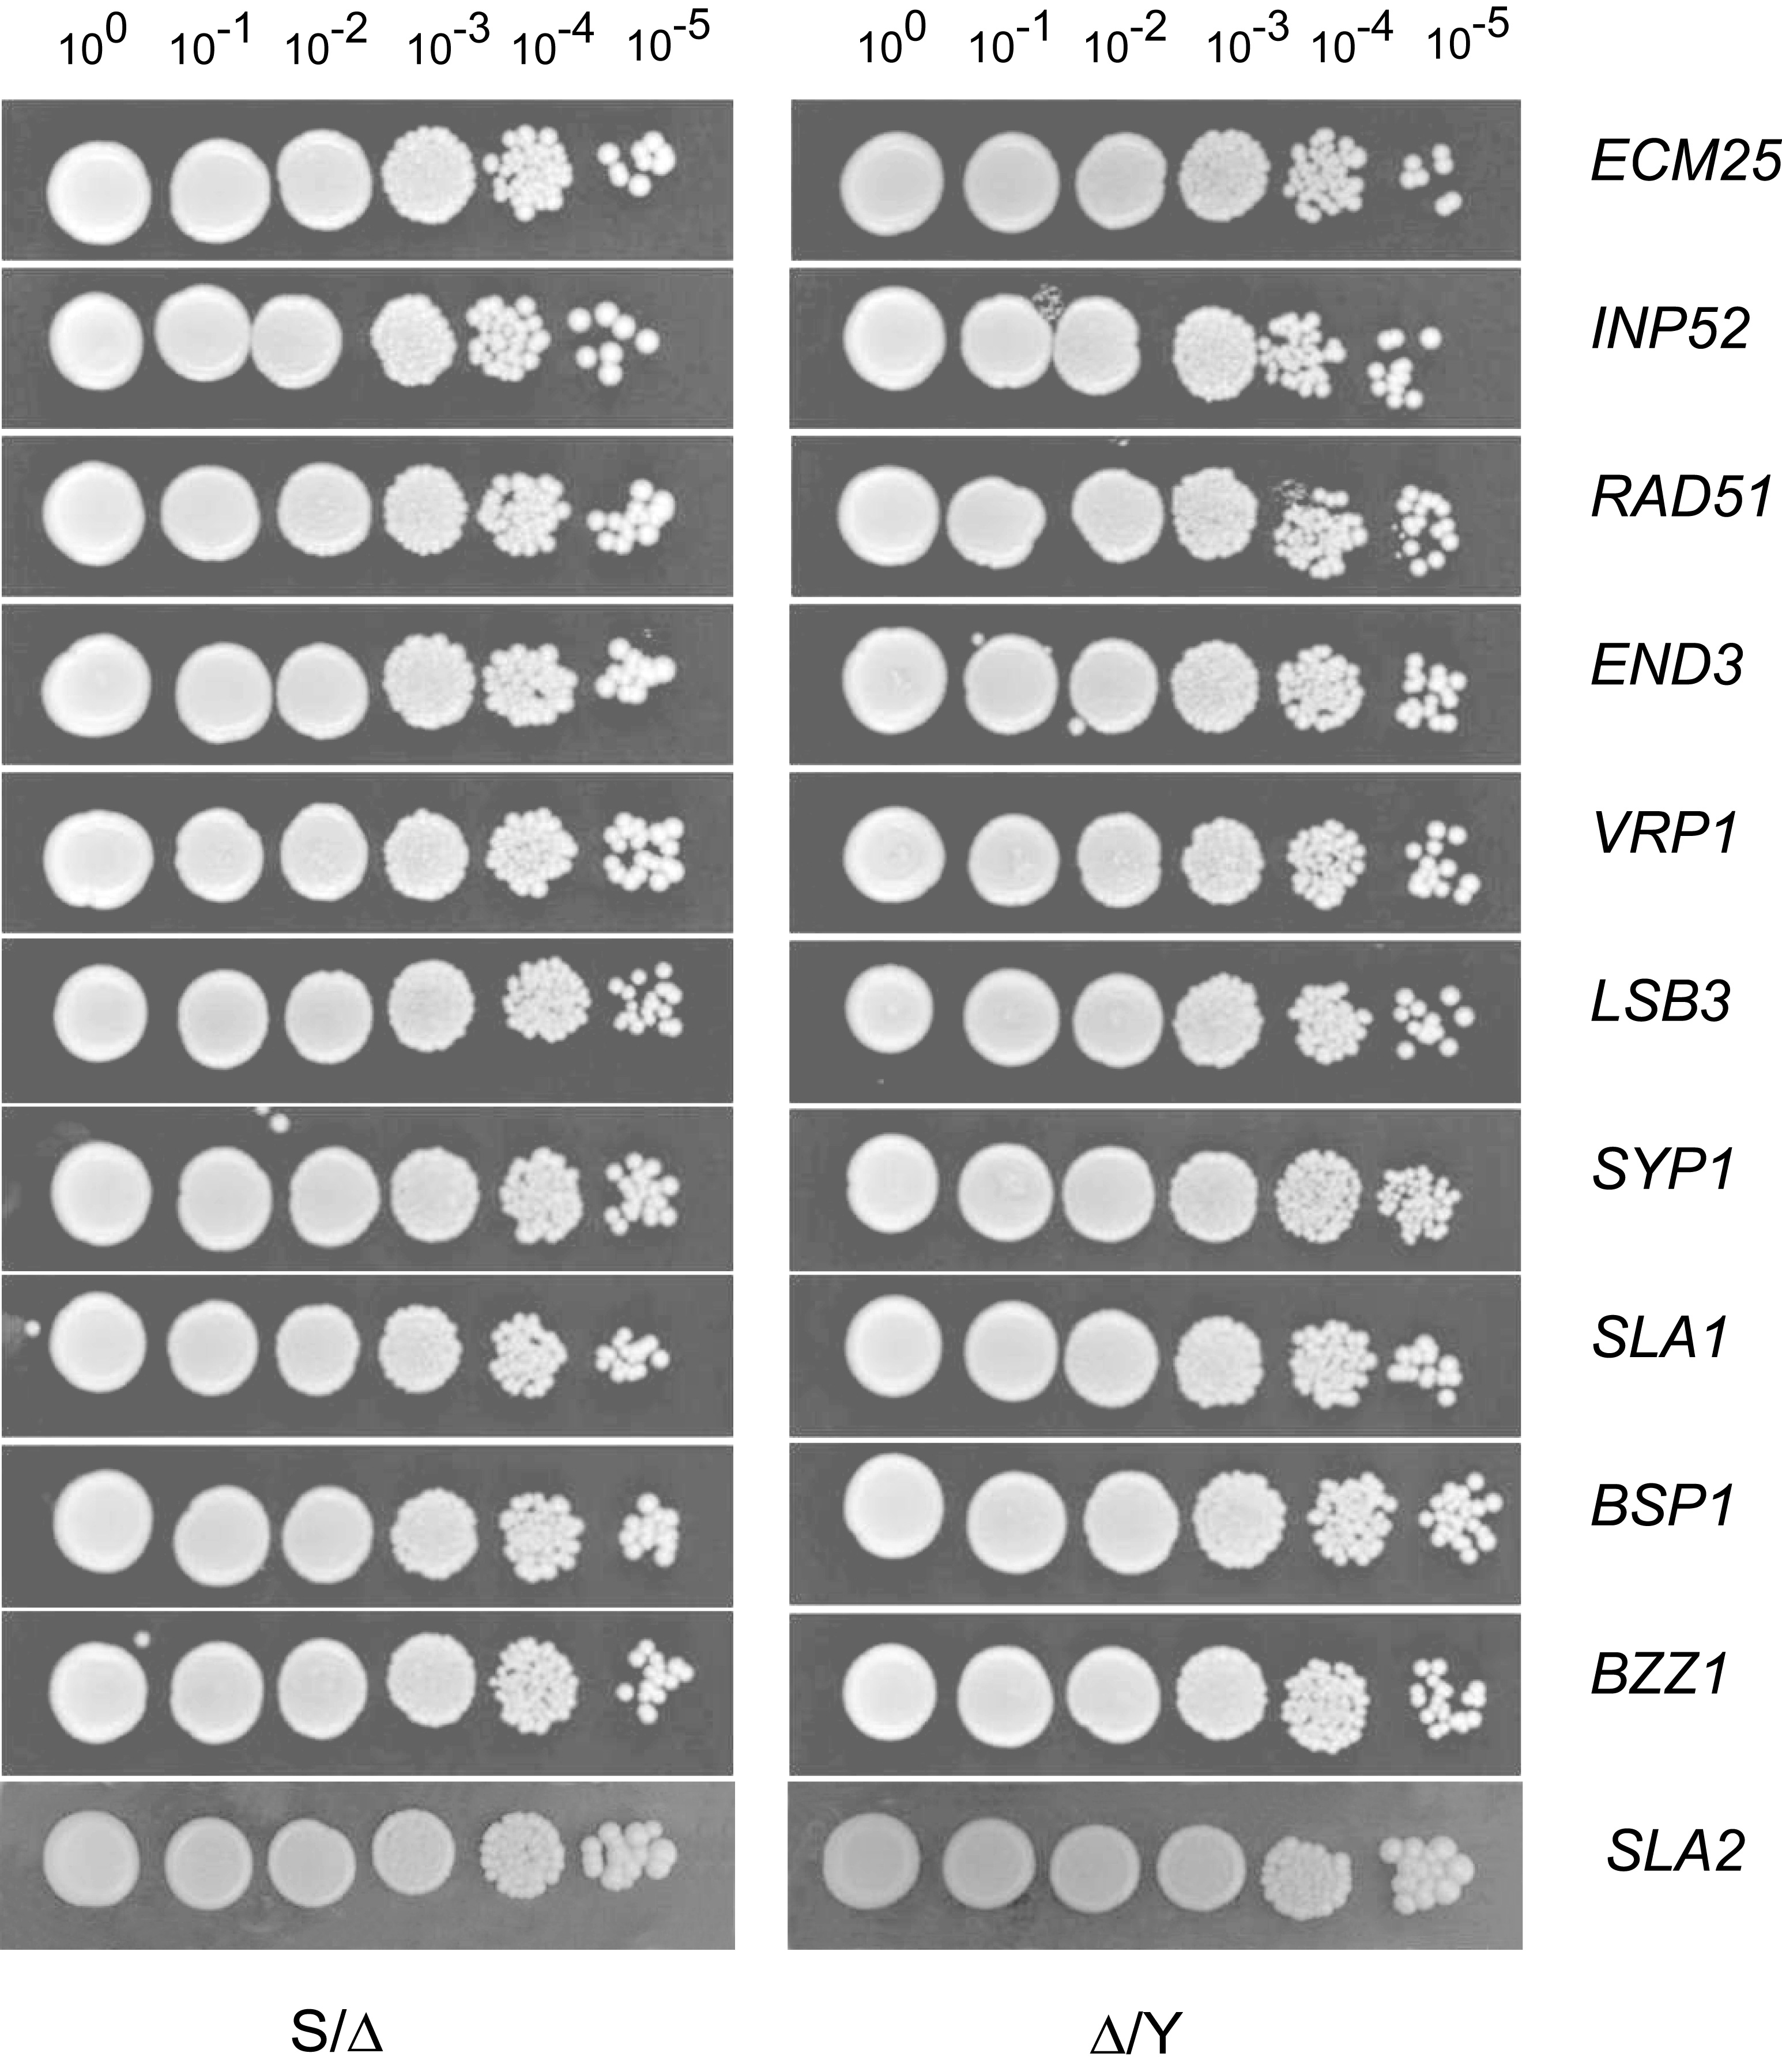

Slide 2
Maximal slope of growth curve at 30˚C in liquid YPD media

Slide 3

RH strain vs wt S/Y hybrid relative fitness at 37˚C in vitro

Slide 4
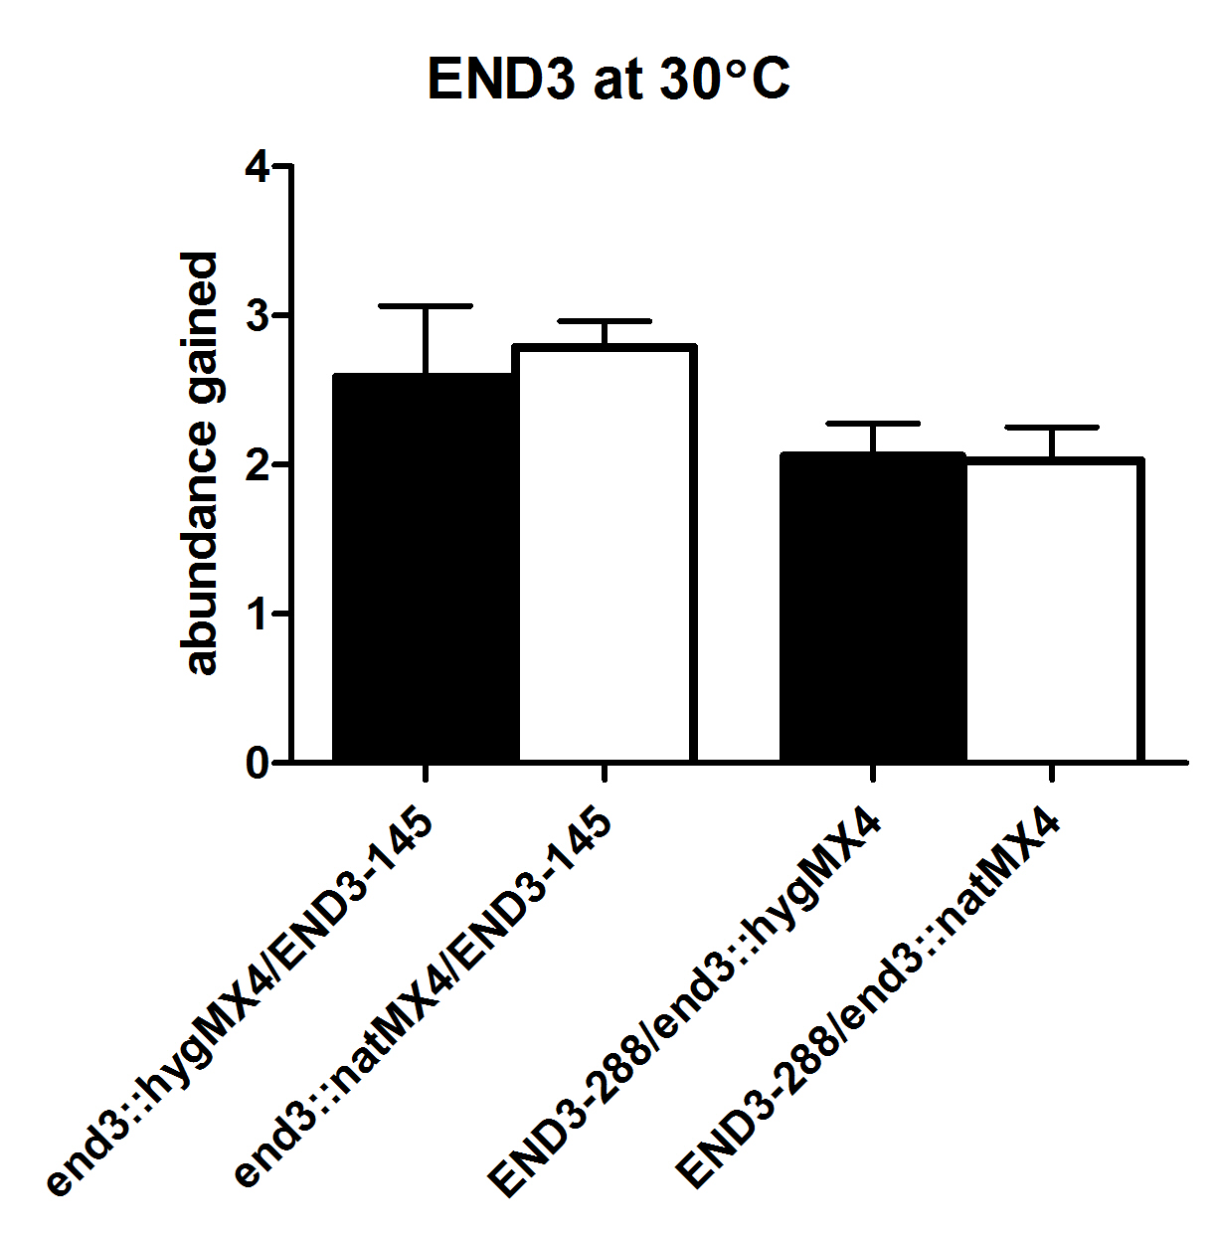
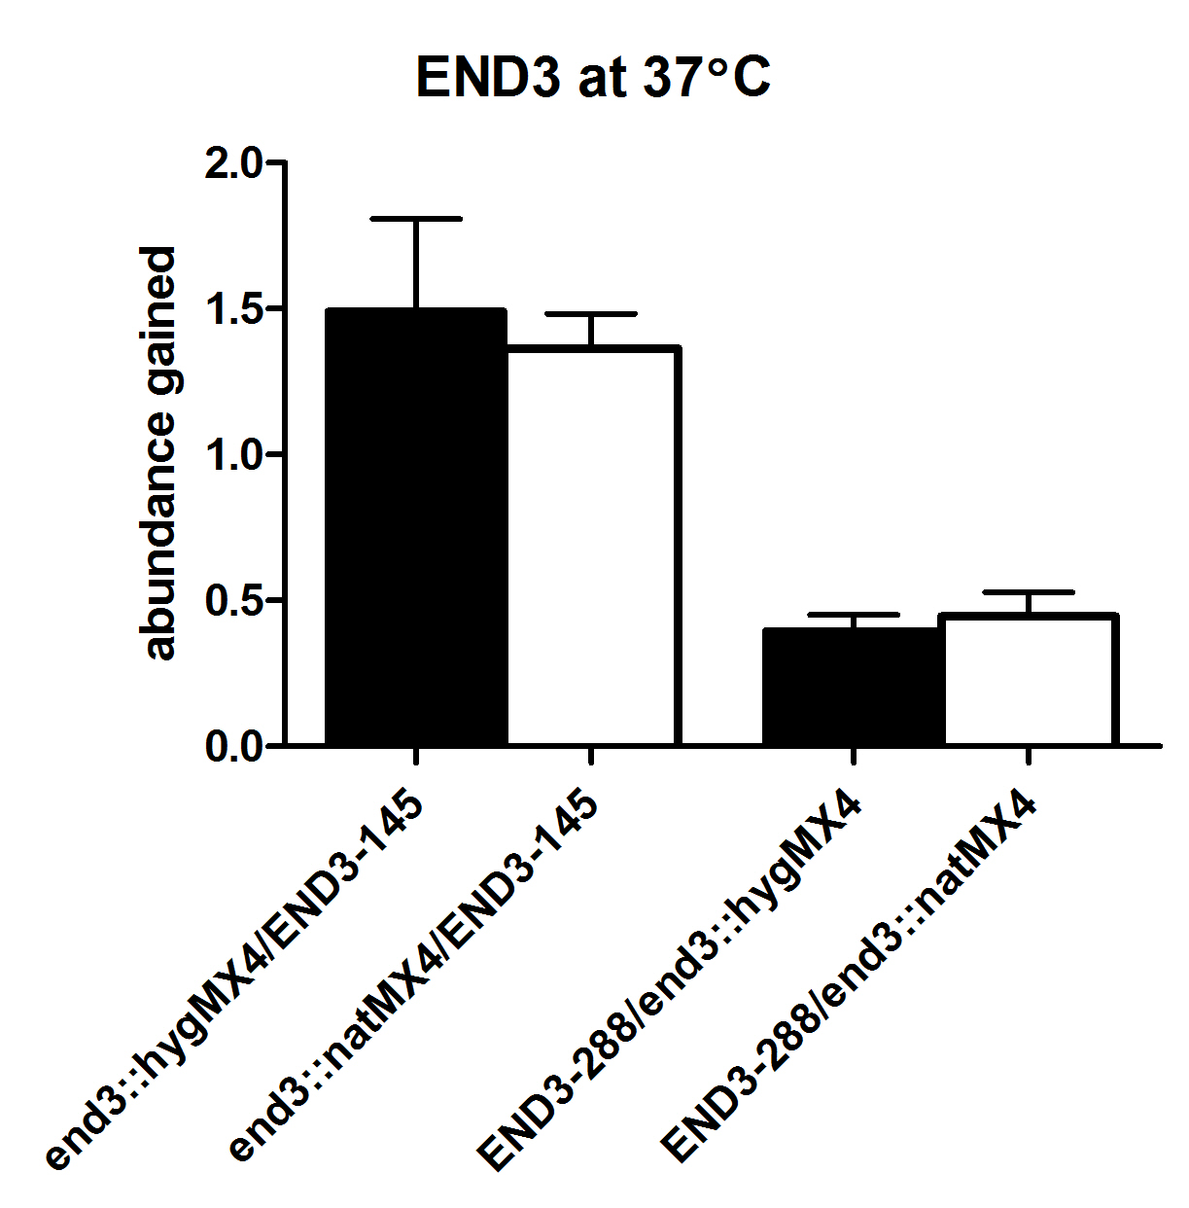
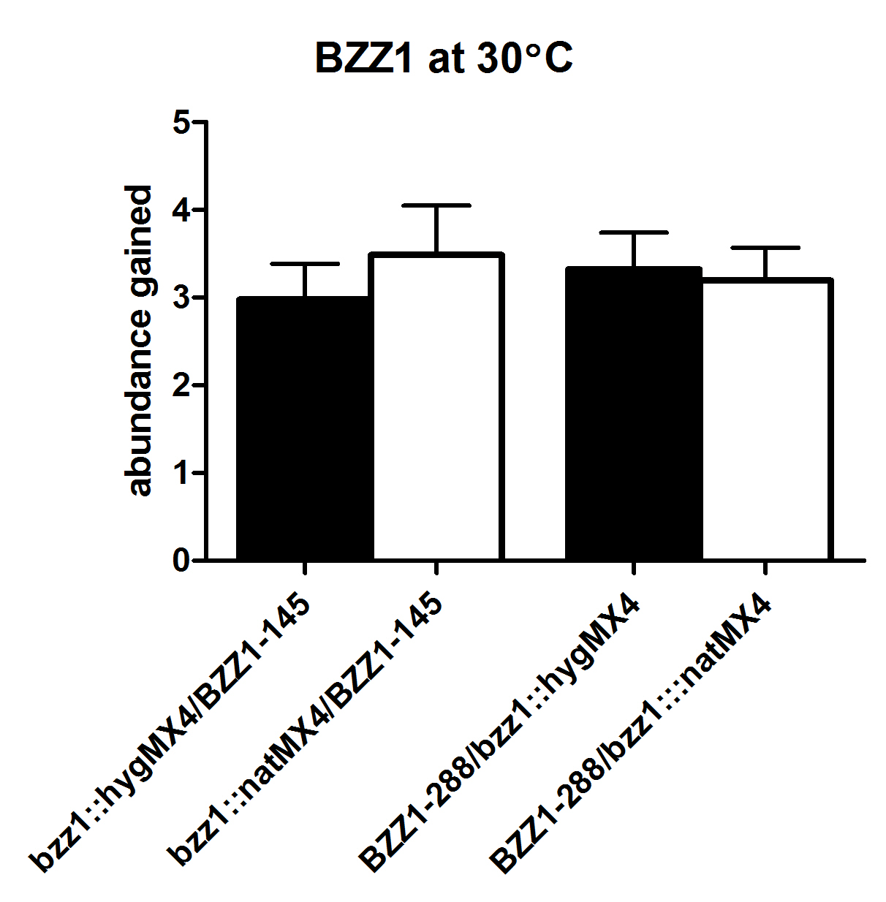
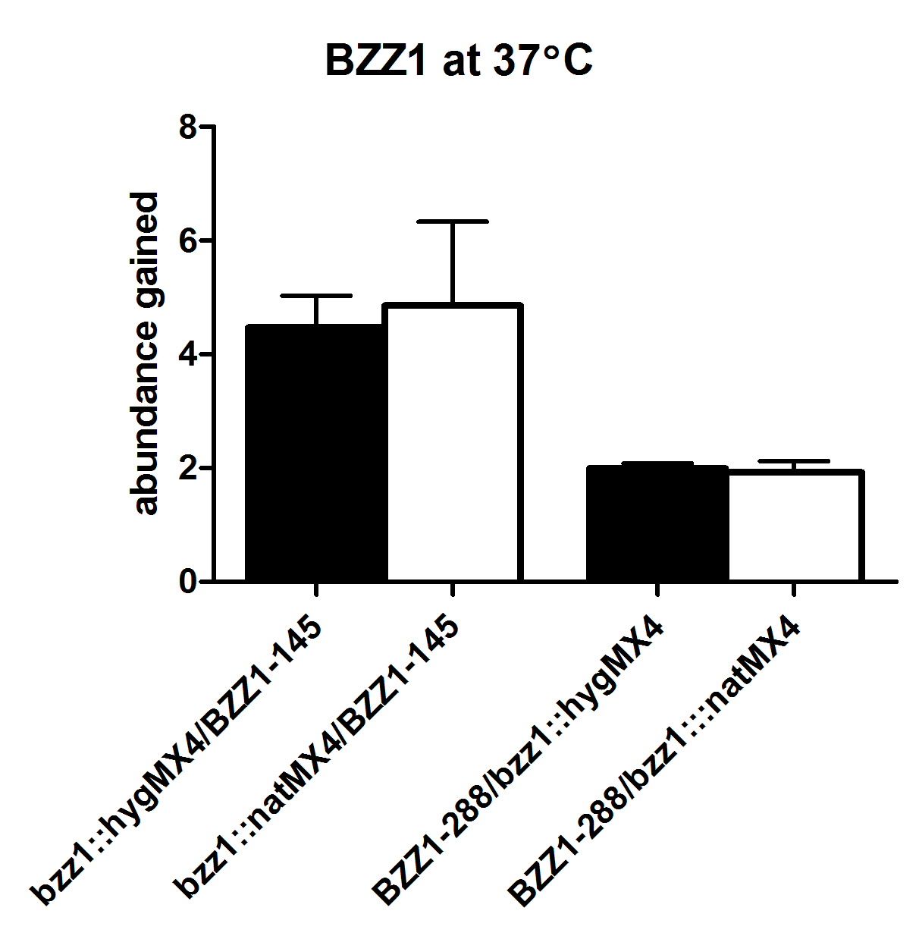

Slide 5
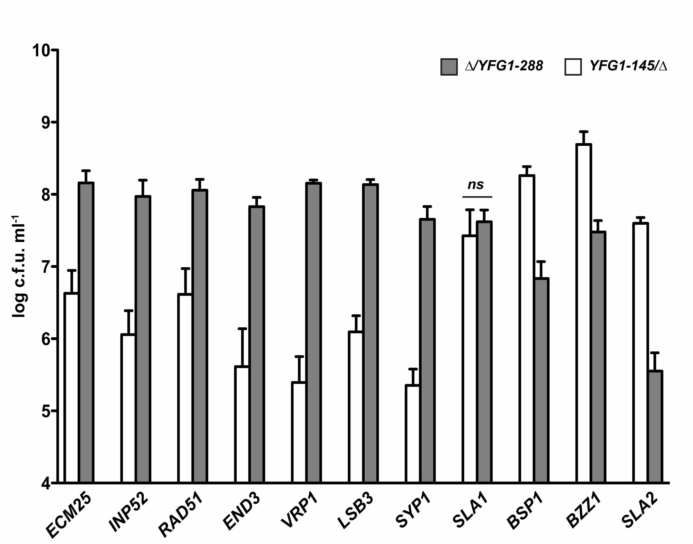

Slide 7
